Slide 1
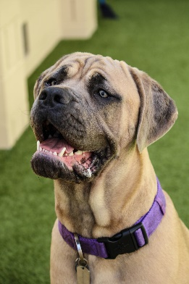
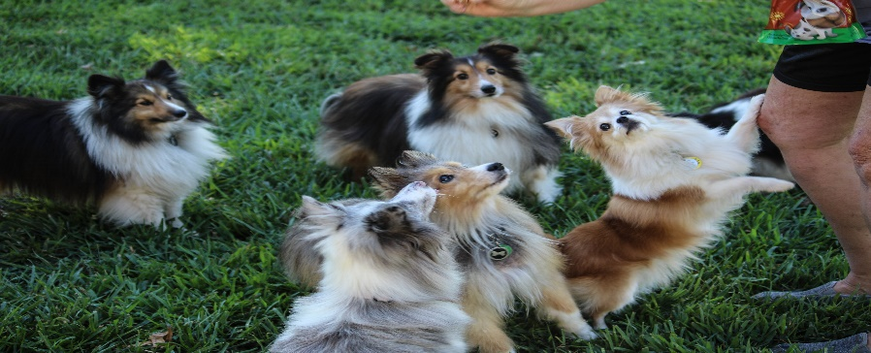
AFI
Update
September 04, 2024

Slide 2
License Year 2023 Inspection Stats October 1, 2023 – August 30, 2024
739 Total Inspections
415 Routine
104 Complaints
77
Pre-License Inspections
75
Re-Inspections Completed
38 Limited Scope Inspections
3 Requested Inspections
27 No Contacts

Slide 3
Facilities Licensed 2024 October 1, 2023 – August 30, 2024

Slide 4
Complaints October 1, 2023 – August 30, 2024
Type | Founded | TOTAL
Against Licensed Facilities | 16 | 64
Against Unlicensed Facilities | 14 | 77
TOTAL COMPLAINTS | 30 | 141

Slide 5
2024 Re-Inspection and No Contact fees October 1, 2023 – August 30, 2024

Slide 6
Closed Licenses
CATEGORY | 2023 License Year | 2024 License Year
Total # of Licenses | 931 | 811
Licenses Closed Out/ Placed Out of Business During the License Year | 130 | 64

Slide 7
AFI “Reason to Believe” Letters
From March 1, 2024 to August 30, 2024:
73 RTB letters sent out
9 pending response
7 pending licensure
10 have become licensed
32 did not require licensure
2 referred to Legal
4 also being handled by local jurisdiction
11 unable to locate correct address

Slide 8
Upcoming AFI Webinars
October 8th: Dr. Erin Petro, the State Public Health Veterinarian will speak on communicable diseases in pet animals of public health importance.
December 10th: The Butler County Animal Response Team will speak about their organization and the events/situations they respond to.

Slide 9
Upcoming AFI Regulation Update
Informal Public Comment Portal will remain open until end of day Monday, September 9th.
After the portal closes, KDA will spend time reviewing all comments and making decisions on any edits prior to starting the formal adoption process.
The formal adoption process takes a minimum of 1 year before any changes would go into effect.

Slide 10
Dr. Smith Animal Health Update

Slide 13
AFI Legal Update

Slide 14
Enforcement
June 1, 2024 to August 30, 2024 New Orders
AFI Orders issued
16 Civil Penalty Orders (CPO)
4 Consent Agreement and Final Order (CAFO) Breaches
1 Cease and Desist Order with Civil Penalties
1 License Suspension Order with Civil Penalties
4 License Revocation Orders with Civil Penalties
1 License Denial & License Revocation Order with Civil Penalties
1 License Denial with Civil Penalties and Cease and Desist Order
1 Legal Letter

Slide 15
Three District Court Cases & 3 OAH Proceedings
1 case in Johnson County District Court
2 cases in Shawnee County District Court
3 OAH proceedings

Slide 16
Updates by Dept Sec Olson and Asst Sec McGinn

