Slide 1
Direct-to-Consumer Exempt Food Sales
Adam Inman, Assistant Program Manager, Food Safety and Lodging

Slide 2
Today we’re going to talk about…
Why There are Food Safety Requirements
KDA – FSL’s Compliance Approach
Laws and Regulations
Exemptions
Food Safety for Exempt Operations
Licenses
Egg Sales
Pop Quizzes!
Fun Photos

Slide 3
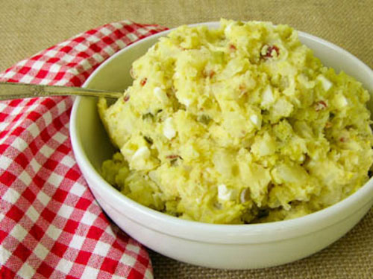
Pop Quiz
Q. What component/s of potato salad require refrigeration?
A. Potatoes, eggs.
Notes:
Commercially prepared mayo is acidic and inhibits bacterial growth and/or toxin formation. Many homemade mayos are also very acidic.

Slide 4

Why do we have food safety requirements?
2011 CDC Estimates
  48 Million FBI cases per year in the U.S.
  128,000 hospitalizations caused by FBI per year in the U.S.
  3,000 deaths caused by FBI per year in the U.S.
2012 Cost Estimate (Journal of Food Protection)
  $77 billion

Slide 5


The Real Impact of Foodborne Illness
Kyle 2003-2006
  Died from E. coli O157:H7 at age 2 and a 1/2
  Spinach
Shirley 1936-2008
  Died from Salmonella at age 73
  Peanut butter
Michael 2004
  Died from Listeria monocytogenes
  Infected through the placenta
  Emergency C-section at 30 weeks
  Lettuce
Source: Stopfoodborneillness.org

Slide 6
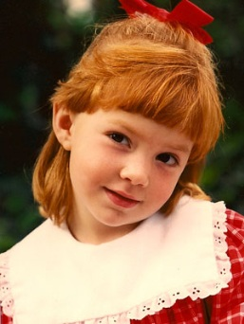
The Real Impact of Foodborne Illness
  “Lauren Beth, age six years, ten months and ten days, died in my arms while on a life support system at San Diego's, highly respected, Children's Hospital, three days after Christmas on December 28th, 1992. Although at the time we did not know Lauren's true killer, we would soon come to the brutal reality of E. coli O157:H7.
  For those of you not familiar with the carnage that E. coli O157:H7 can provide. It is an experience that none of us are prepared to endure, much less observe! Her struggle was valiant, but brutal. After excruciating pain, all of her main organs falling victim to this deadly toxin that is E. coli O157:H7. Three heart attacks, the first of which I was left helpless to witness. Her brain waves were no longer active. Her body was tormented and beaten. Her kidneys, liver and heart were ravaged. Lauren fell into a coma and was taken from my arms forever.”
  – Roni (Lauren’s Mother)
Source: Stopfoodborneillness.org
Notes:
Jack in the Box Outbreak. “Poisoned” book. This is not even the most graphic description of the ordeals of some of the victims of the outbreak.

Slide 7
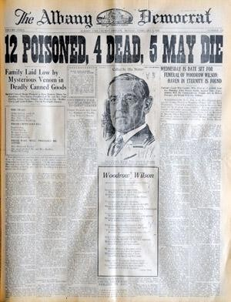
Emelia and Reinhold Gerber
Albany, Oregon 1924
Home Processed String Beans
All 12 individuals died within days of one another
Story was bigger than the death of President Wilson

Slide 8
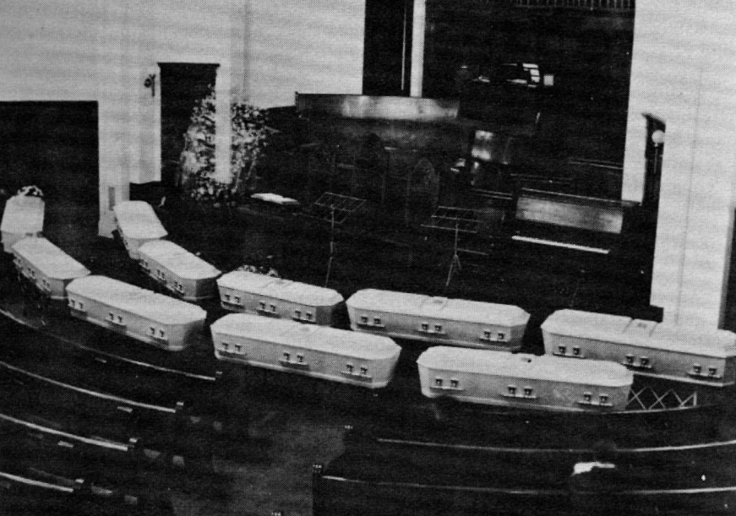

Slide 9

Edward and Delphine Hein
Grafton ND 1931
Dinner party – served a salad topped with home processed peas
13 deaths from botulism
  5 family members
3 small children were too young to attend the party and are the only family survivors

Slide 10
Why do we have food safety requirements?
  That’s why!

Slide 11
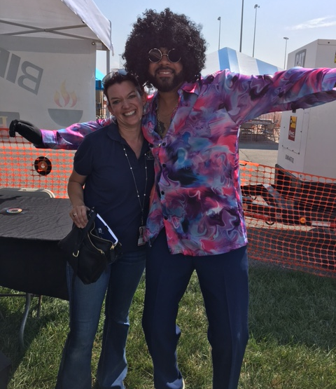
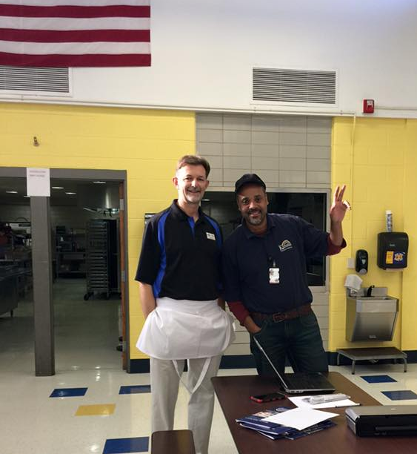
Compliance Approach
Educate, Warn, Enforce
Evaluate systems
Encourage dialogue before, during, and after inspection

Slide 12


Laws and Regulations
All of the laws and regulations can be found on the Kansas Department of Agriculture website
  agriculture.ks.gov
    Public Information
      Statutes, Regulations and Guidance Documents
        Food Safety and Lodging

Slide 13
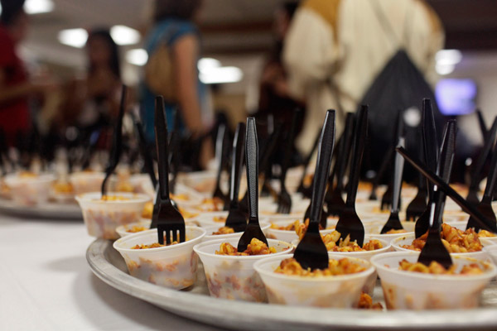
Sampling Exemption
K.S.A. 65-689(d)(13) – No license for “A person who provides food samples, without charge, to promote, advertise or compliment the sale of food or associated equipment.”
K.S.A 65-656(cc) – ‘“Sample” means a small quantity of food and does not include a meal or entrée.’
Key Points:
  Can’t charge for the sample
  Must be a small amount of food
  Must follow K.A.R. 4-28-33 sanitation/hygiene regulations
Notes:
No limit on the number of days.

Slide 14

Six-day Exemption
K.S.A. 65-689(d)(6) – No license for “A person operating a food establishment for less than seven days in any calendar year”
Key Points:
  Must be 6 or fewer days in a year
  “Person” includes partnerships
  Must follow K.A.R. 4-28-33 sanitation/hygiene regulations
  No wholesale/further distribution-only to the end consumer

Slide 15

Fundraising Exemption
K.S.A. 65-689(d)(7) – No license for “A person who prepares, serves, or sells food for the sole purpose of soliciting funds to be used for community or humanitarian purposes or educational or youth activities.”
Key Points:
  No limit on days
  K.A.R. 4-28-34 defines terms and prohibits using funds to compensate food workers
  Must follow K.A.R. 4-28-33 sanitation/hygiene regulations

Slide 16
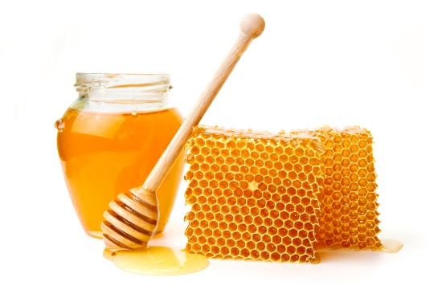
Honey Exemption
KSA 65-656(w) ‘‘Food processing plant’’ does not include any operation or individual beekeeper that produces and distributes honey to other business entities if the producer does not process the honey beyond extraction from the comb.
KSA 65-689(d)(4) No license for “A person who produces food for distribution directly to the end consumer, if such food does not require time and temperature control for safety or specialized processing, as determined by the secretary.”

Slide 17
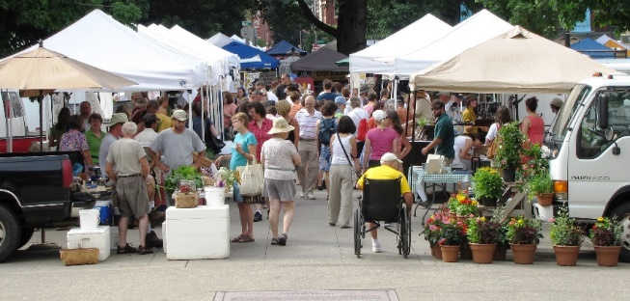
Direct-to-Consumer (D2C)Exemption
K.S.A. 65-689(d)(6) – No license for “A person who produces food for distribution directly to the end consumer, if such food does not require time and temperature control for safety or specialized processing, as determined by the secretary.”
Key Points:
  No specialized processing
  Must follow K.A.R. 4-28-33 sanitation/hygiene regulations
  No wholesale/further distribution-only to the end consumer

Slide 18

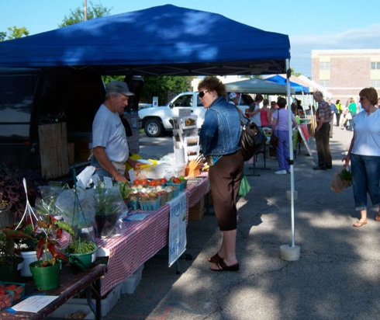
D2C Food Sales
What types of foods can be prepared in a home kitchen and then sold without a license?
  Foods that do not require temperature control for safety (non-PHF/TCS) or specialized processing
    Baked goods*, candy, jelly*, etc.
      *not all are exempt
    Fresh, uncut produce
    Others-may have to ask
  Sold only to the end consumer
Notes:
Cheese breads, vegetable breads are not exempt
Jams and jellies must meet standard of identity in 21 CFR 150-doesn’t include low acid components like peppers

Slide 19
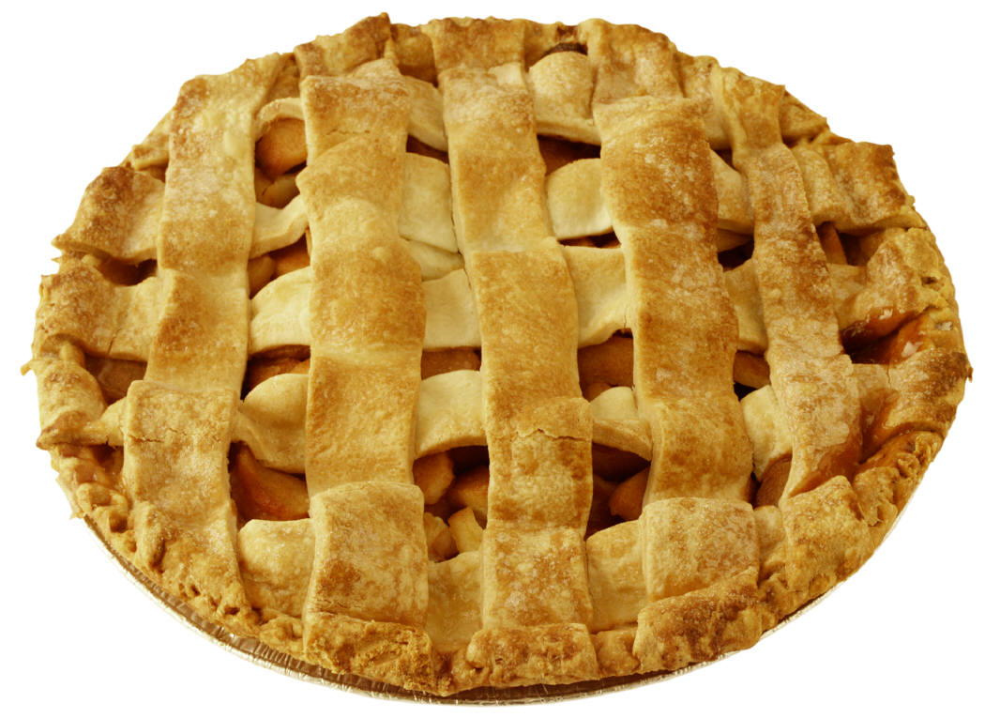



Slide 20
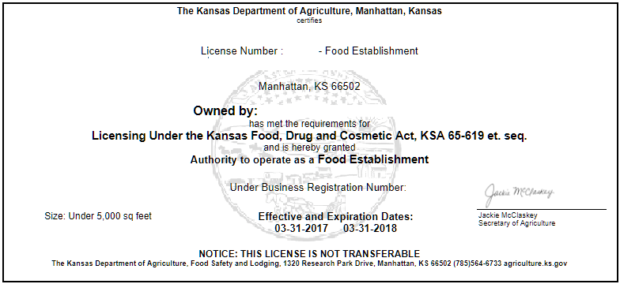
D2C Food Sales
What types of foods cannot be prepared in a home kitchen and then sold without a license?
  Foods that require temperature control for safety (PHF/TCS) or specialized processing
    Cream pies, cheesecakes, salsas, BBQ sauce, cut produce, meats, sprouts, pickles, canned vegetables, etc.
  Cannot be sold to end consumer or to another person for resale

Slide 21
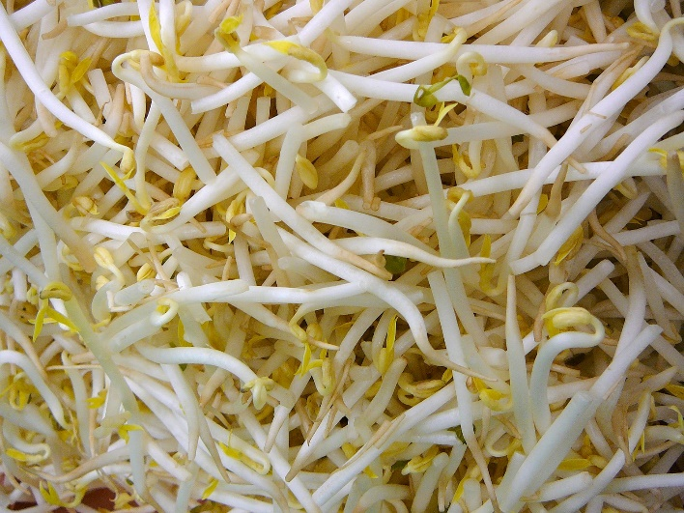
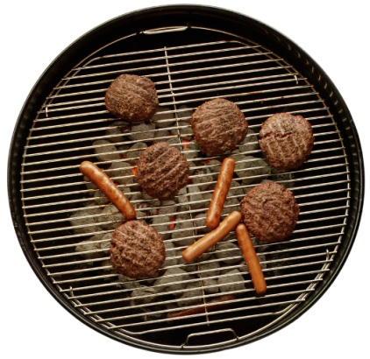
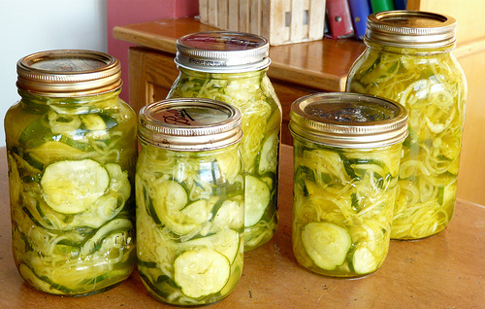
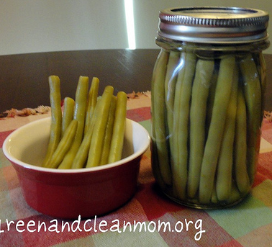
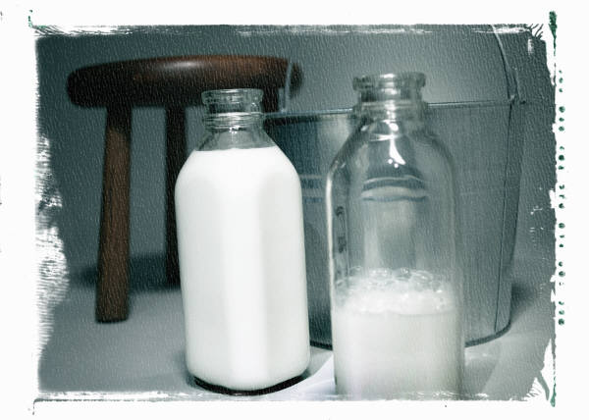
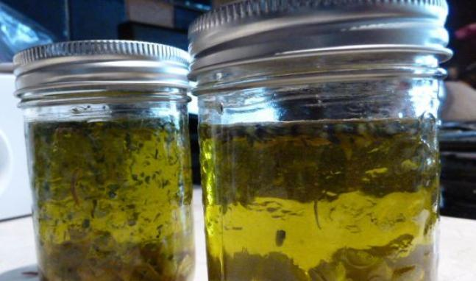
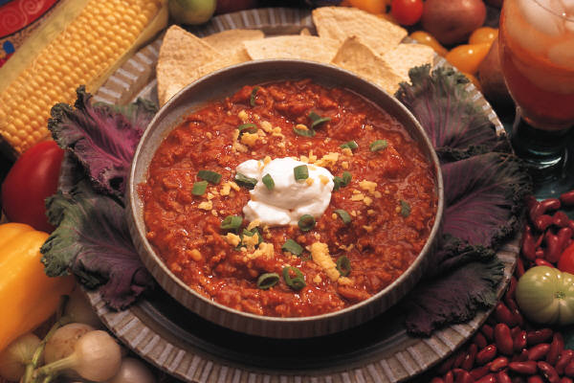

Notes:
Includes Cut leafy greens, Fresh meat or poultry, canned goods (except jams and jellies), etc.

Slide 22

Product Evaluation
Process Authority can determine if product/formulation is:
  Low Water Activity Food (D2C exempt)
  Naturally High Acid Food (D2C exempt)
  Formulated Acid Food (D2C exempt)
  Acidified Food (License required)
  Low-Acid Food (License required)
One Example is the K-State Value Added Foods Lab
Notes:
$15 pH determination including whether Acidifed Food or not @ K-State VAFL

Slide 23
When is a license required?
When the product requires temperature control for safety (PHF/TCS) or specialized processing
When the product is being wholesaled (further distribution)
When the product is being sold to a licensed food establishment
  Grocery
  Convenience
  Specialty Store
  Bakery

Slide 24

D2C Exempt or Not???
Frozen pie crusts
  Exempt
Dried pasta
  Exempt
Kombucha
  License
Tea mixes
  Exempt
Cookie mix kits (Dry)
  Exempt
Mustard
  Product assessment
Infused vinegar
  Exempt
Infused oils
  License

Slide 25

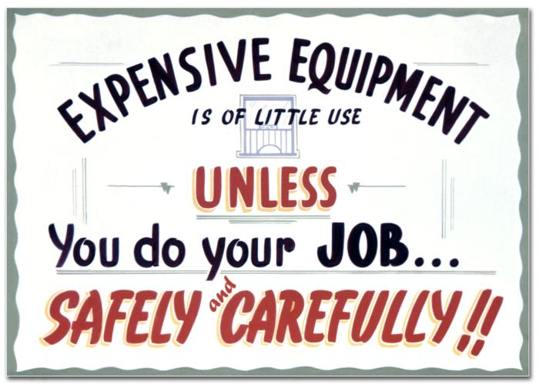
The Fine Print
Even though you may not be required to be licensed, you still need to follow the safety requirements of the Kansas Food Laws.

Slide 26

Exempt food requirements
Critical Food Temperatures
  Food Code
Hygiene
  KAR 4-28-33
Sanitation
  KAR 4-28-33

Slide 27
Critical Temperatures
165°F - Poultry, stuffed meats and pasta, reheating
155°F - Ground beef or pork (tenderized or injected meats)
145°F - Whole muscle meat (beef, pork) or fish
135°F - MINIMUM HOT HOLDING
130°F - Rare roast beef
DANGER ZONE!
41°F - MAXIMUM COLD HOLDING
32°F - Freezing
0°F - Frozen Food Storage
Notes:
What’s a degree among friends? (+/- 2 degrees accuracy)

Slide 28

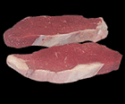

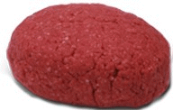
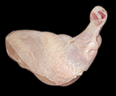
Safe Cooking Temperatures
145°F - Intact Fish, Beef, Pork and Eggs
155°F - Non-intact Fish, Beef, Pork, Pooled Eggs
165°F - Poultry
Notes:
To Summarize, people can die when food is not properly cooked. The only way to know is to check with an accurate thermometer.

Slide 29


KAR 4-28-33 Requirements
What is the goal?
To keep food safe and extra stuff out

Slide 30
KAR 4-28-33 Requirements
No Bare-Hand-Contact (BHC) with Ready-to-Eat (RTE) foods
  Gloves, tongs, deli tissue, toothpicks
No sick employees
  Vomiting, diarrhea, jaundice, sore throat w/ fever, uncovered cuts/wounds, Norovirus, hepatitis A, Shigella, E. coli, Salmonella typhi
Proper handwashing
  100°F water
  Soap
  Paper towels
  “Hands-free” spigot
Sing your ABC’s twice!

Slide 31
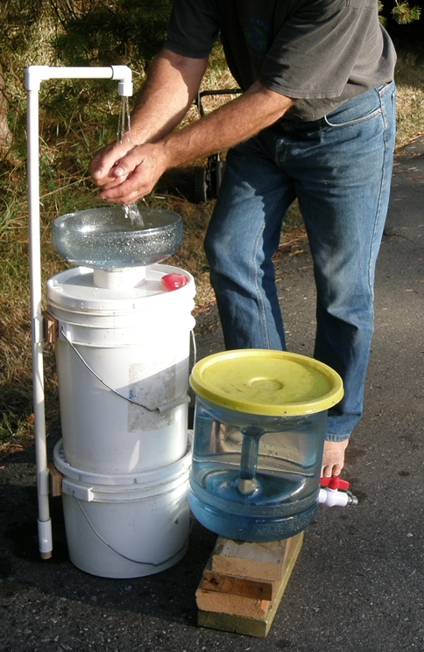
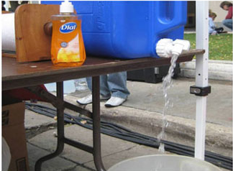
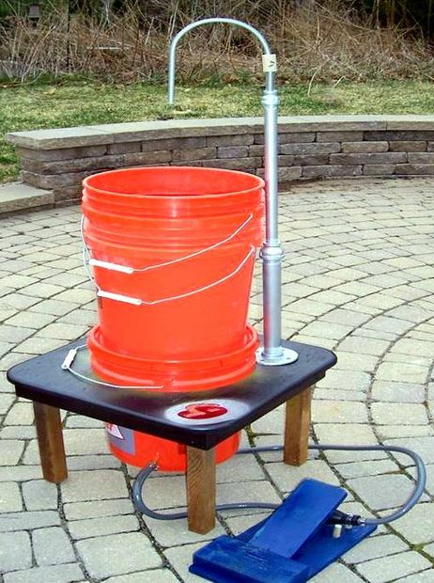
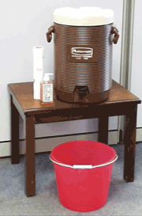
Temporary Handwashing
Notes:
Think about how to keep the water warm and balance that with the ease of construction.

Slide 32
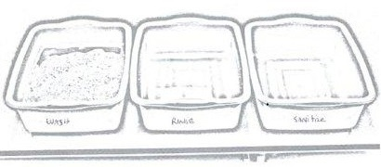
KAR 4-28-33 Requirements
Clean and sanitize
Three-compartment sink or Three Food-grade tubs
  Wash
    110°F water and dish detergent
  Rinse
    110°F clean water
  Sanitize
    50-200 parts per million chlorine
      Generally one ounce (two tablespoons) of bleach in three gallons of water
Notes:
Don’t forget to air dry!

Slide 33
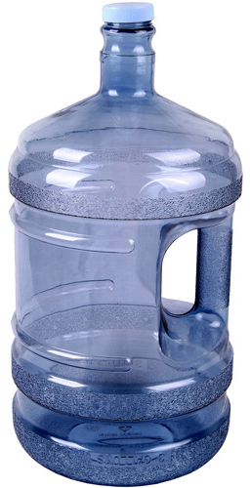
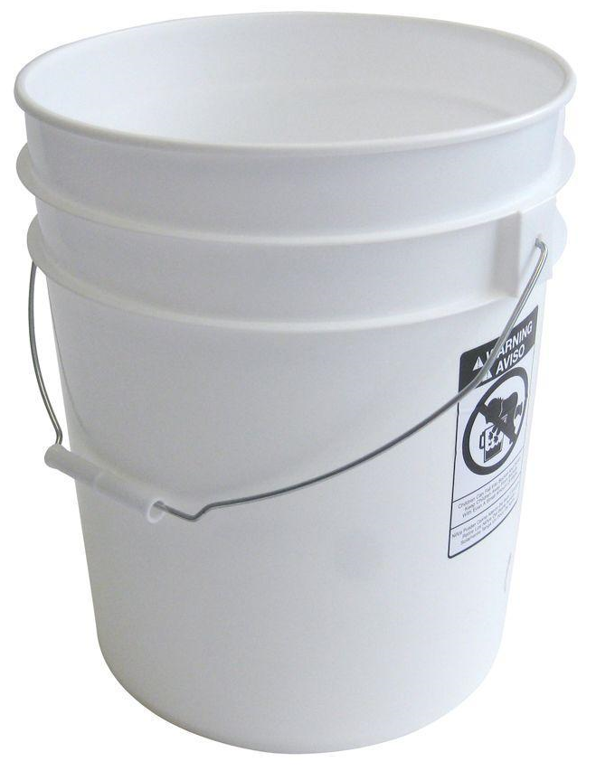
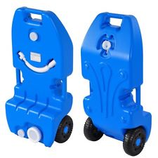
KAR 4-28-33 Requirements
Potable (drinking) water
Waste water into the sanitary sewer (not the storm sewer or onto the ground)
WASTE
DO NOT
DRINK

Slide 34
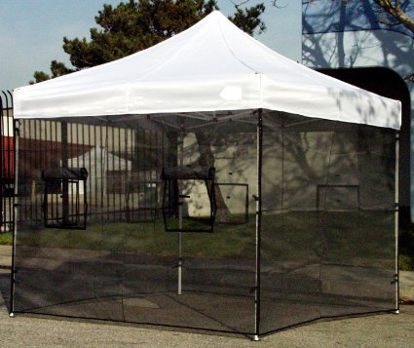
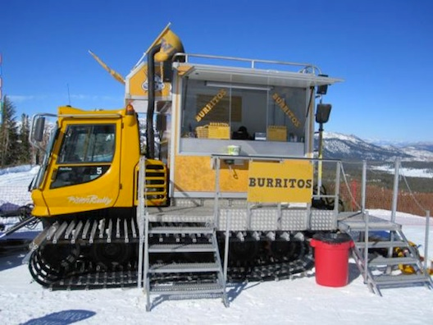
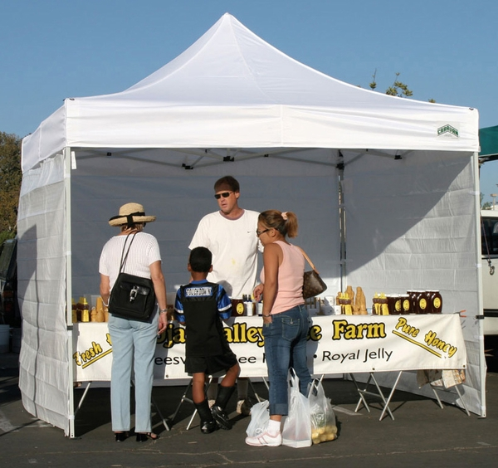
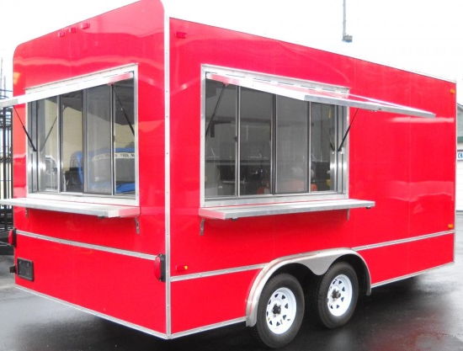
KAR 4-28-33 Requirements
Protect food from the elements
No animals in the area
Enclosure suited to conditions
  Rain
    Overhead, floor
  Flies, mice, etc.
    Full screen enclosure or cease operations
  Blowing dust
    Full walled enclosure or cease operations

Slide 35
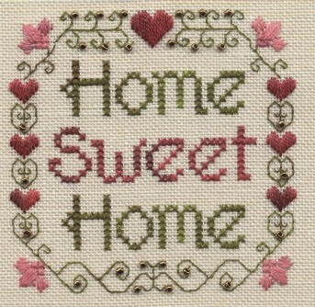
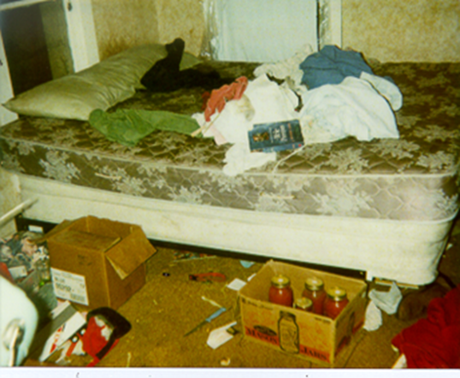
How can I become licensed at my home?
Separate kitchen
Proper equipment for processes being used
Proper storage areas
Proper labeling for packaged products

Slide 36
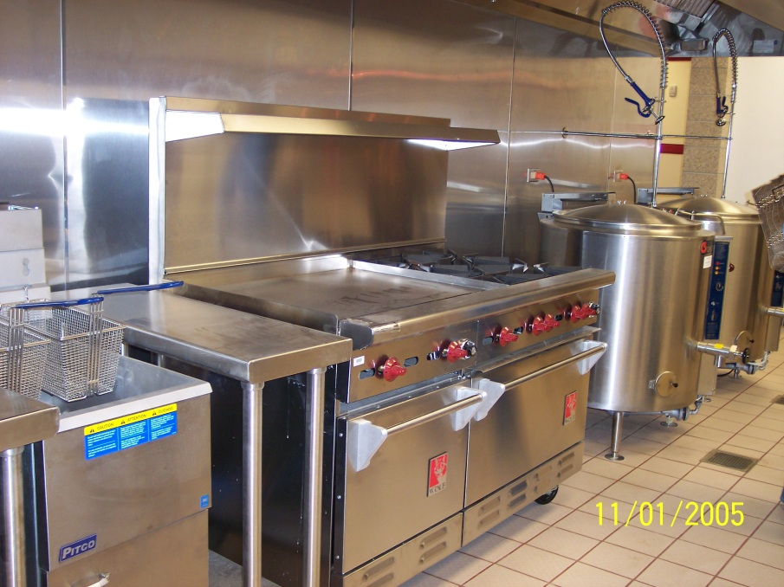
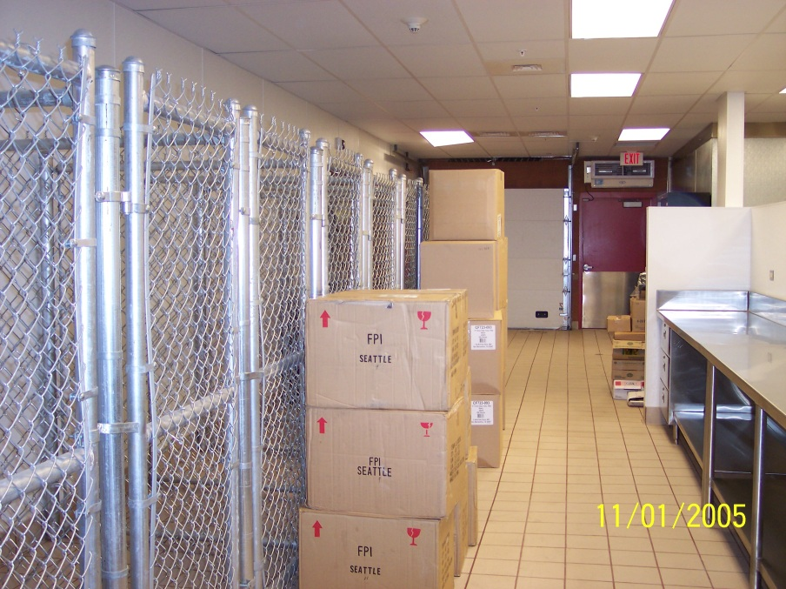
Incubator Kitchens
Each operator who is required to be licensed must be licensed to operate at that location

Slide 37
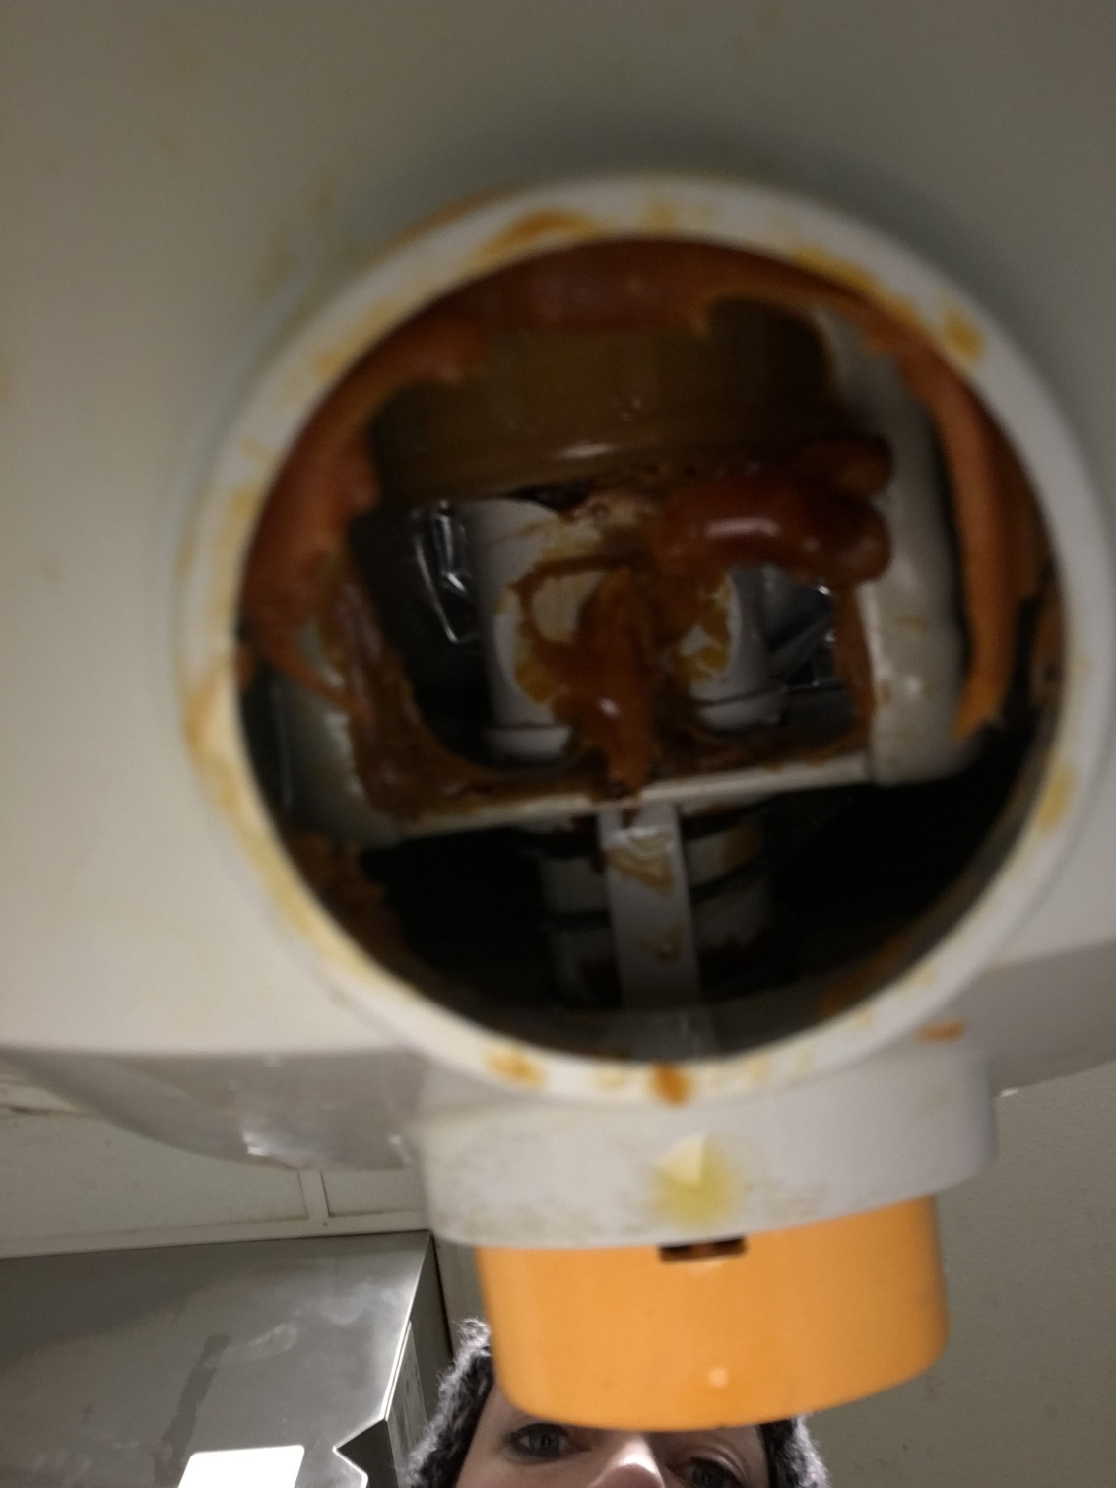
Fun Photos!
Notes:
Nacho cheese dispenser

Slide 38
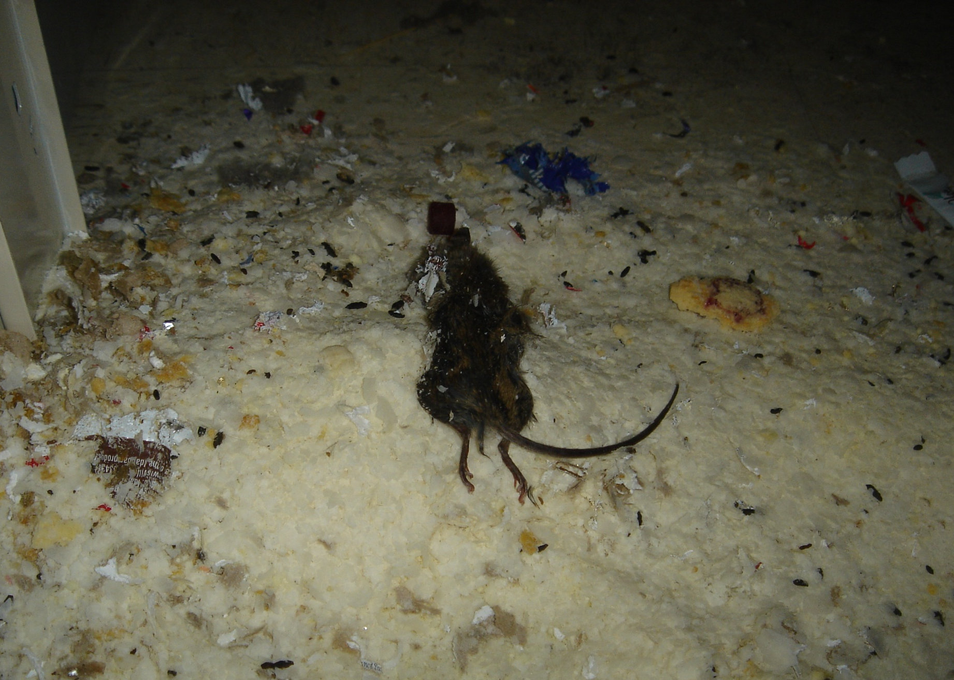
Store Shelf
Notes:
Rodent droppings on a retail shelf. It happens more than you think. Some people think you “fix” the problem by putting new product in front of the old.

Slide 39
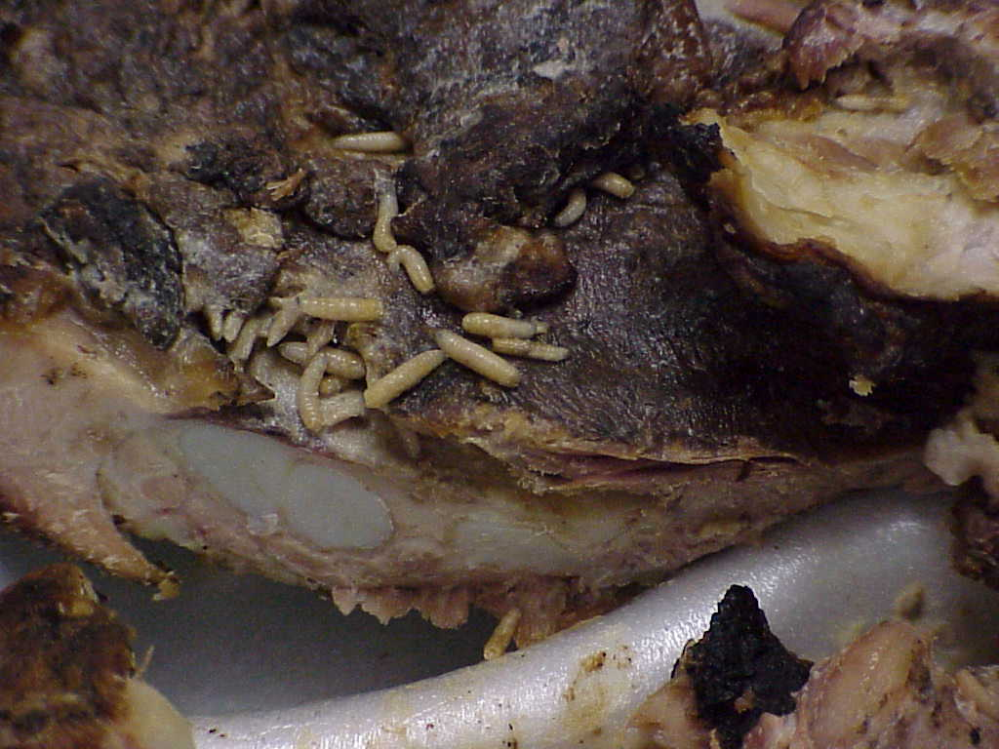
Extra Protein
Notes:
Maggots on ribs at an unlicensed mobile unit.

Slide 40
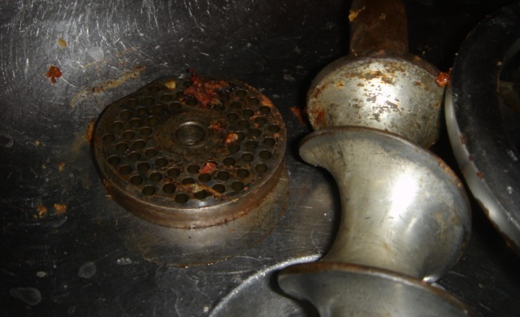
Clean?
Notes:
“Clean” meat grinder

Slide 41
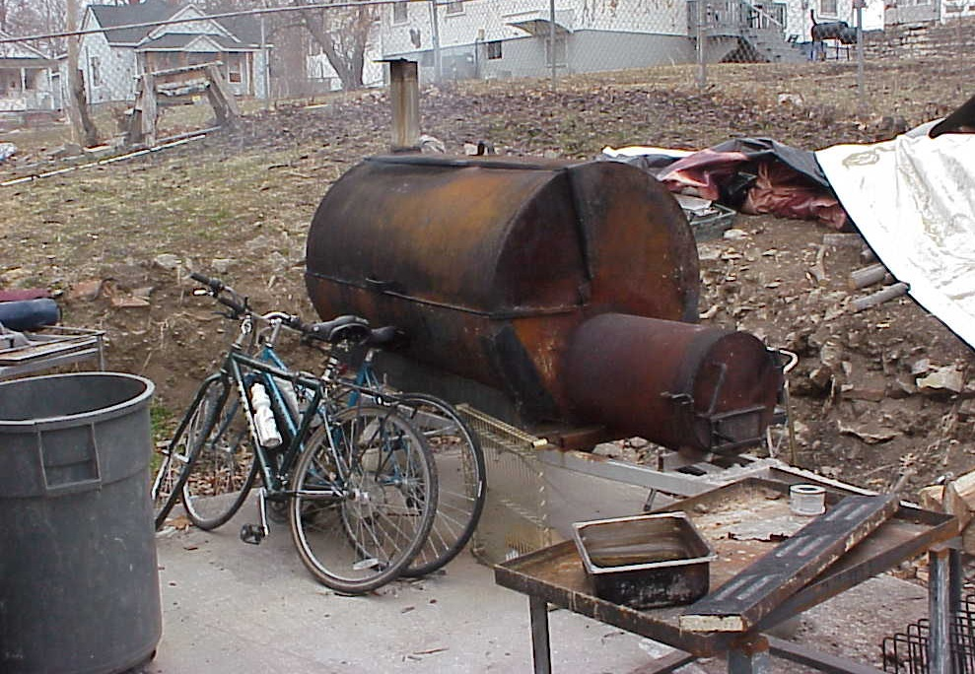
Delivery
Notes:
Outdoor cooker at a restaurant, and delivery vehicles

Slide 42
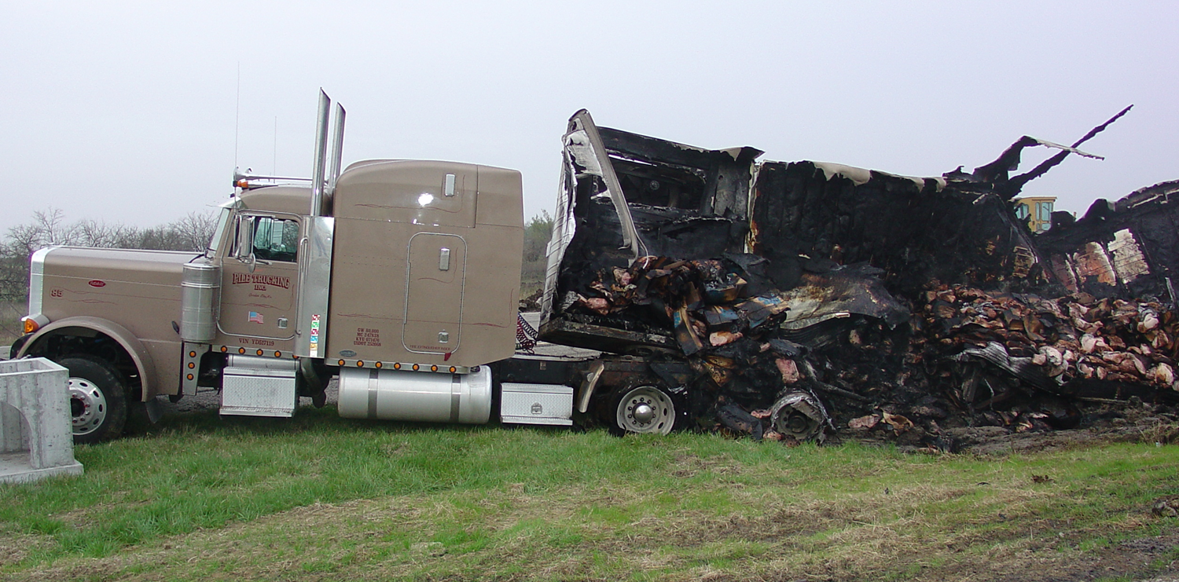
Roadside BBQ
Notes:
BBQ on the interstate

Slide 43
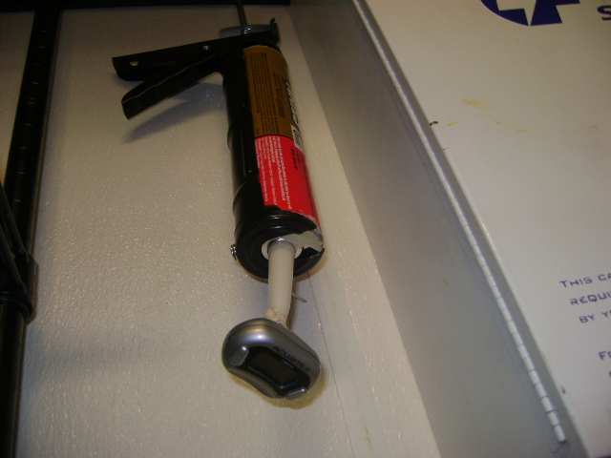
“Proper” Thermometer Use
Notes:
What’s a thermometer for?

Slide 44
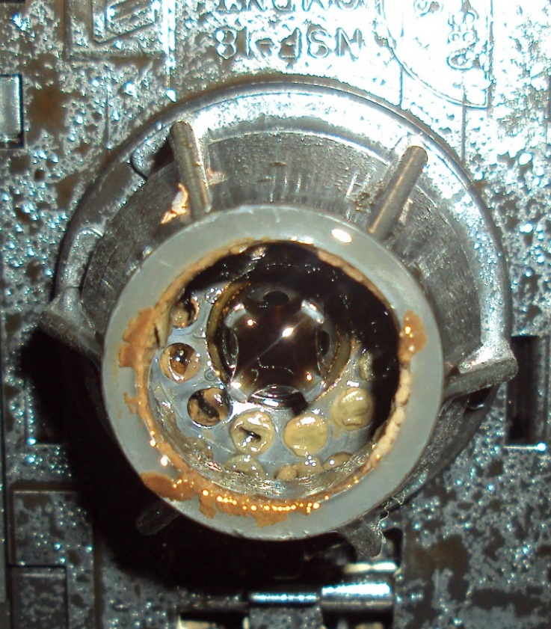
What is it?
Notes:
Build up on a soda fountain nozzle.

Slide 45
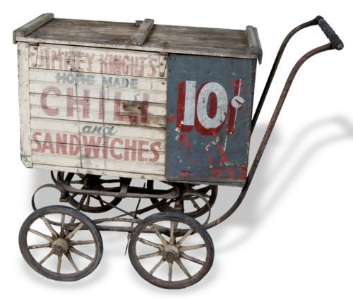
Food Cart Topeka circa 1955

Slide 46
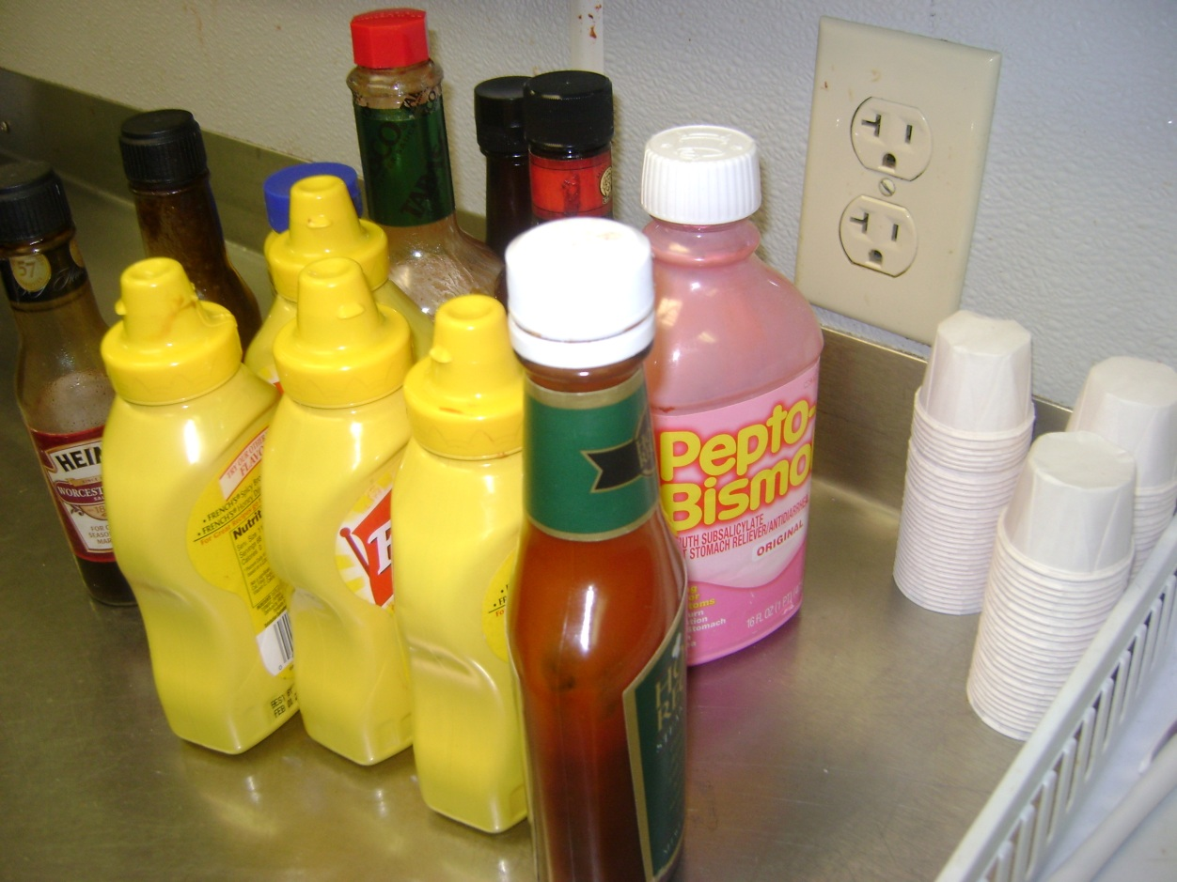
Necessary Condiments
Notes:
“Necessary condiments”

Slide 47
Questions???

Slide 48
Kansas Department of Agriculture
Website
  agriculture.ks.gov
Email
  kda.fsl@ks.gov
Phone
  (785) 564-6767
Fax
  (785) 564-6779

