Slide 1
Overcoming Adoption Barriers

Slide 2
Resources
HSUS Adopters Welcome Manual
Best Friends Adoption Barrier Study & Playbook (network.bestfriends.org)
Human Animal Support Services (HASS) Conversation Based Adoptions
Companions and Animals for Reform and Equity(CARE)
ASPCA Adoption Counseling Webinar
Maddie’s Fund Adoption Manual
Million Cat Challenge

Slide 3
Best Friends Pet Adoption Survey

Slide 5
Adoption Barrier Study
In early 2016 a Thought Leadership Team was convened to recommend where in the animal welfare industry Best Friends could stake a leadership position and make the greatest impact towards a no-kill nation.
A social / behavior change route was explored, with the objective of making adoption a social norm – the only, or at least highly preferred, place for acquiring a pet. However, after reviewing a wide range of existing research available, we found that social change wouldn’t provide the biggest impact. Most people are very favorable toward adoption, and even cite it as their preferred option. The problem was that behavior wasn’t following interest/intent.
The biggest issue was converting those people interested in adoption into actual adopters. While there were several studies that touched on some of the high-level barriers, data wasn’t available to really understand them, their scale, or how to overcome them.
As a result, we set out to do a two-part research study to understand the pet acquisition process, existing barriers (real or perceived) to adoption, and assess potential solutions to overcome those barriers. A qualitative study was conducted in July 2016 to inform a follow-up quantitative study conducted in October 2016. The following presentation contains the results of the research initiatives.
Notes:
This is a lot of words that says that in 2016 Best Friends did a study to see how people were acquiring their animals.
Most people are very favorable toward adoption and even cite it as their preferred option but the problem was that behavior wasn’t following their intent.
Data wasn’t available to understand the scale of the barriers or how to overcome them.
We did a two part research study to understand the pet acquisition process, barriers (real or perceived) to adoption, and assess potential solutions to overcome those barriers.

Slide 6
Rescue & Shelter Experience

Slide 7
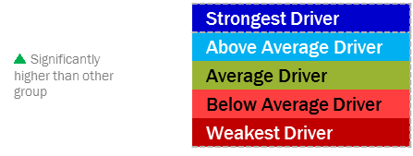
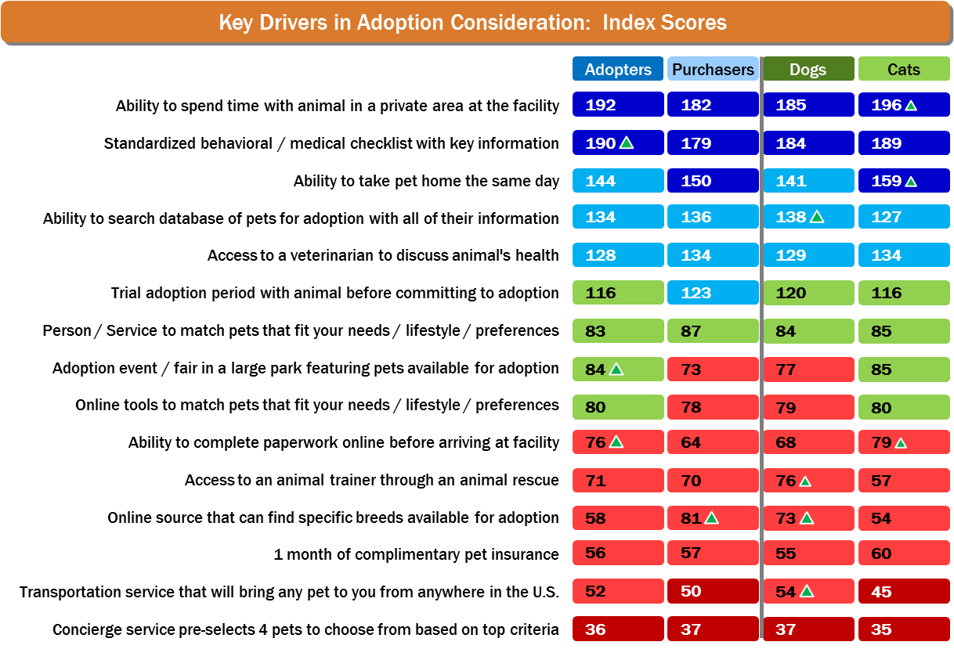
Potential Improvements Recap
The top 6 opportunities all address making adoption easier and removing uncertainty:
Ease & Uncertainty
Uncertainty
Ease
Ease
Uncertainty
Ease & Uncertainty
Note: Top & bottom rated features were consistent across generations!
Notes:
This chart can be overwhelming but if you look at the blue boxes those are the strongest and above average drivers.
The green boxes are average drivers.
This is broken down by adopters and purchasers and broken by species.
The top 6 opportunities all address making adoption easier and removing uncertainty.

Slide 8
Rescues and Shelters make up 30-38% of sources
Breeders & Pet Stores make up 25-35% of sources

Slide 9
CARE – Are we looking for reasons not to adopt?

Slide 10
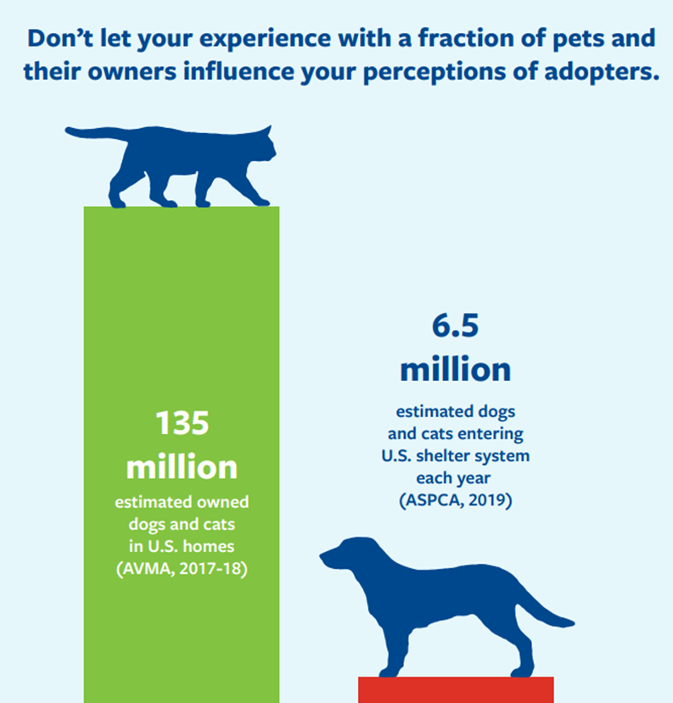
HSUS Pets for Life
Surveys conducted by the HSUS Pets for Life team have identified neighborhoods where only 3% of pets come from shelters or rescues.¹
When we compare this to a national average of about 40%, it’s clear that more homes are available
Notes:
Anyone who has worked the intake counter at a shelter knows how heartbreaking it can be. For me this was the hardest job in the shelter and one that contributed to the most compassion fatigue. It’s easy to take that trauma and apply it to everyone that comes into the shelter. We need to understand that we only see a tiny fraction of the animals that are in homes. Less than 5% to be exact.

Slide 11
HASS 27 Common Barriers
Mandatory background checks
Mandatory home inspections
Fenced yard requirements (which sometimes even require a fence be six or eight feet high)
Proof of vaccine and sterilization status of existing pets
Veterinary reference checks
Landlord or HOA reference checks
No adopters with children (or small children)
No adopters under a certain age (commonly 21 to 25)
No adopters in college
No adopters in the military
Mandating older adopters adopt only “senior” pets (sometimes called “seniors for seniors”)
No adopters who work full time outside the home
No adopters who will keep pets outside (partly or solely)
Over-inclusive “do not adopt” lists (people are often permanently placed on these for surrendering a pet or getting any citation)
Unfriendly, rude, or hostile treatment by a staff member or volunteer
High adoption fees and no sliding scale or fee reduction system
“Ghosting” potential adopters by not responding to communication
Intimidating or scaring potential adopters in order to prevent them from adopting
Sharing misinformation or lying to potential adopters to prevent them from adopting
Asking for an adopter’s medical history, criminal history, employment status, income, or other unnecessary personal information
Any other form of discrimination based on real or perceived race, ethnicity, economic status, housing status, gender, sexuality, sex, size, appearance, age, disability, or health status
Operating only during standard business hours (no weekend or evening hours)
Requiring multiple visits to the shelter before adoption
Requiring “meet and greets” with an entire family, or all existing pets, before adoption
Long or overly burdensome adoption applications or processes
Unwelcoming or uncommunicative staff and/or volunteers
Mandatory waiting periods before an animal can go home

Slide 12
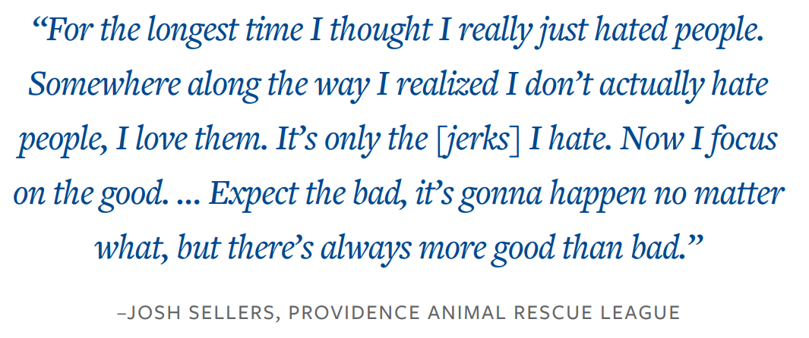
What causes barriers
Staff & Volunteers see an overwhelming amount of animal suffering which may turn into judgmental attitudes toward people
Policies are put in place because of one event
Need to find the “perfect” home
Implicit Bias
Notes:
Read quote.
Tell the story about Paul and Saul.
Bias against Chevelle’s owner.
Nothing will make you feel smaller than judging someone who is a great advocate for animals.

Slide 13
Harvard Implicit Association Test
Implicit.Harvard.edu/implicit/takeatest.html
Notes:
I recommend everyone take part in this study and have all of their staff, volunteers and fosters do it as well.

Slide 14
What Does Success Look Like?
Better customer service
Shortened length of stay for animals in your care
Increase in number of adoptions
More staff time for adoption follow up and support
A network of community support post-adoption
An inclusive and equitable adoption process
100% response rate to adoption inquiries
Better adoption matches
Community perception that shelter pet adoption is the easiest, best option for adoption
Awareness and ease of adopting through shelters and rescue organizations.
Volunteers support with all aspects of adoptions, including marketing and post-adoption support.
Increased adoption representation across all demographics in your community
Staff and volunteer reflection of your community members
Accessible adoption for everyone no matter what resources they do or do not have, such as technology, transportation, etc.
A culture of yes

Slide 15
HSUS Adopters Welcome
Notes:
Where do you start?
Start with talking about their lifestyle. Are they active? Do they love to drive to Colorado and go hiking in the mountains? Are they happy with sitting at home watching a Chiefs game?
Not everyone is as knowledgeable than us in animal husbandry. Do they know that mosquitos transmit heartworms? Not everyone does. I had a woman that was surrendering a dog and had taken it to the Vet to get it up to date on everything and when I asked her about heartworm prevention she said the vet dewormed the dog. I thought for a second and that logic tracks. A heartworm is a worm and the dog was dewormed so therefore it doesn’t have worms. When I explained heartworm disease she said she was never told that by a Veterinarian.
We like to think that the Vets are doing all of this education but they are just as overworked as we are and they sometimes don’t have the time to go over everything they should. We need to fill in those gaps.
I just want to be clear that conversational adoptions doesn’t mean you never say no. You start from a place of yes and if it’s not a good fit guide them an animal that is a good fit.
I don’t know if you use the Next Door app but there was a guy in my neighborhood that complained about an experience, he had with trying to adopt a dog. He went through a ridiculously long process only to be told he wasn’t good enough for this group to adopt. He was so turned off by the process that he wasn’t even going to try with another group. If you don’t have an inclusive process, you are affecting every animal welfare agency, not just your own.
Get rid of applications. Replace them with a survey instead. What are they looking for, what’s important to them? Use that survey as a starting point to have a conversation. This is not an interrogation or a job interview. It’s a conversation about animals. You have someone in front of you that loves animals, you love animals. Let’s talk about animals, make good matches, and be a resource for adopters.
Returned adoptions is not a bad thing either. It doesn’t mean you failed. I used to run a lot of LOS reports and what I found was the LOS of an animal that was returned was always half what it was before it got adopted the first time. Anything an animal left, whether it was a volunteer taking the dog off site or a sleep over with a foster we always had them fill out a behavior report. Were they good in the car? What did they see? Kids, bikes, airplanes? Did they know how to go up and down stairs, were they potty trained? This information is key to getting an accurate bio.

Slide 16
Benefits of Conversation Based Adoptions HASS
Support of diversity, equity, and inclusion
Improved customer satisfaction
Saved money Conversation-based adoptions increase the number of animals adopted.
Increased adoptions will decrease the length of stay and, subsequently, decrease the overall cost of care. This will allow for more money to be used on additional support services instead.
Increased impact of staff time The time spent enforcing adoption barriers can now be used to provide the support adopters need to transition pets into a new home successfully.
More community engagement
Improved morale within shelter
Increased marketing and media engagement: The process of conversation-based adoptions will result in more adoptions overall, leading to more success stories and positive narratives to share.
Increased fundraising and grants: Positive public perception in the community generates more financial support.
Following data-driven best practices qualifies organizations for more grant opportunities.
Keeping more people and animals together and reducing intake: Providing post-adoption support keeps families together and directly reduces unnecessary intake.
Increased adopter satisfaction will create a stronger bond between shelter/rescue staff and adopters and build trust to continue seeking support when needed.
Increased live release rate
Improved humane care in shelter: Through open-adoption policies, organizations reallocate staff time from unnecessary practices and instead toward improved care of the animals in the shelter by providing enrichment that may not have been feasible previously.
Additionally, more staff time means more time to provide individualized, quality care for each animal, therefore getting to know each animal’s personality traits and providing more perspective to potential adopters.
Promotion of responsible pet ownership and increased public safety
Enhanced reputation of pet adoption in general: Positive interactions with the community create great word-of-mouth!
A positive community reputation will continue to build your organization's reputation as a place of quality character and support.

Slide 17
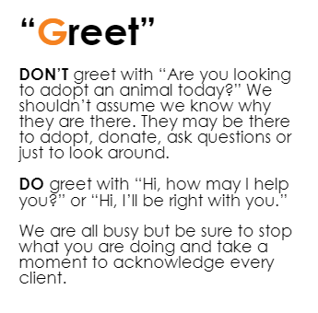
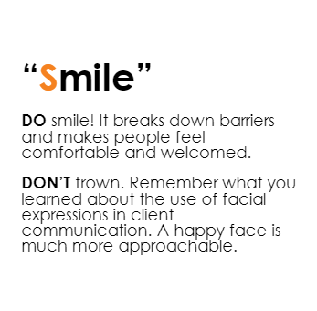
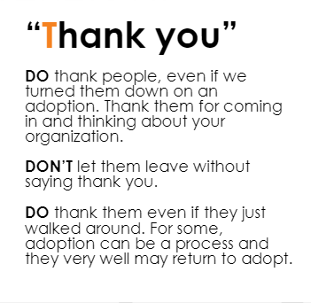
Best Friends Adoption Playbook
Focus on Customer Service
Tenets of G.U.T.S.
Notes:
We need to have good customer service. We need to be grateful when people come to us. A bad experience will be 10X more difficult to overcome than taking the time to make sure someone has a positive experience.

Slide 18
HASS Barrier Busting Basics

Slide 19
HASS Barrier Busting Basics

Slide 20
HASS Barrier Busting Basics

Slide 21
HASS Barrier Busting Basics

Slide 22
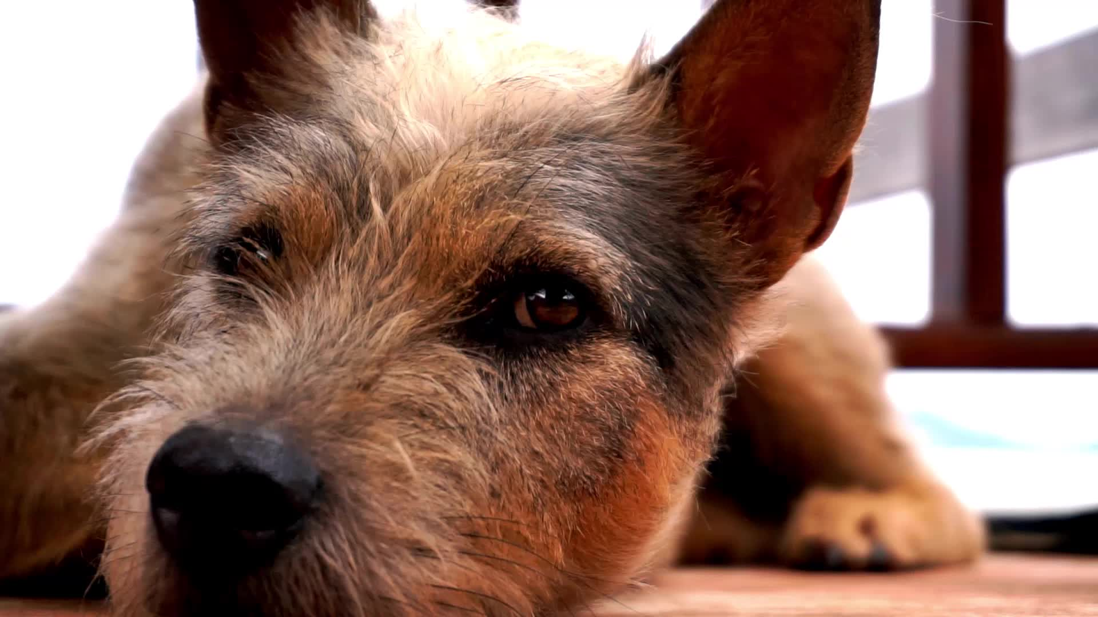
C.A.R.E.
If just 5% BIPOC adopted 2 million animals would find homes
Notes:
The total animals that would need to be saved for the nation the be no-kill is 378,000. Just 1% of BIPOC adoptions would lead to 400,000 animals saved and be enough to get the nation no-kill.

Slide 23
Key Take Aways
Inclusivity is a cultural change
Identify potential barriers and biases
Focus on customer service
Greet people, have convenient hours, respond to emails, answer the phones
Be a resource for adopters
Returned adoptions is not a bad thing!

Slide 24
Timy@bestfriends.org

