Slide 1
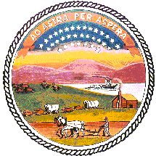
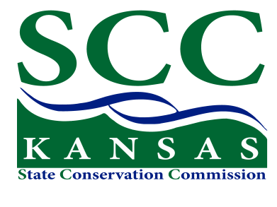
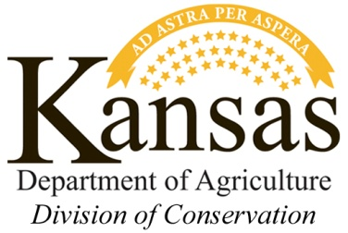
Riparian and Wetland Program Update
2017 Spring Workshops
Katie Burke
R&W Program Manager
Steve Frost
Administrative Manager

Slide 2
Riparian & Wetland Program
Funding for the R&W Program does not presently go to every county every year, but is directed to projects on a case-by-case basis …

Slide 3
Riparian & Wetland Program
Program started in 1994
64 Approved RWPPs by 2002
259 projects submitted 1994 - 2003
259 R&W contracts approved 2004 – 2017 for total cost-share of $1,342,522

Slide 4
Riparian & Wetland Program
R&W dollars are currently spent on:
Riparian forest buffers
Occasional wetland projects
Educational projects
R&W Future goals:
RWPPs – Riparian and Wetland Protection Plans
Diversify the program

Slide 5
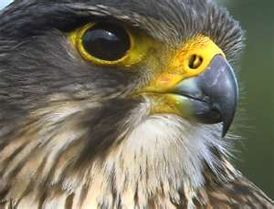
RWPPs - Riparian & Wetland Protection Plans
Developed in 1990s or early 2000s
Many conservation districts created a plan to address local resource concerns
Included in the plans:
Description of values / resources (i.e. habitat, wildlife) associated with wetlands and riparian areas
Goals of the District related to RW areas
Riparian and Wetland types
Potential BMPs
Plan implementation strategy
Evaluation and monitoring plans

Slide 6
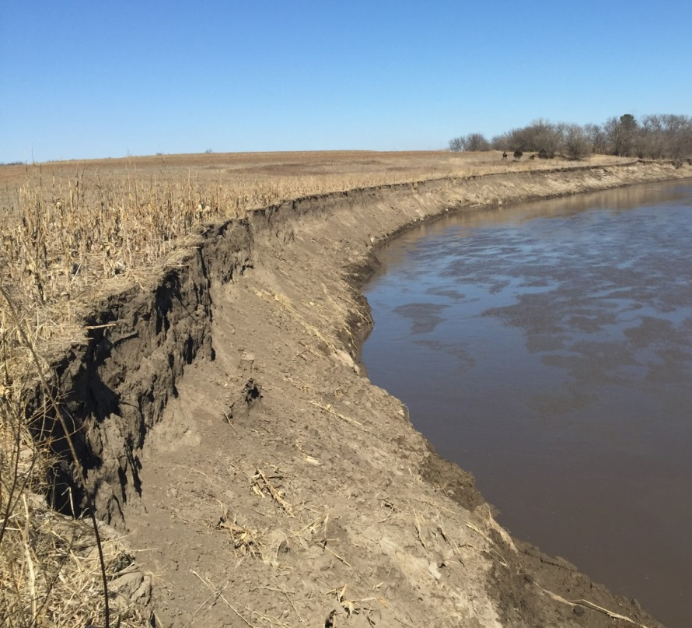
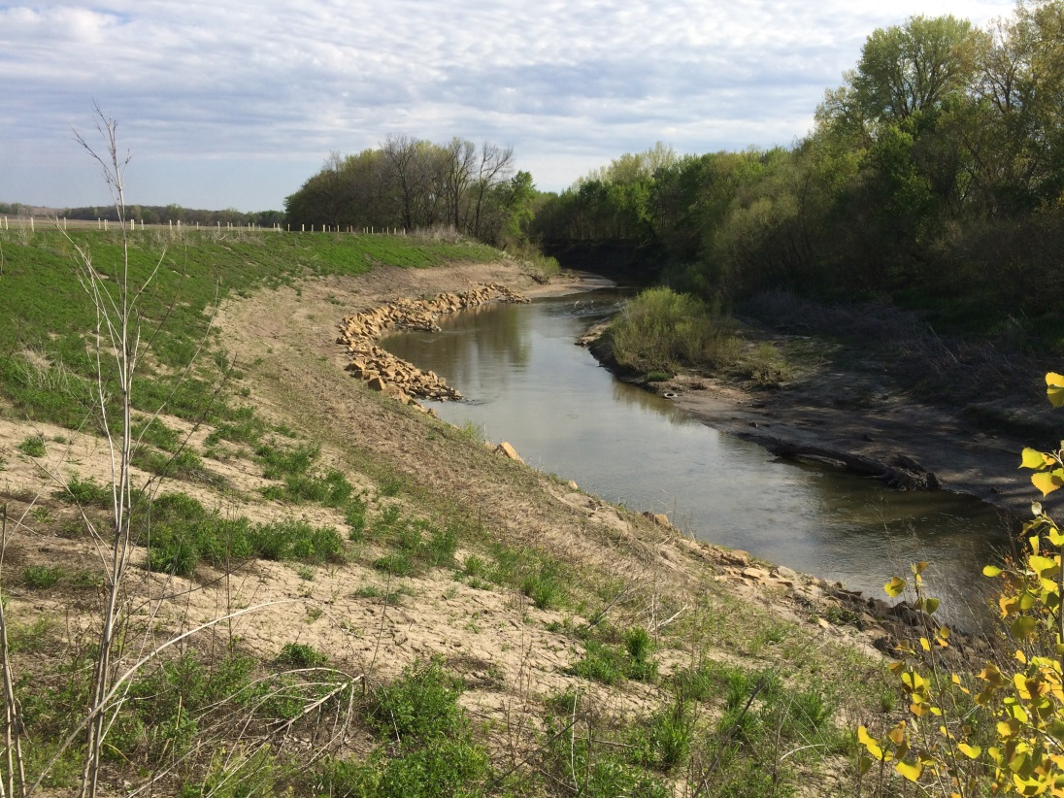
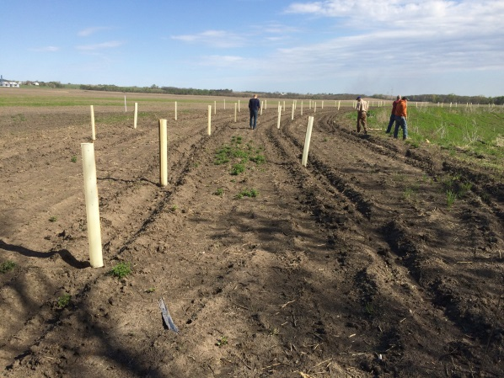
Riparian & Wetland Program
Protecting eroding riparian areas with tree plantings and KFS maintenance contracts

Slide 7
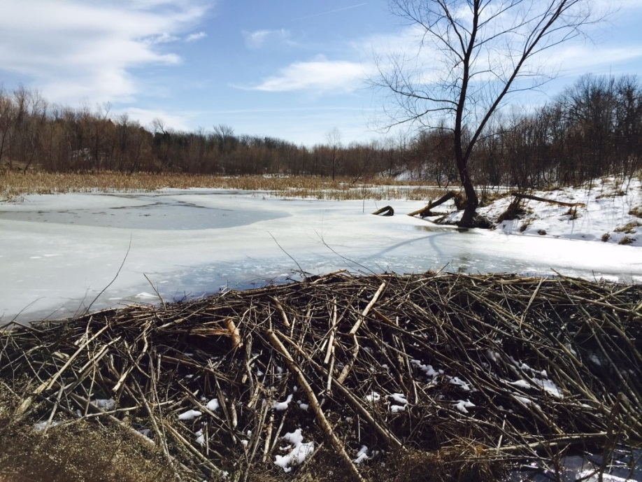
Riparian & Wetland Program
Wetland projects on a case-by-case basis
Cost share goes to earthwork, pipe if necessary, vegetation plantings
DOC also funds information / education projects (i.e. Playa Lakes Symposium)

Slide 8
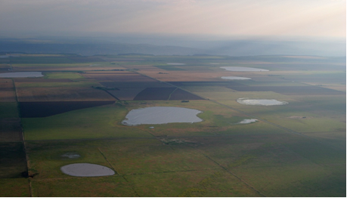
Riparian & Wetland Program
Goal: increase wetland projects and practices - including playas
Photo provided courtesy of Playa Lakes Joint Venture

Slide 9
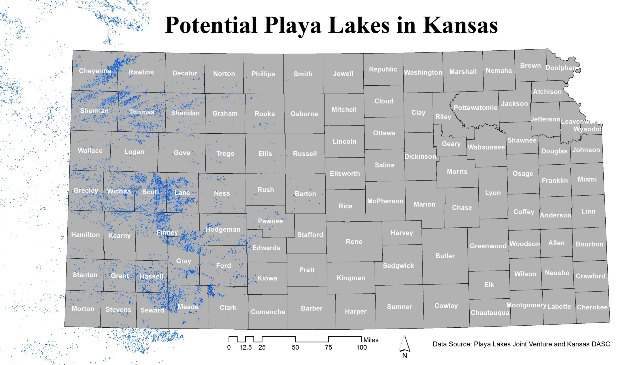

Slide 10
Kansas Water Plan: Ogallala-High Plains Aquifer Action Items
Encourage research on the rate and volume of water moving from playas to the Ogallala High Plains Aquifer; quantify the levels of restoration needed and enumerate the average amount of water deposited annually in playas

Slide 11
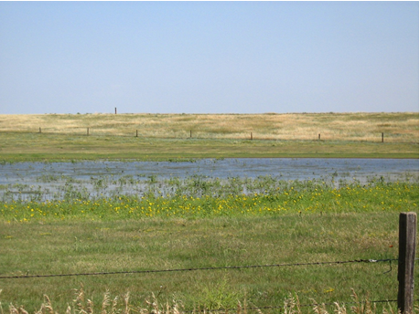
How do playas fit in to DOC’s Riparian and Wetland Program?
DOC R&W Program Objectives:
Encourage the development of riparian
and wetland protection plans in each
(every) conservation district
Create, enhance, or restore riparian and
wetland areas to support their natural
functions and values
Provide information, education and awareness
pertaining to the function and values of wetlands and riparian areas and how they can be restored and protected to provide natural processes
Photo provided courtesy of Playa Lakes Joint Venture

Slide 12
FSA Announces New CRP SAFE Practice for Playas
Program Will Protect and Restore Playa Lakes, Increase Habitat for Migratory Birds
A newly-established Conservation Reserve Program (CRP) SAFE practice—the Migratory Bird, Butterfly, and Pollinator Habitat practice—will allow up to 10,000 new acres in Kansas to be offered into CRP. Eligibility is strictly limited to landowners and ag producers who want to enhance existing playas or restore historic playas located in distinct priority areas established in the western one-third of Kansas.
There are approximately 7500 playas eligible in these priority areas. Research has shown that properly functioning playas are a primary source of recharge for the Ogallala Aquifer — contributing up to 95 percent of inflow to the aquifer and improving the quality of that water — and also provide critical habitat for migrating waterfowl, cranes and shorebirds.
This SAFE practice, CP38B, is designed to provide private landowners a market-based financial incentive for restoring playas, the most common wetlands in the region. An innovative market-based approach for sign-up will enable landowners to submit bids of up to $300 per acre. Submitted bids are based upon landowner values in a competitive process. While the program has been approved, an enrollment period has not yet been announced. Details on signup dates and requirements will be provided in the near future.
The program allows for a minimum playa size of 2 acres and up to a maximum tract size of 160 acres. Mid-contract management practices to keep the cover healthy will be required. This includes the option for managed harvesting of the acres and/or prescribed grazing. Contracts will be for 10-15 years. SAFE is a continuous CRP signup conservation practice, but offers will be ranked at intervals. Offers that don’t make the first cut-off date, or aren’t accepted during the first batch, will be carried over for consideration during the next round.
The Migratory Bird SAFE is a grassroots, cooperative conservation effort that was jointly proposed by Playa Lakes Joint Venture and the Rainwater Basin Joint Venture, based in Nebraska. It involves several partners including FSA and NRCS, Kansas Department of Wildlife, Parks and Tourism, Ducks Unlimited, and Kansas Alliance for Wetlands and Streams. These agencies, along with Kansas Farm Service Agency, are all available to work with producers interested in enrolling in the Migratory Bird, Butterfly, and Pollinator Habitat SAFE.

Slide 13
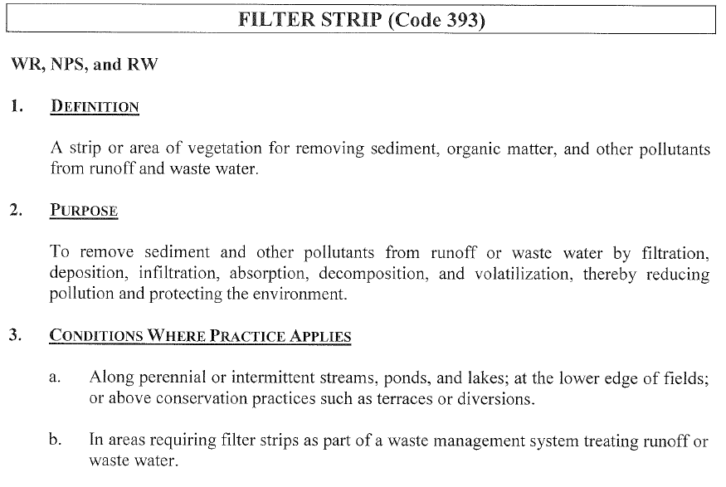
R&W Practices that Apply to Playas
Filter Strips:
Shaping
Seedbed prep
Fertilizer

Slide 14
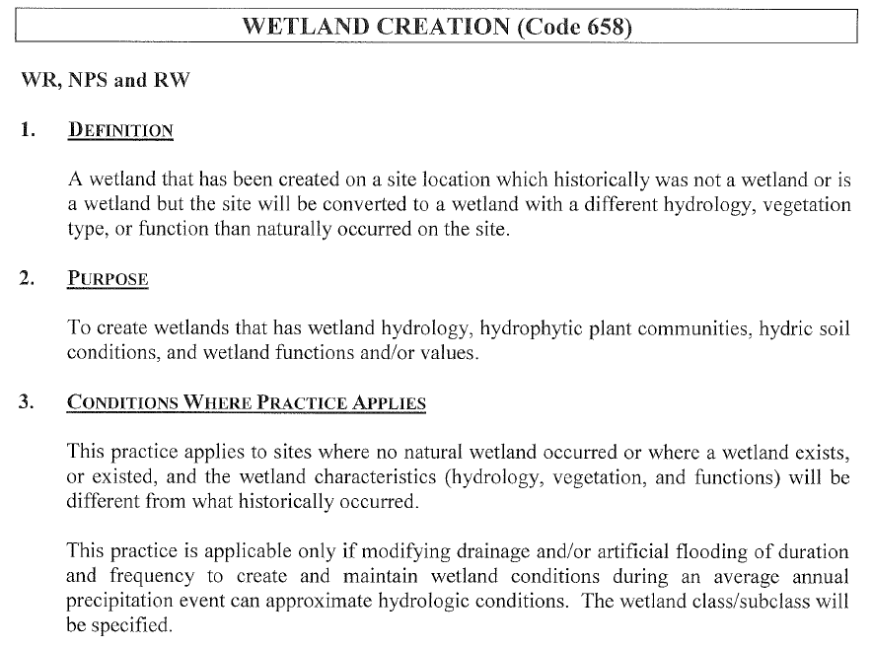
RW Practices that Apply to Playas
Wetland Creation:
Earthwork
Pipe

Slide 15
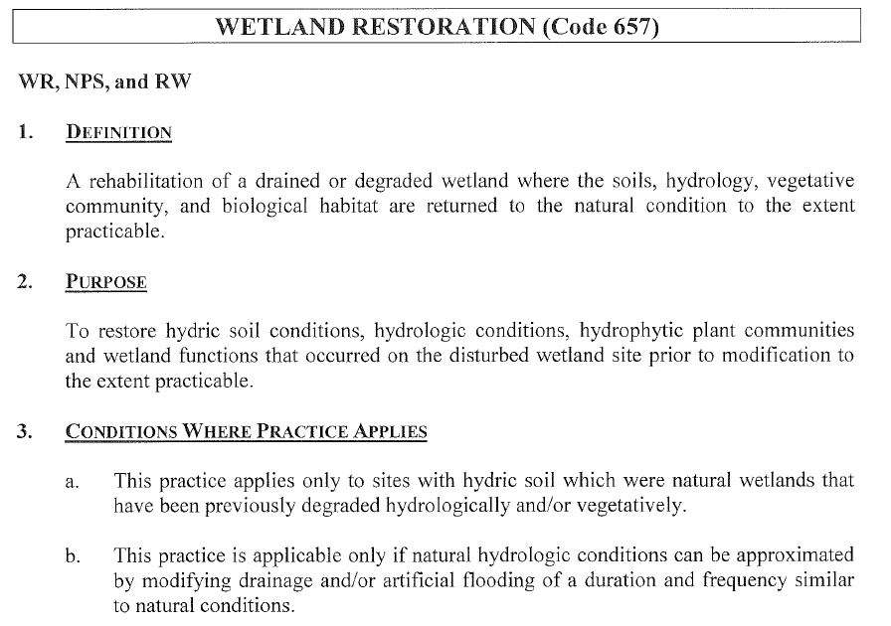
RW Practices that Apply to Playas
Wetland
Restoration:
Earthwork
Pipe

Slide 16
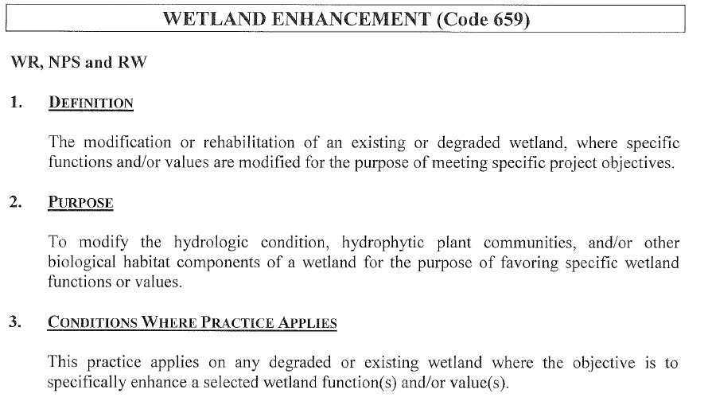
RW practices that apply to playas
Wetland
Enhancement:
Earthwork
Pipe

Slide 17
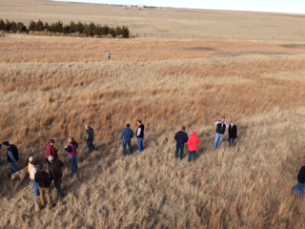
R&W Information and Education Projects
Potential educational projects:
Signage at a restored playa demonstration project
Information centers
Field days
Workshops
School events

Slide 18
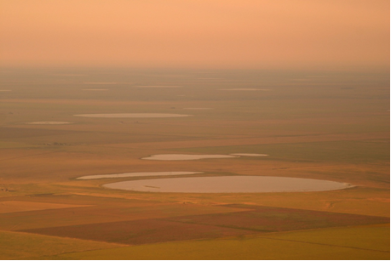
Riparian & Wetland Program
Photo courtesy of Playa Lakes Joint Venture
DOC will be working
to update funding /
policies for playa
conservation and
protection
Visit with DOC staff
about developing / updating your RWPPs

Slide 19
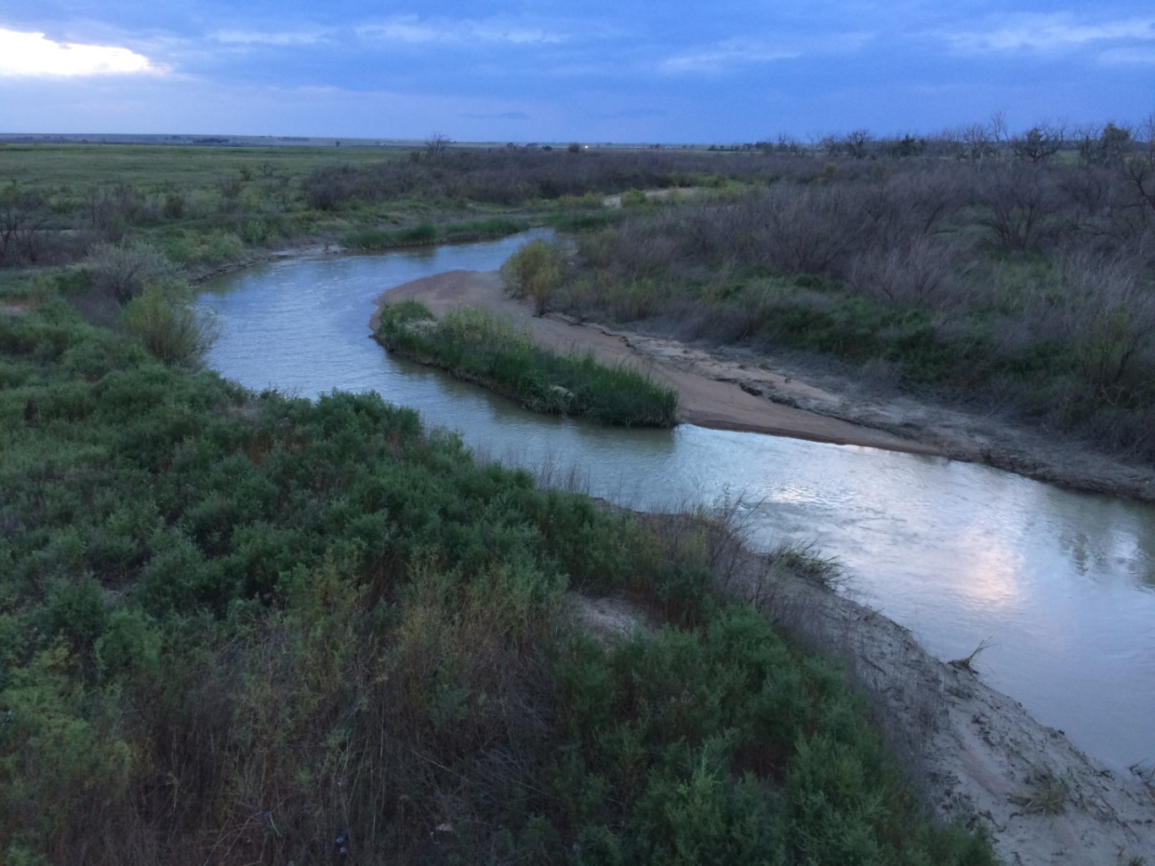
Upper Arkansas River Conservation Reserve Enhancement Program

Slide 20
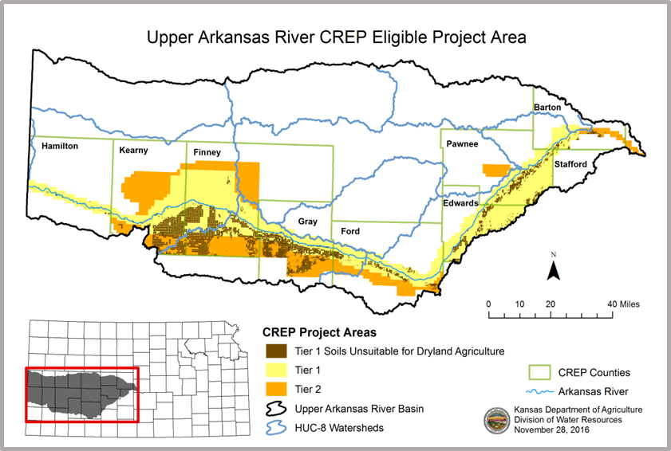
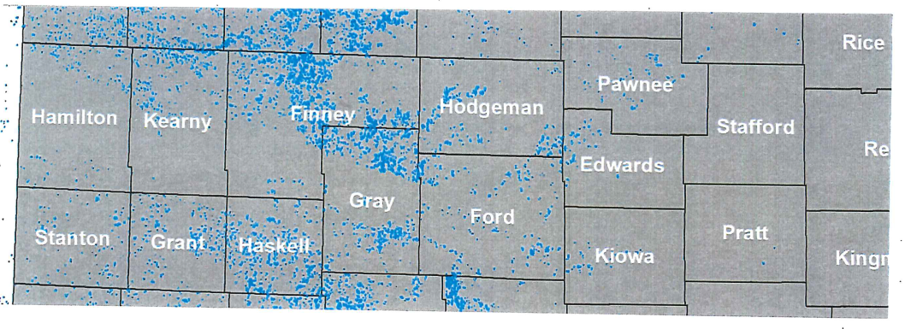
The Conservation Reserve Enhancement Program (CREP) in Kansas is a federal / state partnership created for enhancing water conservation efforts along the Upper Arkansas River (UAR) corridor from Hamilton County to Rice County.

Slide 21
CREP is a voluntary, incentive-based program allowing producers to enroll eligible irrigated acres in targeted areas for 14–15 year contracts with FSA, permanently retire the associated state water rights on the enrolled acres, and establish an approved land cover (typically a native grass) on the same acreage. The producer receives an annual rental payment, plus additional cost share opportunities for specific conservation practices from FSA and an upfront incentive payment from DOC.

Slide 22
CP9 Shallow Water Areas for Wildlife - The purpose of this practice is to develop or restore shallow water areas to an average depth of 6 to 18 inches for wildlife. The shallow water area must provide a source of water for wildlife for the majority of the year. Exception: For areas west of the 100th meridian that receive less than 25 inches of annual precipitation, the shallow water area must provide a source of water for wildlife for a minimum of 4 months of the year. Note: This is not a pond development or wetland restoration practice. However, this practice may be constructed on suitable hydric and non-hydric soils.
Eligible cropland conservation practices approved by FSA to meet the goals and objectives for this CREP project are as follows:
CP2 (Permanent Native Grasses and Legumes) – 27,550 acres;
CP4D (Permanent Wildlife Habitat, Non-easement) – 400 acres;
CP9 (Shallow Water Areas for Wildlife)* – 200 acres;
CP21 (Filter Strips) – 100 acres;
CP22 (Riparian Buffer) – 100 acres and;
CP23/CP23A (Wetland Restoration) – 200 acres.

Slide 23
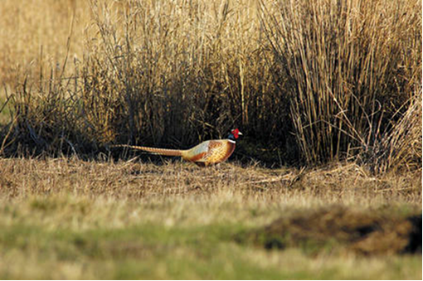
Groundwater is the dominant source of water for all uses in the basin, and aquifer declines are a serious concern. Therefore, water conservation is the main management objective in the Upper Arkansas CREP. However, the program also provides other resource benefits including soil conservation, water quality protection, wildlife habitat enhancement, and energy savings.
The majority of irrigated acres
enrolled have been on highly
erodible, sandhills soils that are
unsuitable for dryland farming.

Slide 24
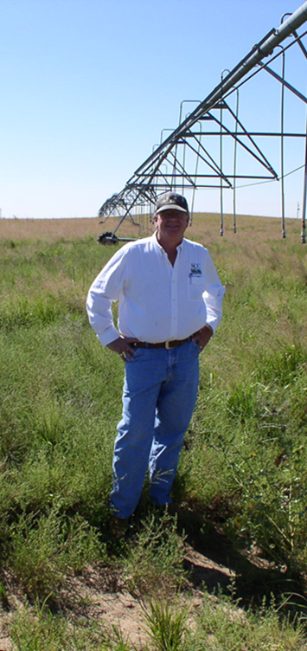
As of Sept. 30, 2016, a total of 109 state CREP contracts on 18,318 acres have been approved by the State of Kansas. These contracts have resulted in the permanent retirement of 37,430 acre-feet of annual water appropriation on 124 water rights from 162 wells. Both Gray and Kearny counties are now at the current enrollment cap of 7,237.5 acres each.
Any questions ???

Slide 25
FSA Conservation Practice Definitions:
CP2 Establishment of Permanent Native Grasses - The purpose of this practice is to establish new or maintain existing vegetative cover of native grasses on eligible cropland that will enhance environmental benefits.
CP4D Permanent Wildlife Habitat, Non easement - The purpose of this practice is to establish new or maintain existing permanent wildlife habitat cover to enhance environmental benefits for the wildlife habitat of the designated or surrounding areas.
CP9 Shallow Water Areas for Wildlife - The purpose of this practice is to develop or restore shallow water areas to an average depth of 6 to 18 inches for wildlife. The shallow water area must provide a source of water for wildlife for the majority of the year. Exception: For areas west of the 100th meridian that receive less than 25 inches of annual precipitation, the shallow water area must provide a source of water for wildlife for a minimum of 4 months of the year. Note: This is not a pond development or wetland restoration practice. However, this practice may be constructed on suitable hydric and non-hydric soils.
CP21 Filter Strips - The purpose of this practice is to remove nutrients, sediment, organic matter, pesticides, and other pollutants from surface runoff and subsurface flow by deposition, absorption, plant uptake, denitrification, and other processes, and thereby reduce pollution and protect surface water and subsurface water quality while enhancing the ecosystem of the water body.
CP22 Riparian Buffer - The purposes of this practice are to: 1) remove nutrients, sediment, organic matter, pesticides, and other pollutants from surface runoff and subsurface flow by deposition, absorption, plant uptake, denitrification, and other processes, and thereby reduce pollution and protect surface water and subsurface water quality while enhancing the ecosystem of the water body; 2) create shade to lower water temperature to improve habitat for aquatic organisms; and 3) provide a source of detritus and large woody debris for aquatic organisms and habitat for wildlife.
CP23 Wetland Restoration - The purpose of this practice is to restore the functions and values of wetland ecosystems that have been devoted to agricultural use. The level of restoration of the wetland ecosystem shall be determined by the producer in consultation with NRCS or TSP.
CP23A Wetland Restoration, Non-Floodplain - The purpose of this practice is to restore the functions and values of wetland ecosystems that have been devoted to agricultural use. The level of restoration of the wetland ecosystem shall be determined by the producer in consultation with NRCS or TSP.

