Slide 1
AFI
Update
November 29, 2023

Slide 2
AFI News
Inspector Chris Demel and his partner, Amber, welcomed a baby boy yesterday at 7:05pm. All are doing well.

Slide 3
Canine Respiratory Disease Outbreak
First reported in the Portland, Oregon area a few months ago
No causative agent identified as of yet and only dogs affected
Early symptoms: coughing, sneezing, lethargy
Three clinical syndromes reported so far:
Tracheal inflammation that lasts 6-8 weeks or longer, not responsive to antibiotics
Chronic pneumonia, not responsive to antibiotics
Severe, acute pneumonia within 24 to 36 hours; deaths and extensive hospitalization reported with this syndrome

Slide 4
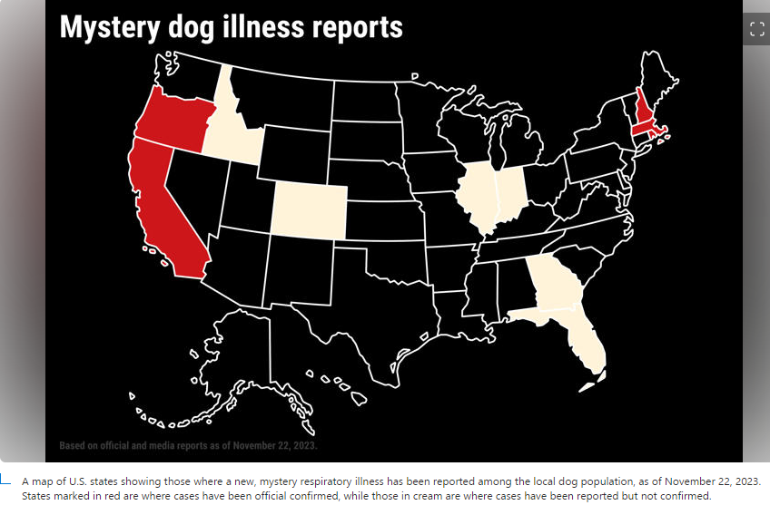
Canine Respiratory Disease Outbreak
Other States with this illness reported in last few days:
Vermont
Maryland
Washington
From Newsweek article “Dog Illness Map Shows States Where Pets Are Affected”, dated 11/22/2023

Slide 5
AFI Bill Draft Update

