Slide 1
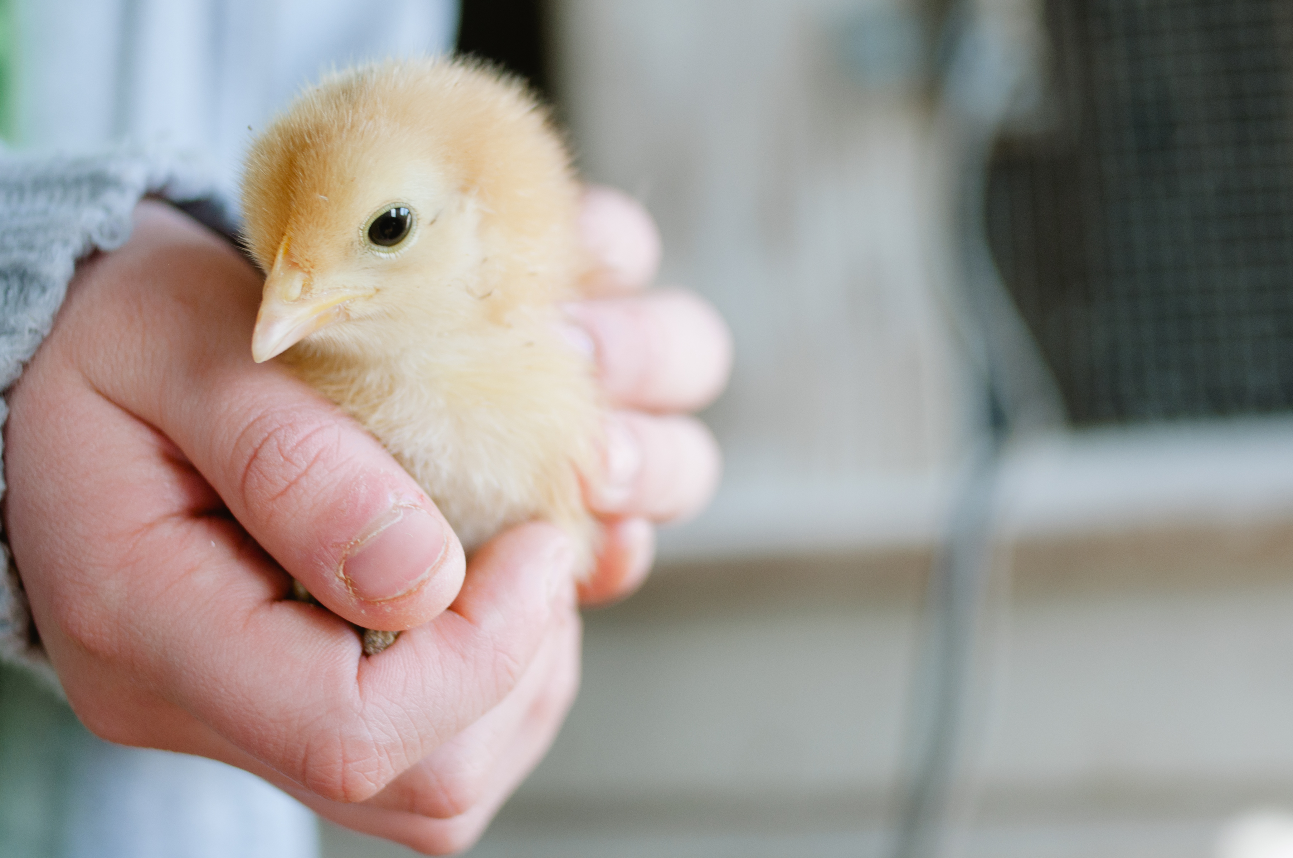
Drug Residue Avoidance in Poultry

Slide 2
Poultry Industry
The poultry industry is a dynamic and highly specialized industry.
This large commercial industry is heavily influenced by the slightest of changes in economic factors such as feed, availability and cost. Each year billions of chickens are raised in both commercial and backyard settings as a source of food, for both meat and eggs.
Notes:
Pull general stats

Slide 3
Commercial vs. Backyard
Backyard:
Commercial:
Less than 100 birds per household
Increased space per chicken
Specialized production
Allows birds to: scratch, forage, peck and have outdoor exercise
Low productivity
High mortality rates (due to lack of technical know-how and access to key inputs)
Requires a large amount of land
Can be weather dependent
More than 100 birds per operation
Meets the demand of both meat and eggs
Increases production
Highly efficient system which saves land, feed, labor and other resources
Continuous production year round
Creates potential health risks, animal abuse and harmful to the environment
Faces global competition and is largely dependent on access to cheap inputs and improvements in production and marketing efficiency
Notes:
https://www.researchgate.net/publication/24049842_Analysis_of_the_Philippine_Chicken_Industry_Commercial_versus_Backyard_Sectors
http://www.roysfarm.com/poultry-farming/
The “backyard” setting is defined ‭as having less than 100 birds per household.
A small operation or backyard setting often allows for increased space per chicken and specialized production. This system allows for allows the birds scratching, foraging, pecking and outdoor exercise.
The backyard sector suffers from low productivity and high mortality rates because of lack of technical know-how and access to key inputs. This sector requires a large amount of land and can be weather dependent
A poultry farm is classified as “commercial” if it has more than 100 birds.
Commercial poultry farming is necessary to meet the demand of both meat and eggs. Intensive poultry farming method increases production and is a highly efficient system which saves, land, feed, labor and other resources. It ensures continuous production throughout the year in any environment and season.
The commercial sector is often criticized creating health risks, animal abuse and harming the environment. This sector also faces global competition and is largely dependent on access to cheap inputs and improvements in production and marketing efficiency.

Slide 4
Both commercial and backyard operations have to use nationally approved medications (antibiotics) regularly to keep the poultry birds free from diseases.

Slide 5
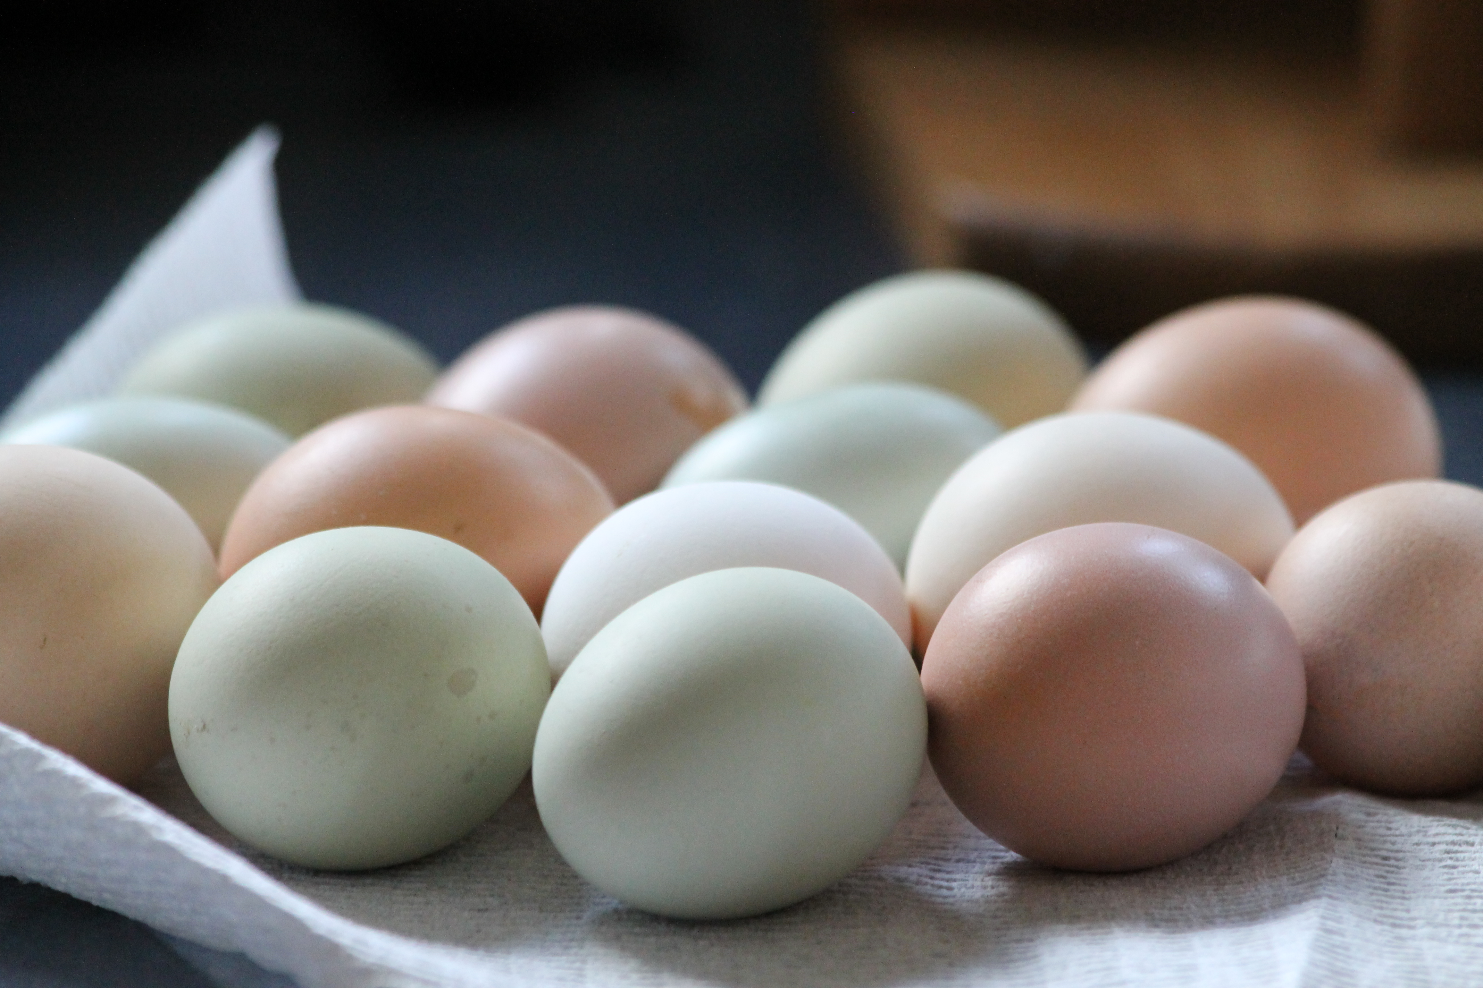
Drug Residue vs. Illegal Drug Residue
“Drug residue” refers to the presence of veterinary drugs or dewormers in meat or eggs.
“Illegal drug residue” is any drug found above the allowable range in an animal sent to slaughter.
Notes:
According to Codex Alimentarius Commission Procedural Manual, Fourteenth Edition (2004), Animal Drug Residues are defined as:
“Residues of veterinary drugs include the parent compounds and/or their metabolites in any edible portion of the animal product, and include residues of associated impurities of the veterinary drug concerned.”

Slide 6
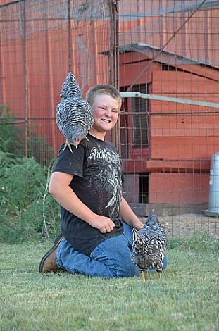
Reasons for antibiotic use:
Increased feed efficiency
Increased growth promotion
Treat and prevent disease
Overcome parasitic infections
Alleviate pain from an injured bird

Slide 7
Drug Residue Concerns:
Chickens particularly those in a non-commercial setting may inadvertently consume materials that contain drug products. (Example: chickens eating manure from an animal that has recently been treated with medication)
Need to be aware of the potential contaminants.
Chickens treated with drugs can be absorbed and distributed to various parts of the body.

Slide 8
Human Health Risk Issues
Any adulterated product may result in the following:
  Drug residue allergies
  Development of antibiotic resistant bacteria
  Potential for cancer, reproductive or developmental effects
  Hormone-related risks
Notes:
A major issue of drug use in food animals as well as over-use of antibiotics in humans is antibiotic-resistant bacteria isolated from meat or milk.
A general hypothesis is that the greater amount of a drug used, the more likely bacteria would develop resistance to it.
In the dairy industry, milk residue is an obstacle that is often faced. Contaminated milk is a major concern for human health.

Slide 9
Industry Action:
Programs and industry implementations:
  Hazard Analysis Critical Control Points
  USDA and FDA inspections (testing and monitoring), tolerance limits and withdrawal times are used to safeguard against potential risk to humans.
  Veterinary Feed Directives
These safe concentrations are determined in scientific studies designed to determine how much drug a human can be exposed to over the duration of his/her lifetime without any adverse effects.
Note: Chickens producing eggs for human consumption are considered food animals regardless of the type of operation.

Slide 10
Industry Action:
Large segments of the industry are making production management changes based on consumer concerns in order to meet the demand. Some producers have started eliminating the use of antibiotics in order to produce and market “antibiotic free” chicken.
“Are the changes being made to satisfy consumer demand good, bad or indifferent for the animals and the industry?”
Notes:
Company examples?

Slide 11
Common Drug Residues in Poultry:
Chloramphenicol is the most prominent antibiotic residue in eggs. It can persist in yolk for up to 66 days, depending on the dosage. Sulphadimidine and arsanilic acid have been found as residues in egg albumen.
FDA gives minimum withdrawal periods prior to slaughter: 5 days for many drugs, 3 days for tetracyclines and 10 days for sulfaquinoxaline.
Vaccination for the control of coccidiosis is becoming more popular, thus eliminating the risk of residue carry-over in poultry products.
Hormones are no longer used in poultry production.
Notes:
http://www.wattagnet.com/articles/762-drug-residues-and-contaminants-in-poultry-products

Slide 12
Backyard Poultry Dilemma
Very few drug products are on the market for egg-laying hens in non-commercial settings
Dosing instructions may not be suitable for smaller flocks
Results in the potential for ‘extra-label’ drug use
A common medication are “dewormers” (in the form of medicated feeds or premixes)
Difficult for small flocks to ensure the dose of the product is accurate and that they actually consumed the product.
Notes:
The backyard poultry industry is faced with the challenge of having very few drug products on the market for egg-laying hens in non-commercial settings. Most of the FDA approved medications for laying hens are designed to meet the needs of large scale operations. Therefore, the dosing instructions may not be suitable for smaller flocks kept in free-range systems. A drug product used beyond what is specifically stated on the approved FDA label is ‘extra-label’.
A commonly used medication for treating chickens are “dewormers”. There are very few dewormers labeled for all classes of chickens and are often in the form of medicated feeds or premixes which increase the difficulty for use in small flocks. It becomes difficult to ensure the dose of the product is accurate and that they actually consumed the product.

Slide 13
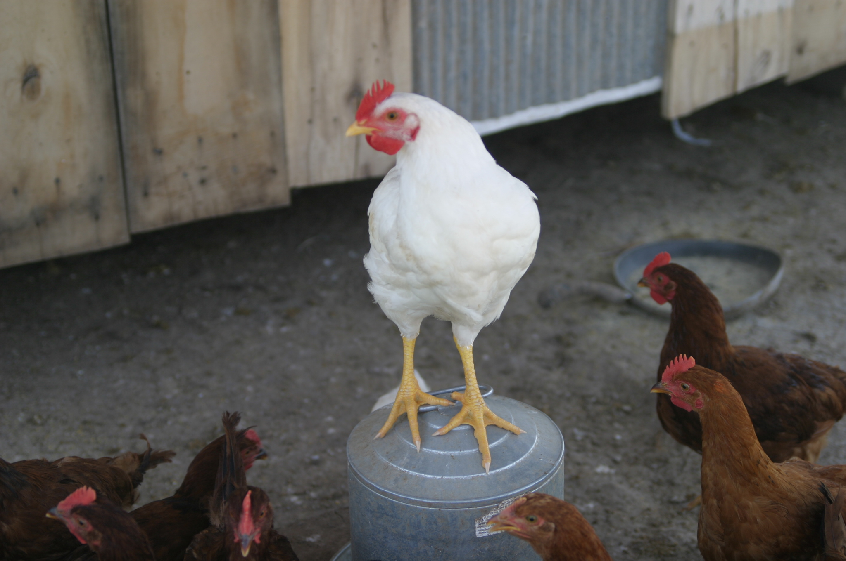
What are the consequences of
Illegal Drug Residue?
Producers found guilty of illegal drug residue may face the following:
financial penalties
criminal penalties
refusal at the sale barn and packing facilities
negative public perception

Slide 14
Residue Testing and Monitoring
Residues in fresh meat are monitored by the Food Safety Inspection Service through the National Residue Program.
Random samples are tested for monitoring the national residue incidence.
Notes:
Same for poultry??

Slide 15
Prevention Practice Tips
1. Disinfect the coop
2. Quarantine, if necessary
Clean all surfaces with an effective detergent. Many disinfectants require at least 30 minutes to destroy infectious organisms and should be completely dry before use.
An unhealthy chicken should be immediately quarantined and accurately diagnosed in order to prevent the further spread of disease.

Slide 16
Prevention Practice Tips
3. Vaccinate
4. Keep chickens clean
Vaccination should be performed on birds if they are transported on/off the premises regularly and for disease treatment.
Minimize/eliminate the entry of new chickens into your flock and limit contact with visitors.

Slide 17
Prevention Practice Tips
5. Be aware of the top chicken diseases
In general sick chickens are less active, have a retracted neck close to its body and an unkempt appearance. However, not all diseases have the same appearance. It is important to be aware of common diseases and their corresponding symptoms.

Slide 18
Veterinary-Client-Patient Relationship
It is important for a producer to have an ongoing relationship with an accredited veterinarian. This helps to ensure the veterinarian has assumed responsibility for making medical judgements regarding the health of the animal and need for medical treatment.

Slide 19
Record Keeping
Should your operation get cited for a residue violation and you believe it is a case of mistaken identity, good records are your best evidence that the animal in question does not belong to you.
Records should include: treatment date, animal identification, name of employee administering the drug, drug administered, weight of animal, route of administration, disease being treated, withdrawal time and the first date the animal can be sent to slaughter.
Records should be kept at least two years.
Notes:
Should your operation get cited for a residue violation and you believe it’s a case of mistaken identity, good records are your best evidence that the animal in question does not belong to you.

Slide 20
Avoid Extra-Label Drug Use
Extra-label drug use (ELDU) is the use of an animal drug in a manner that is different from label instructions in regard to:
the disease being treated
route of administration of the drug
dosage of the drug
the recommended treatment regimen
It is important to follow all labeled directions and withdrawal dates.
Notes:
Withdrawal time is the amount of time required for a drug or chemical concentration to fall below the Tolerance Level established in a specific target animal tissue. It is determined experimentally and dependent upon drug, dose, formulation, route of administration, species, target issue and disease/management factors. The time required for drug concentrations in all food animal tissues or products are below tolerance. Considerations include aesthetic considerations, risks perceived by the public, sensitive populations and issues, international relations and trade barriers
Extra-label drug use is a higher dose than the label, a different route or species than the label or a different disease that is being treated than indicated on the label.

Slide 21
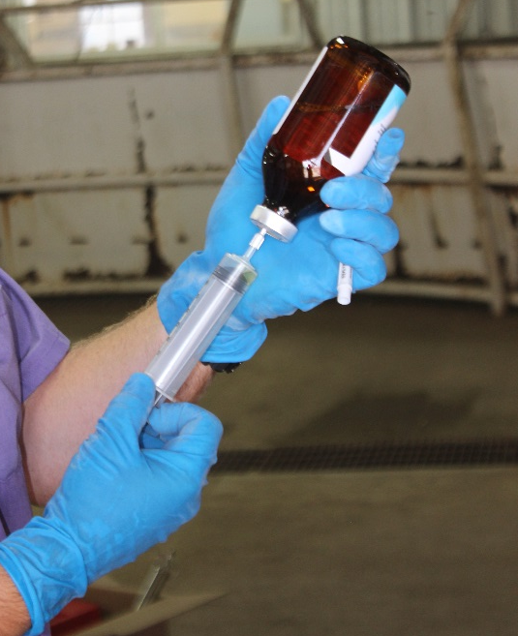
Injection Technique
Things to consider when giving an injection include:
Administer the shot in the neck
Inject subcutaneously when possible
Make sure the injection site is clean
Use the proper size needle based on: the location, route of administration, volume of injection and the thickness of the fluid
Do NOT use bent needles

Slide 22
What is a Veterinary Feed Directive (VFD)?
And
What is their part in drug residue avoidance?

Slide 23
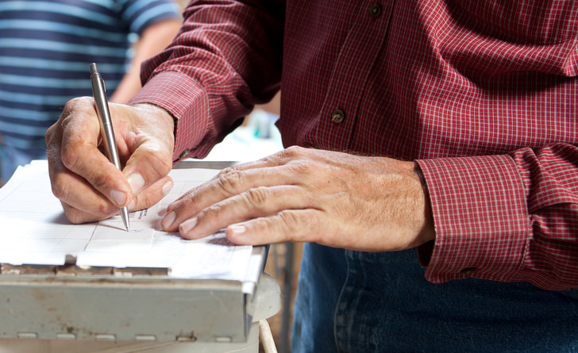
What is a VFD?
A VFD is a written (nonverbal) statement issued by a licensed veterinarian that authorizes the use of a VFD drug in or on animal feed.

Slide 24
How are VFDs related to drug residue?
VFDs are part of the FDAs strategy to reduce the amount of drug residue in the meat. It is an action to promote the judicious use of medically important antimicrobial drugs in food animals.

Slide 25
Summary
Failing to practice good residue avoidance can lead to financial penalties and a poor public perception on the poultry industry. Good management practices, along with following withdrawal times on VFDs, help to reduce residues. Remembering tips like keeping chickens clean, disinfecting the coop, quarantine and vaccinate (if necessary) and being aware of the top chicken diseases result in a better quality product.

Slide 26
Contact Us
Kansas Department of Agriculture
(785) 564-6601 or (785) 564-6778
agriculture.ks.gov/animalhealth
vfdinfo.org

