Slide 1
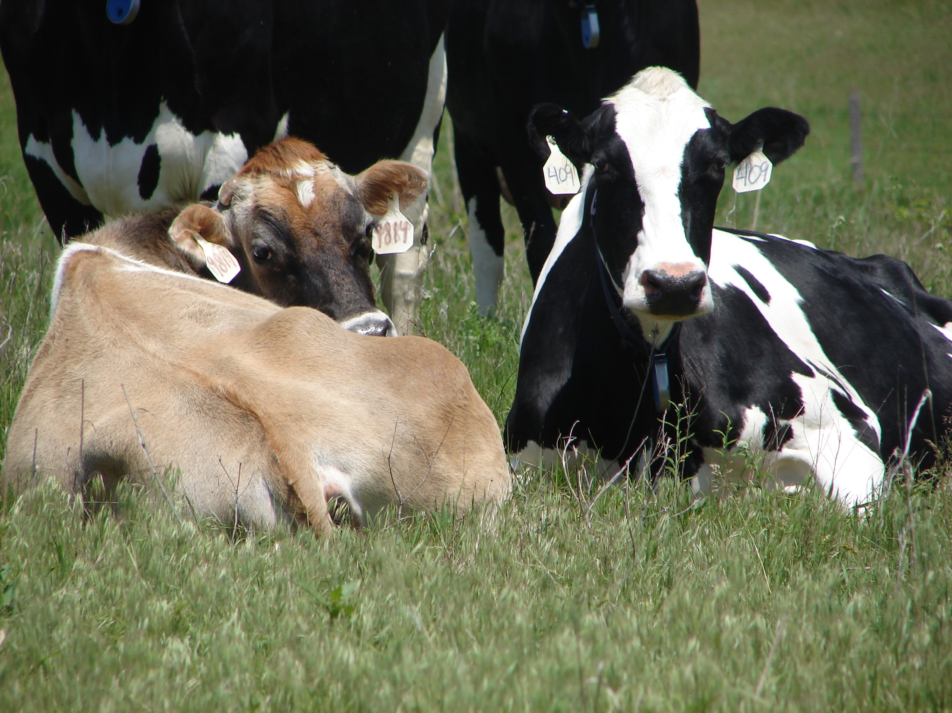
Drug Residue Avoidance in Dairy Cattle

Slide 2
Dairy Industry
Committed to producing safe and wholesome products
High-quality milk and dairy products
Continuous evaluation of quality management practices and disease prevention protocols
Top priority: judicious use of antibiotics
Many precautions are taken so contaminated milk or meat never enter the food supply chain
Notes:
The dairy industry is committed to producing safe and wholesome products to fulfill the world’s expanding appetite for high-quality milk and dairy products.
It is through continuous evaluation of quality management practices and disease prevention protocols that producers keep animals healthy and comfortable.
Dairy producers make the judicious use of antibiotics a top priority. Many precautions are taken so that sick animals requiring treatment do not have contaminated milk or meat enter the food supply chain.

Slide 3
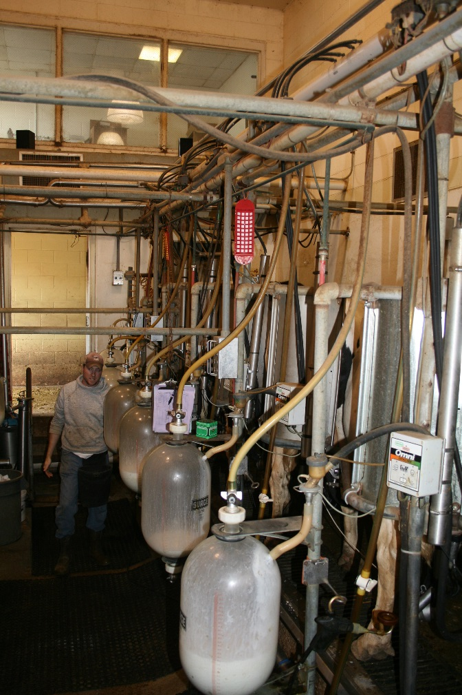
Drug Residue vs. Illegal Drug Residue
“Drug residue” refers to the presence of veterinary drugs or dewormers in meat. In dairy cattle, drug residue can also be found in the milk.
“Illegal drug residue” is considered to be any drug found in an animal sent to slaughter that is above the allowable range.
Notes:
According to Codex Alimentarius Commission Procedural Manual, Fourteenth Edition (2004), Animal Drug Residues are defined as:
“Residues of veterinary drugs include the parent compounds and/or their metabolites in any edible portion of the animal product, and include residues of associated impurities of the veterinary drug concerned.”

Slide 4
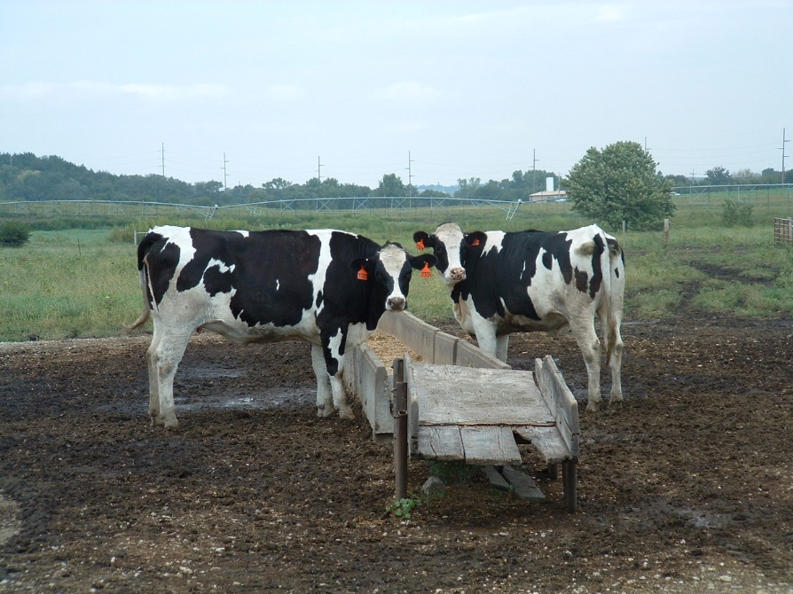
What are the consequences of
Illegal Drug Residue?
Producers who are found guilty of illegal drug residue may face the following:
financial penalties
criminal penalties
refusal at the sale barn and packing facilities or
negative public perception

Slide 5
Human Health Risk Issues
In the dairy industry, contaminated milk is a major concern for human health. Any adulterated product may result in the following:
  Drug residue allergies
  Development of antibiotic resistant bacteria
  Potential for cancer, reproductive or developmental effects
  Hormone-related risks
Notes:
A major issue of drug use in food animals as well as over-use of antibiotics in humans is antibiotic-resistant bacteria isolated from meat or milk.
A general hypothesis is that the greater amount of a drug used, the more likely bacteria would develop resistance to it.
In the dairy industry, milk residue is an obstacle that is often faced. Contaminated milk is a major concern for human health.

Slide 6
Residue Testing and Monitoring (Milk)
The Grade A Pasteurized Milk Ordinance requires that all bulk milk tankers be sampled and analyzed for beta-lactam drug residues before the milk is processed.
Positive test results lead to the mandatory testing of raw milk samples from each farm which supplied raw milk for that truckload.
Notes:
Additional screening of other drug residues is performed through a random sampling program. Samples: bulk milk pick-up tanker, pasteurized fluid milk and milk products, producer
Target tissues tested (milk, kidneys often tested at slaughter)
STOP (swab test on premises)
FAST (fast antimicrobial screen test)
SOS (sulfa-on-site)
CHARM II; SNAP (milk residues)
Lab tests (HPLC/GC/Mass Spectrometry)

Slide 7
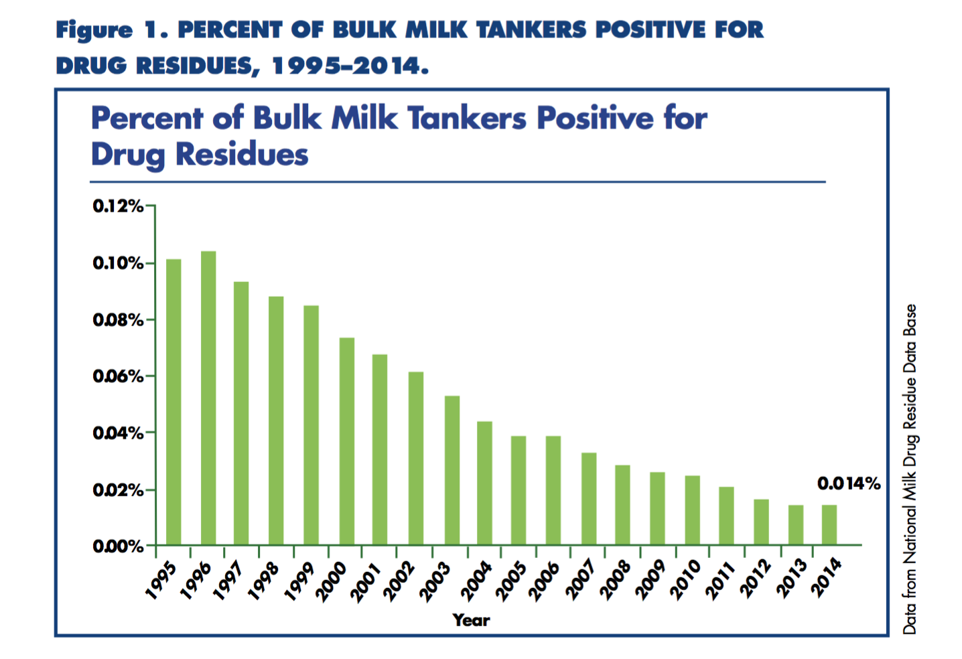
0.014%
Notes:
Iowa 2016 Residue Manual Dairy Farm Program
Through increased education and industry advancements …this graph signifies a dramatic decrease from an already low-level of occurrence of positive test for drug residues in bulk milk tankers.

Slide 8
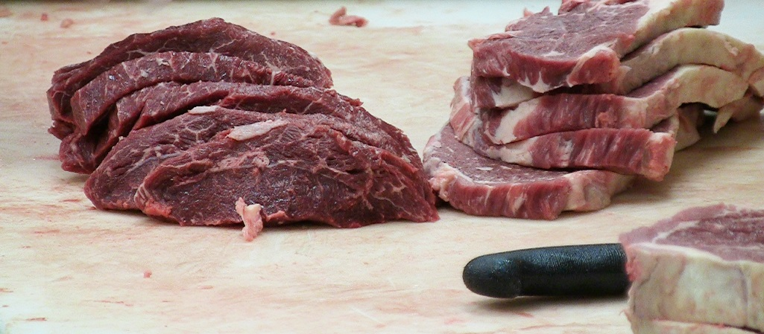
Residue Testing and Monitoring (Meat)
In the dairy industry, culled cows are sent to meat packing facilities. Like beef cattle, these cows must follow all protocols set forth by the industry.
Notes:
The United States Department of Agriculture (USDA) Food Safety Inspection Service (FSIS) conducts tests for chemicals—including antibiotics and various other drugs, pesticides and environmental chemicals— in meat, poultry, and egg products destined for human consumption.

Slide 9
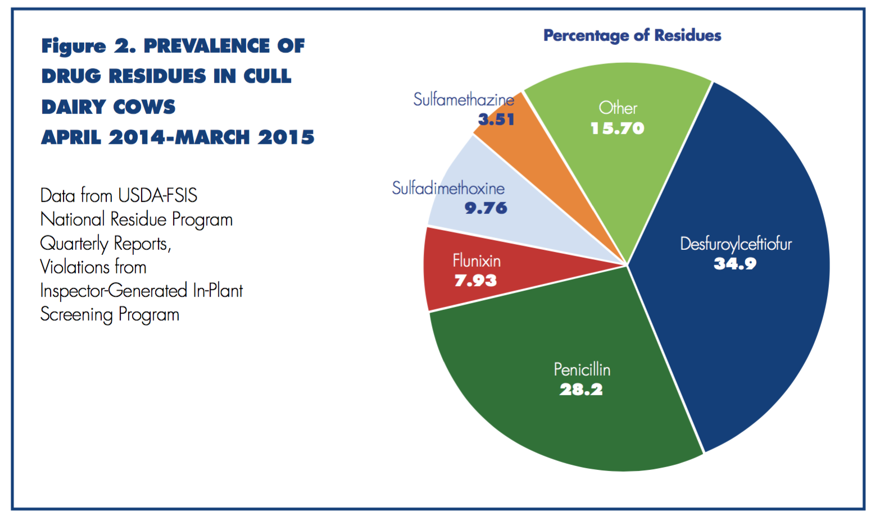
Notes:
Iowa 2016 Residue Manual Dairy Farm Program

Slide 10
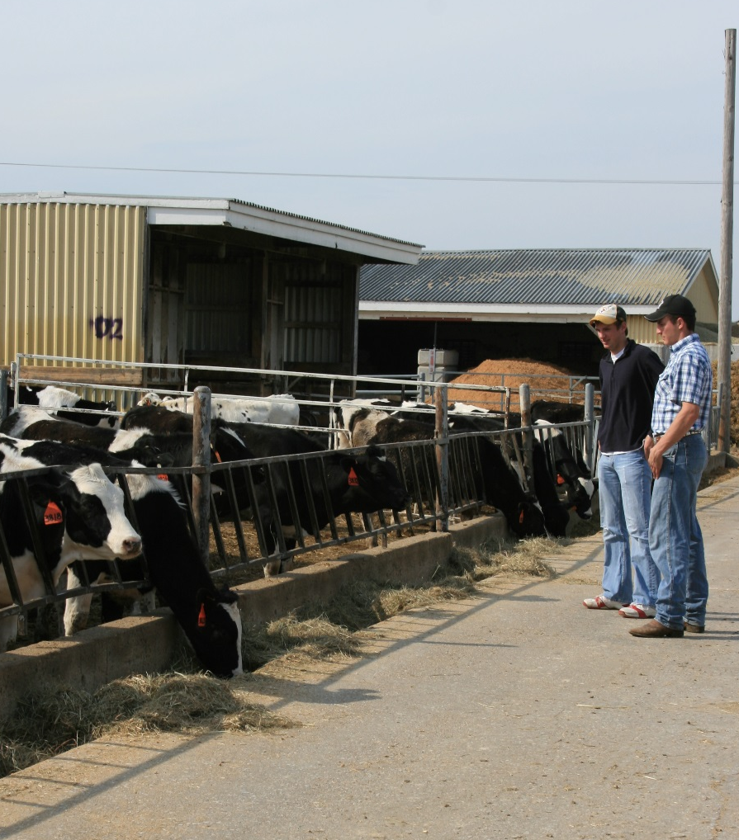
Prevention Practices
Veterinary-Client-Patient Relationship
Good Record Keeping
Avoid Extra-Label Drug Use
Proper Injection Techniques

Slide 11
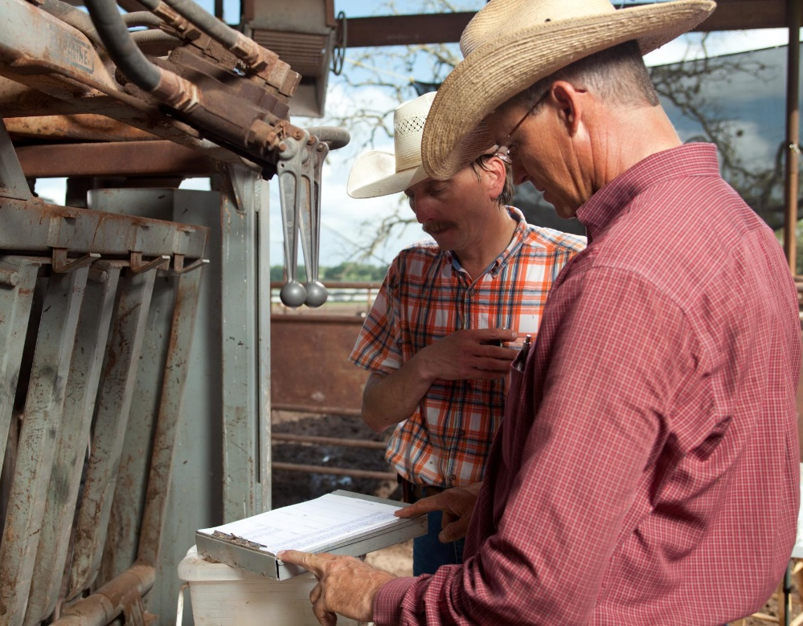
Veterinary-Client-Patient Relationship
It is important for a producer to have an ongoing relationship with an accredited veterinarian. This helps to ensure the veterinarian has assumed responsibility for making medical judgements regarding the health of the animal and need for medical treatment.

Slide 12
Record Keeping
Should your operation get cited for a residue violation and you believe it’s a case of mistaken identity, good records are your only evidence that the animal in question does not belong to you.
Records should include: treatment date, animal identification, name of employee administering the drug, drug administered, weight of animal, route of administration, disease being treated, withdrawal time and the first date the animal can be sent to slaughter.
Records should be kept at least two years.
Notes:
Should your operation get cited for a residue violation and you believe it’s a case of mistaken identity, good records are your best evidence that the animal in question does not belong to you.

Slide 13
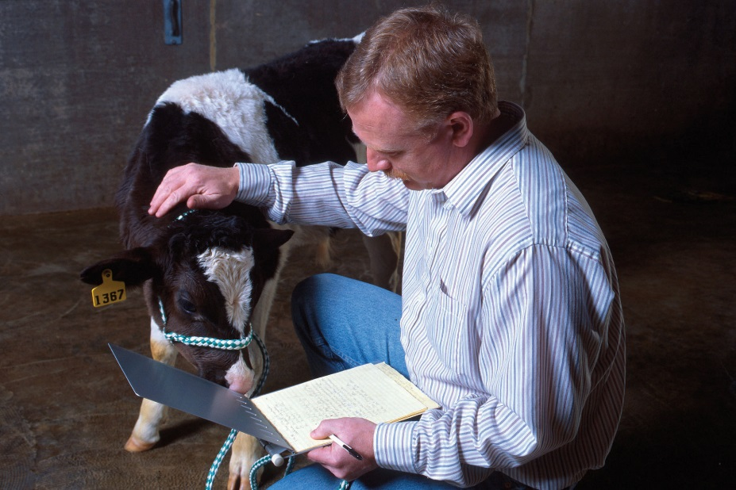
Avoid Extra-Label Drug Use
Extra-label drug use (ELDU) is the use of an animal drug in a manner that is different from label instructions in regard to:
^{the disease being treated}
route of administration of the drug
^{dosage of the drug}
^{recommended treatment regimen}
It is important to follow all labeled directions and withdrawal dates.
Notes:
Withdrawal time is the amount of time required for a drug or chemical concentration to fall below the Tolerance Level established in a specific target animal tissue. It is determined experimentally and dependent upon drug, dose, formulation, route of administration, species, target issue and disease/management factors. The time required for drug concentrations in all food animal tissues or products are below tolerance. Considerations include aesthetic considerations, risks perceived by the public, sensitive populations and issues, international relations and trade barriers
Extra-label drug use is a higher dose than the label, a different route or species than the label or a different disease that is being treated than indicated on the label.

Slide 14
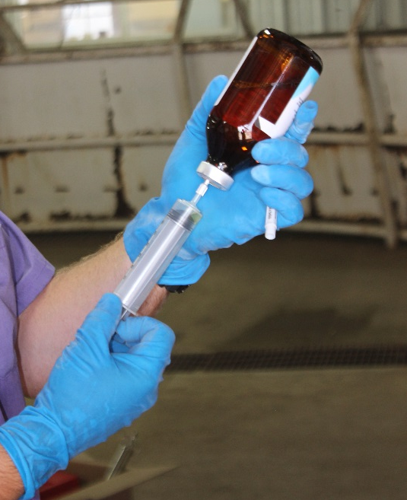
Injection Technique
Things to consider when giving an injection include:
Administer the shot in the neck
Inject subcutaneously when possible
Make sure the injection site is clean
Use the proper size needle based on: the location, route of administration, volume of injection and the thickness of the fluid
Do NOT use bent needles

Slide 15
What is a Veterinary Feed Directive (VFD)?
And
What is their part in drug residue avoidance?

Slide 16

What is a VFD?
A VFD is a written (nonverbal) statement issued by a licensed veterinarian that authorizes the use of a VFD drug in or on animal feed.

Slide 17
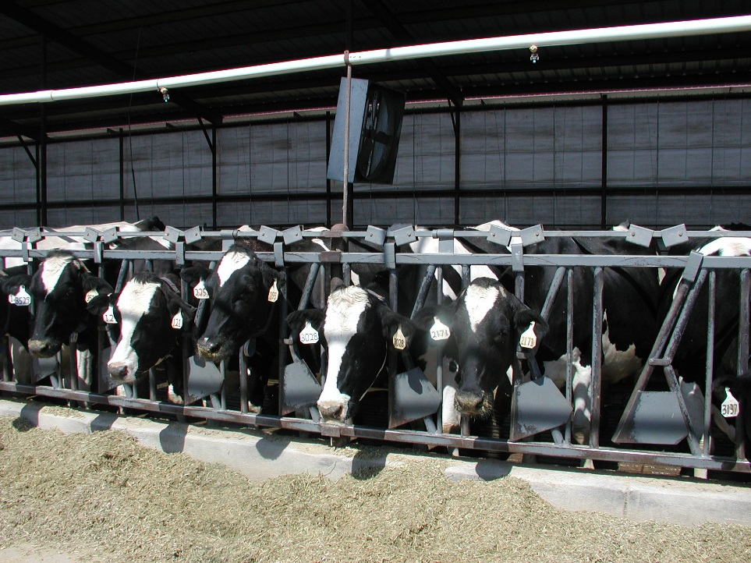
How are VFDs related to drug residue?
VFDs are part of the FDAs strategy to reduce the amount of drug residue in the meat. It is an action to promote the judicious use of medically important antimicrobial drugs in food animals.

Slide 18
Summary
Failing to practice good residue avoidance can lead to financial penalties and lead to poor public perception of the dairy industry. Good management practices along with following withdrawal times on VFDs helps reduce residue at milking and packing facilities. Remembering tips like having a good VCPR, practicing accurate record keeping, avoiding ELDU and having proper injection site techniques results in better milk and meat quality in the end.

Slide 19
Contact Us
Kansas Department of Agriculture
(785) 564-6601 or (785) 564-6778
agriculture.ks.gov/animalhealth
vfdinfo.org

