Slide 1


Food Safety and Lodging
1320 Research Park Drive
Manhattan, Kansas 66502

Slide 2
FOLLOW ALONG
Look for the booklet page #
Booklet Page #

Slide 3

PRESENTATION OVERVIEW
Introduction
Identifying Common Foodborne Illnesses
Food Microbiology
Protecting Food in Preparation
Consumer Advisory
Protecting Food in Serving
Safe & Clean
Corrective Actions
When to Call
Contacts
Helpful Websites
Booklet Page 1

Slide 4

POP QUIZ
Q. What ingredient/s of potato salad require refrigeration?
A. Potatoes, eggs.
Notes:
Commercially prepared mayo is acidic and inhibits bacterial growth and/or toxin formation. Many homemade mayos are also very acidic.

Slide 5
FOOD SAFETY IS…
Everyone’s Responsibility
In Your Hands
A Full-Time Job
Important
Booklet Page 2

Slide 6
FOODBORNE ILLNESS
Annual estimates for the United States
48 million illnesses
128,000 hospitalizations
3,000 deaths
$77 Billion cost to the economy
Booklet Page 5

Slide 7


THE REAL COST
Kyle 2003-2006
Died from E. coli O157:H7 at age 2 and a 1/2
Spinach
Shirley 1936-2008
Died from Salmonella at age 73
Peanut butter
Michael 2004
Died from Listeria monocytogenes
Emergency C-section at 30 weeks
Lettuce
Infected through the placenta
Source:StopFoodborneIllness.org

Slide 8
THE REAL COST
“Lauren Beth, age six years, ten months and ten days, died in my arms while on a life support system at San Diego's, highly respected, Children's Hospital, three days after Christmas on December 28th, 1992. Although at the time we did not know Lauren's true killer, we would soon come to the brutal reality of E. coli O157:H7.
For those of you not familiar with the carnage that E. coli O157:H7 can provide. It is an experience that none of us are prepared to endure, much less observe! Her struggle was valiant, but brutal. After excruciating pain, all of her main organs falling victim to this deadly toxin that is E. coli O157:H7. Three heart attacks, the first of which I was left helpless to witness. Her brain waves were no longer active. Her body was tormented and beaten. Her kidneys, liver and heart were ravaged. Lauren fell into a coma and was taken from my arms forever.”
– Roni (Lauren’s Mother)
Source:StopFoodborneIllness.org
Notes:
Give “Wait time/Weight time”, about 1 minute (English reading audience).

Slide 9
HAZARDS
Biological
Chemical
Physical
Bacteria, Viruses, Parasites
Cleaners, Degreasers, Sanitizers, Additives, Medicines
Glass, Metal Shavings, Fingernails, Jewelry
Notes:
Photo 1. Under a moderately-high magnification of 8000X, this colorized scanning electron micrograph (SEM) revealed the presence of a small grouping of Gram-negative Salmonella typhimurium bacteria that had been isolated from a pure culture.
Photo 2. Noodles stored in a hydraulic oil bucket
Photo 3. Screw found in a restaurant entrée.

Slide 10
BIOLOGICAL HAZARDS
Viruses
Bacteria
Parasites
Norovirus
E. coli
Trichinella spiralis
Hepatitis A
Salmonella
Listeria monocytogenes
Cyclospora
Cryptosporidium
Notes:
Photo 1. Norovirus particles
Photo 2. E. coli
Photo 3. Trichinella spiralis cysts in muscle cells

Slide 11
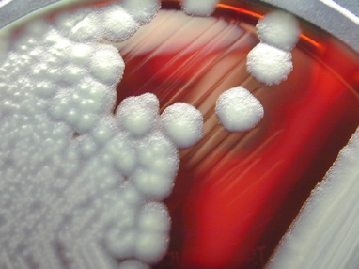
FOODBORNE ILLNESSES
Bacillus cereus
Onset
1-16 hours
Lasts
6-24 hours
Symptoms
Nausea, vomiting, cramping, diarrhea
Common Sources
Rice and rice dishes, vegetables, sauces
Prevention
Proper cooking, cooling, and reheating
Booklet Page 3

Slide 12
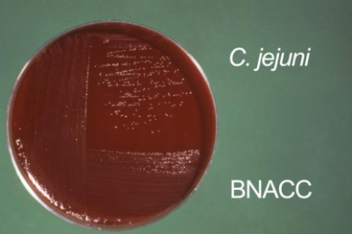
FOODBORNE ILLNESSES
Campylobacter
Onset
2-5 Days
Lasts
1-4 Days
Symptoms
Cramping, fever, diarrhea, nausea, headache, vomiting
Common Sources
Unpasteurized dairy, poultry, meats, infected food worker
Prevention
Proper cooking or pasteurization
Booklet Page 3

Slide 13
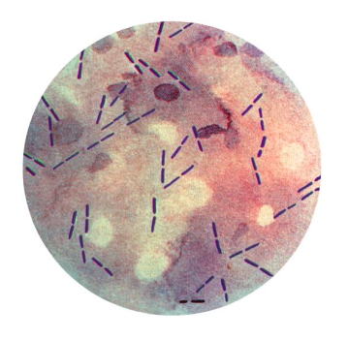
FOODBORNE ILLNESSES
Clostridium perfringens
Onset
8-24 Hours
Lasts
24-36 Hours
Symptoms
Cramping, diarrhea, nausea
Common Sources
Poultry, meats, beans, gravy, slow-cooked foods
Prevention
Proper cooking and reheating
Booklet Page 3

Slide 14
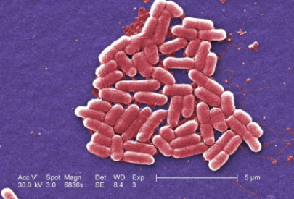
FOODBORNE ILLNESSES
Entero-hemorrhagic
E. coli
Onset
2-10 Days
Lasts
1-4 Days
Symptoms
Diarrhea (often bloody), severe cramping, nausea, vomiting
Common Sources
Raw and undercooked meats (especially ground beef), produce
Prevention
Proper cooking, prevent cross-contamination
Big 5
Booklet Page 3
Notes:
Have the class write “produce” in sources
Hemolytic Uremic Syndrome (HUS)-Kidney failure
10 cells can cause infection

Slide 15
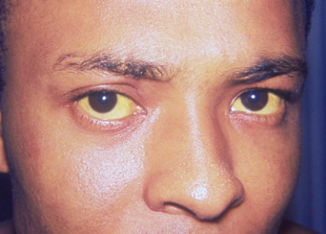
FOODBORNE ILLNESSES
Hepatitis A
Onset
10-50 Days
Lasts
1-2 Weeks to Several Months
Symptoms
Fever, fatigue, headache, nausea, loss of appetite, vomiting, abdominal pain, jaundice
Common Sources
Shellfish, ready-to-eat foods contaminated by a carrier
Prevention
Approved shellfish sources, handwashing, no bare-hand-contact with ready-to-eat foods, employee illness policy
Big 5
Booklet Page 3
Notes:
Ask “What is Jaundice? “

Slide 16
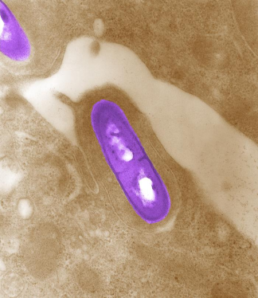
FOODBORNE ILLNESSES
Listeria monocytogenes
Onset
1 Day to 3 Weeks, up to 10 Weeks
Lasts
Depends on disease progression, may have permanent effects.
Symptoms
Nausea, vomiting, fever, chills, headache, meningitis, miscarriages
Common Sources
Unpasteurized dairy, cheese, vegetables, seafood, poultry, melons
Prevention
Hold refrigerated (<41° F) food less than 7 days, prevent cross-contamination
Booklet Page 3

Slide 17
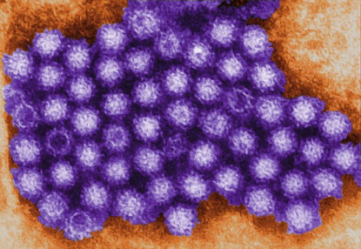
FOODBORNE ILLNESSES
Norovirus
Onset
24-48 Hours
Lasts
1-2 Days
Symptoms
Diarrhea, vomiting, nausea, cramping, fever, headache
Common Sources
Unpasteurized dairy, cheese, vegetables, seafood, poultry, melons
Prevention
Hold refrigerated (<41° F) food less than 7 days, prevent cross-contamination
Big 5
Booklet Page 3
Notes:
It only takes 10 Norovirus particles to cause infection. This photo would be about 6 doses. About 1,000 in the width of a human hair.

Slide 18
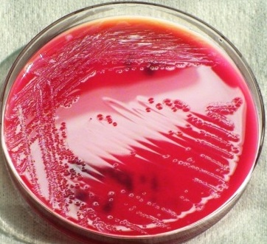
FOODBORNE ILLNESSES
Shigella
Onset
12 Hours to 7 Days
Lasts
4-7 Days
Symptoms
Diarrhea (often bloody), cramping, fever, nausea, headache, sometimes vomiting
Common Sources
Ready-to-Eat Foods from bare-hand-contact. Comes from human feces
Prevention
Good handwashing, no bare-hand-contact, approved food/water, control flies.
Big 5
Booklet Page 3

Slide 19
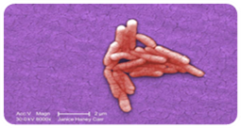
FOODBORNE ILLNESSES
Salmonella
Onset
6 Hours to 3 Days
Lasts
1-3 Days
Symptoms
Cramping, headache, nausea, diarrhea, fever, sometimes vomiting
Common Sources
Undercooked or raw animal foods, infected food workers
Prevention
Avoid cross-contamination, cook thoroughly, good handwashing
Booklet Page 3

Slide 20
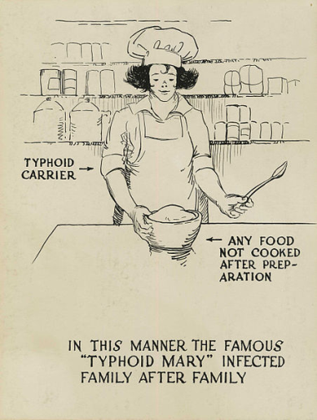
FOODBORNE ILLNESSES
Salmonella Typhi
Onset
3-60 Days, usually 8-14 Days
Lasts
2-4 Weeks
Symptoms
Fever, headache, malaise, loss of appetite, constipation (sometimes diarrhea), joint pain
Common Sources
Ready-to-Eat Foods from bare-hand-contact. Comes from human feces
Prevention
Good handwashing, no bare-hand-contact, approved food/water, Employee exclusion
Big 5
Booklet Page 3
Notes:
1000 cells can cause infection

Slide 21
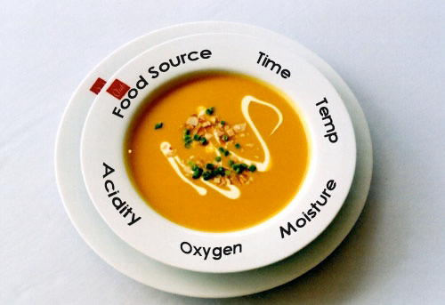
FOOD MICROBIOLOGY
Growth Conditions
  Food Source
  Acidity
  Time
  Temperature
  Oxygen
  Moisture
Booklet Page 8

Slide 22
TCS FOODS
Foods that require Time and Temperature Control for Safety (TCS)
Animal products
Heat-treated Starches
Special Produce
Booklet Page 7
Notes:
Potentially Hazardous Foods changing to Time/Temperature Control for Safety foods

Slide 23

TCS FOODS
Animal products
Meat, Poultry, Seafood, Dairy
Booklet Page 7

Slide 24

TCS FOODS
Heat treated Starches
Rice, Potatoes, Beans, Pasta, Vegetables
Booklet Page 7

Slide 25

TCS FOODS
Special Produce
Tofu, Sprouts, Cut Melons, Cut tomatoes, Garlic in Oil, Cut Leafy Greens
Booklet Page 7

Slide 26
TIME & TEMPERATURE
Temperature Danger Zone
41°F to 135°F
Rapid Bacterial Growth After 4 Hours
Booklet Page 8

Slide 27
THERMOMETERS
Use a Calibrated, Sanitized Temperature Measuring Device
Use approved sanitizer or single use alcohol wipe
Thin tip probe for thin foods
Hamburgers, chicken patties, etc.
Booklet Page 9

Slide 28
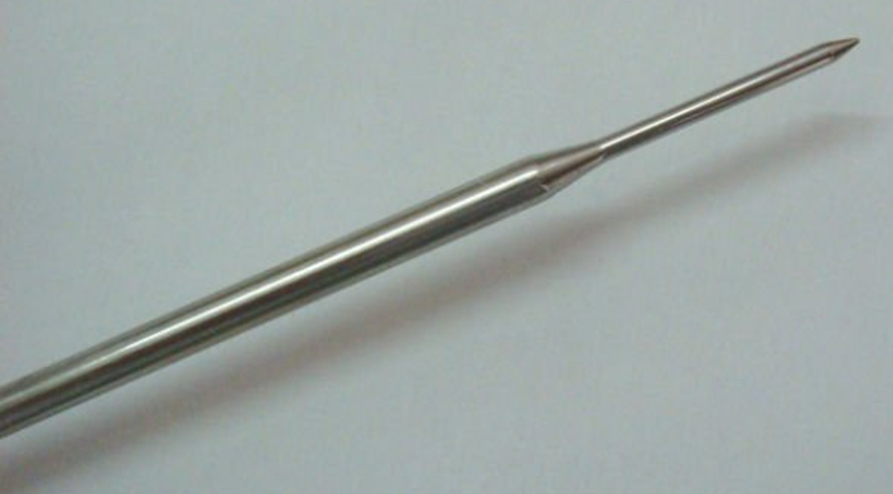
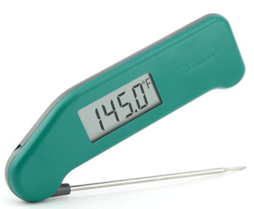
THERMOMETERS
Notes:
Thin tip is important for hamburgers and other thin foods.

Slide 29
CHECK FOR ACCURACY
Ice Slurry
Temperature should read 32°F
For metal stem thermometers, adjust the calibration nut to 32°F while in ice
Place thermometer stem in the ice slurry
Fill a cup full of small ice cubes
Add enough water to fill the spaces
Booklet Page 9

Slide 30
FOOD SAFETY RISK FACTORS
Food Source
Poor Personal Hygiene
Improper Holding
Contamination
Environmental Contamination
Inadequate Cooking
Booklet Page 4

Slide 31
FOOD SAFETY RISK FACTORS
FOOD SOURCE
Food from unapproved or uninspected source
Unsound or Adulterated food
Shellfish records not maintained properly
Booklet Page 4

Slide 32
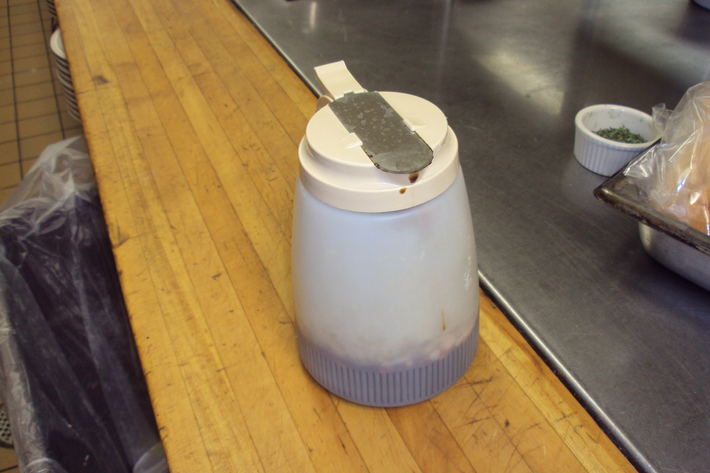
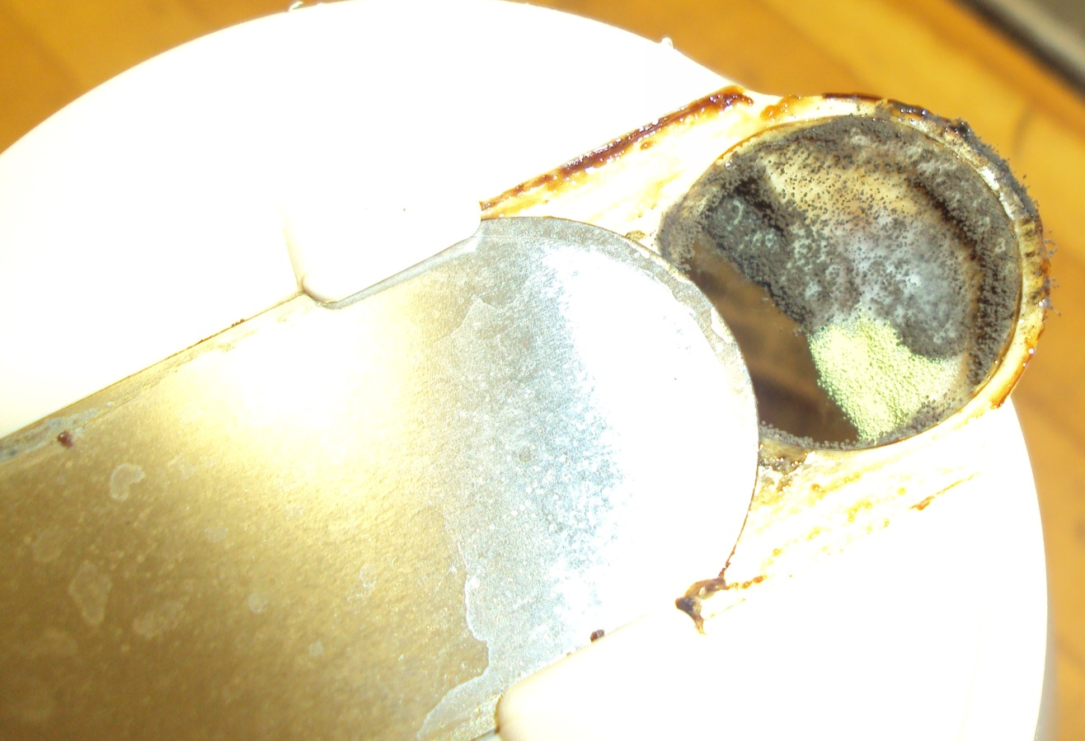
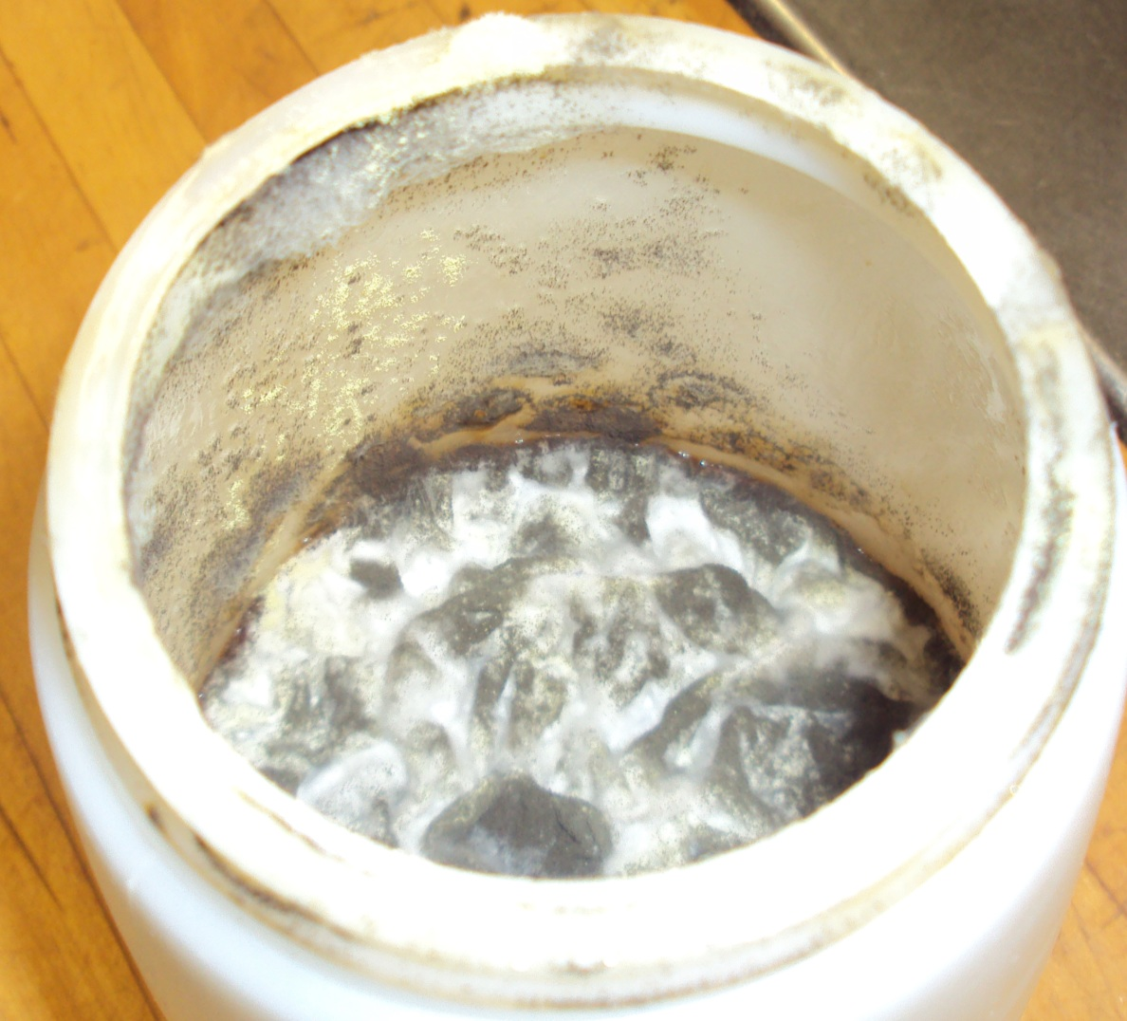
Notes:
Moldy syrup

Slide 33
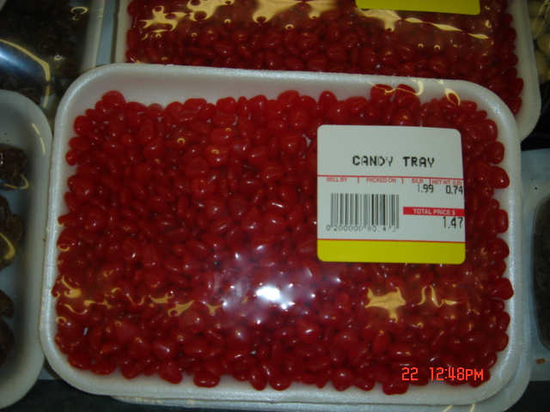
IMPROPER LABELING
Notes:
No common name, ingredients

Slide 34
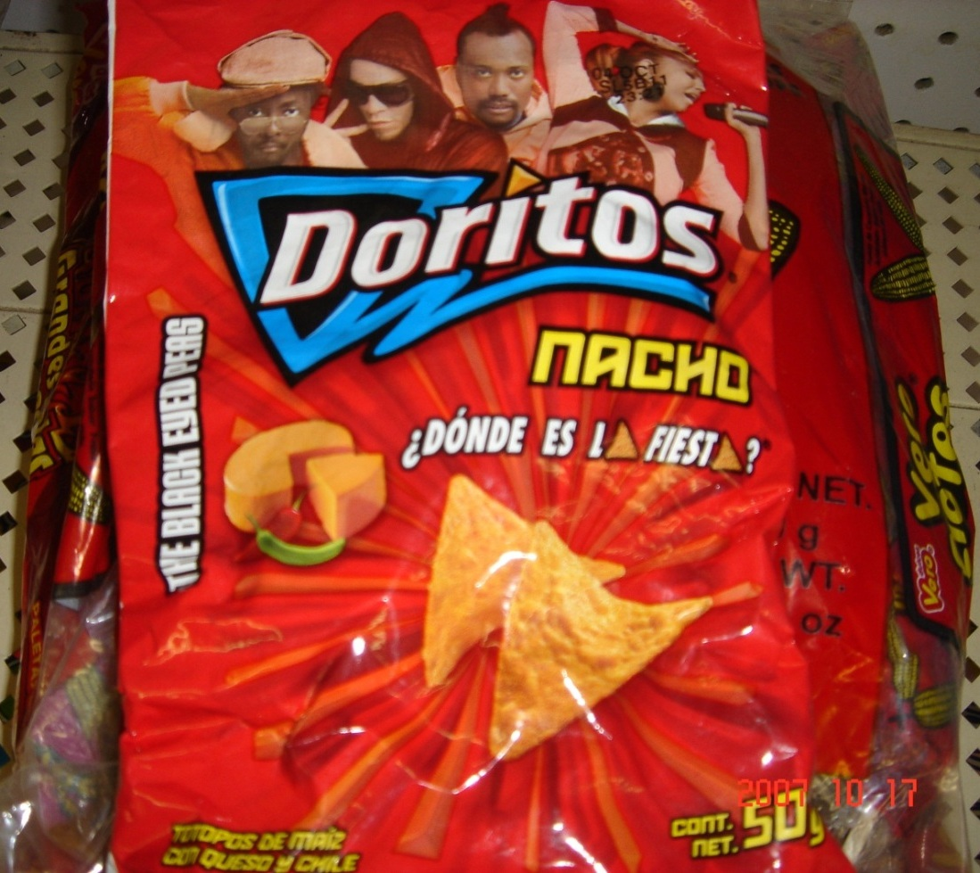
IMPROPER LABELING
Notes:
Not in English.

Slide 35
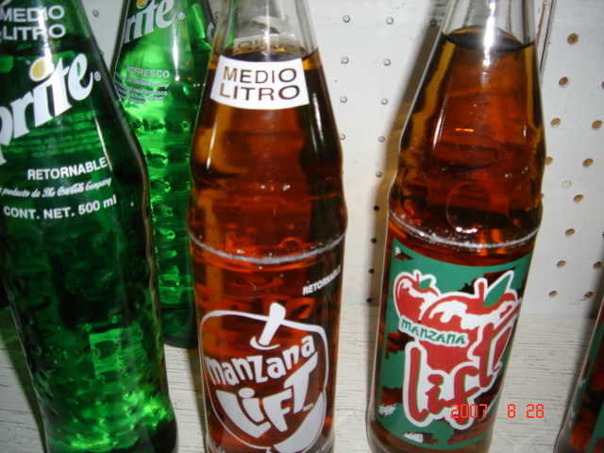
IMPROPER LABELING
Notes:
Not in English also.

Slide 36

IMPROPER LABELING
Notes:
Not in English also.

Slide 37
EMPLOYEE HEALTH
Employee Reporting to Employer
Employer Reporting to KDA
Certain Symptoms or Conditions (Big 5)
Certain Symptoms or Conditions (Big 5)
Booklet Page 6
Notes:
If any doubt, ask KDA.

Slide 38
EMPLOYEE HEALTH
Big 5
Salmonella Typhi
Shigella
Enterohemorrhagic E. coli
Hepatitis A
Norovirus
Booklet Page 6

Slide 39
EMPLOYEE HEALTH
Employee Restriction
Employee Exclusion
Booklet Page 6

Slide 40
EMPLOYEE HEALTH
Employee Restriction
Booklet Page 6
Notes:
What is Restriction?

Slide 41
EMPLOYEE HEALTH
Employee Restriction
Can’t work with food or equipment
Booklet Page 6

Slide 42
EMPLOYEE HEALTH
Restrict Employees
Fever
Sore Throat w/Fever*
Uncovered, Infected Wound (cut, lesion or boil)
No symptoms but diagnosed w/ Shigella, EHEC E. coli, Norovirus*
Booklet Page 6
Notes:
* HSP exclusions

Slide 43
EMPLOYEE HEALTH
Highly Susceptible Populations (HSPs)
Also restrict Employees when exposed to Big 5
Booklet Page 6
Notes:
* HSP exclusions

Slide 44
EMPLOYEE HEALTH
Removing Restrictions
See Food code 2-201.13
Booklet Page 6
Notes:
2-201.13 Removal of Exclusions and Restrictions.^{[4]}
Food employees diagnosed with Norovirus, hepatitis A virus, Shigella spp., E. coli O157:H7 or other EHEC, and symptomatic with diarrhea, vomiting, or jaundice, are excluded under subparagraph 2-201.12 (A)(2) or 2-201.12(B)(2). However these symptomatic, diagnosed food employees differ from symptomatic, undiagnosed food employees in the requirements that must be met before returning to work in a full capacity after symptoms resolve.
The person in charge may allow undiagnosed food employees who are initially symptomatic and whose symptoms have resolved to return to work in a full capacity 24 hours after symptoms resolve.
However, diagnosis with a listed pathogen invokes additional requirements before the person in charge may allow diagnosed food employees to return to work in full capacity.
Asymptomatic food employees diagnosed with Norovirus, Shigella spp., E. coli O157:H7 or other EHEC may not return to work in a full capacity for at least 24 hours after symptoms resolve. The person in charge shall only allow these food employees to work on a restricted basis 24 hours after symptoms resolve and they shall only allow this if not in a food establishment that serves a highly susceptible population. These restricted food employees remain restricted until they are medically cleared or otherwise meet the criteria for removal from restriction as specified under subparagraphs 2-201.13(D) (1)-(2); 2-201.13(E)(1)-(2); or 2-201.13(F)(1)-(2).
In a food establishment that serves a highly susceptible population, food employees who are diagnosed with Norovirus, Shigella spp., E. coli O157:H7 or other EHEC and initially symptomatic with vomiting or diarrhea, shall not work on a restricted basis after being asymptomatic for at least 24 hours. These food employees must remain excluded until they are medically cleared or otherwise meet the criteria for removal from exclusion from a highly susceptible population under subparagraph 2-201.13(D)(1)-(2), 2-201.13(E)(1)-(2), or 2-201.13 (F)(1)-(2).
Food employees diagnosed with hepatitis A virus are always excluded if diagnosed within 14 days of exhibiting any illness symptom, until at least 7 days after the onset of jaundice, or until medically cleared as specified under subparagraphs 2-201.13(B)(1)-(4).
Food employees diagnosed with hepatitis A virus are always excluded if diagnosed within 14 days of exhibiting any illness symptom, until at least 7 days after the onset of jaundice, or until medically cleared as specified under subparagraphs 2-201.13(B)(1)-(3). A food employee with an anicteric infection with the hepatitis A virus has a mild form of hepatitis A without jaundice. Food employees diagnosed with an anicteric infection with the hepatitis A virus are excluded if they are within 14 days of any symptoms. Anicteric, diagnosed food employees shall be removed from exclusion if more than 14 days have passed since they became symptomatic, or if medically cleared. Asymptomatic food employees diagnosed with an active infection with the hepatitis A virus are also excluded until medically cleared.
Food employees diagnosed with typhoid fever (caused by a Salmonella Typhi infection) are always excluded, even without expressing gastrointestinal symptoms, since these symptoms are not typically exhibited with typhoid fever. Outbreaks of foodborne illness involving typhoid fever (Salmonella Typhi) have been traced to asymptomatic food employees who have transmitted the pathogen to food, causing illness. The high virulence combined with the extremely high infectivity of S. Typhi warrant exclusion from the food establishment until the food employee has been cleared by a physician or has completed antibiotic therapy.
Despite lacking specific epidemiological evidence of transmission through food contaminated by food employees infected with E. coli O157:H7 or other EHEC/STEC bacteria are included with the 5 listed pathogens in the Food Code. This is because of the documented ease of transmission from person-to-person in a day care setting and because characteristics of foodborne outbreaks suggest a low infectious dose and the potential for the organism to be transmitted through food contaminated by soiled hands. The severity and consequences of infection, including hemolytic uremic syndrome (HUS), associated with Shiga toxin-producing E. coli warrant the institution of disease interventions.
Asymptomatic shedders are food employees who do not exhibit the symptoms of foodborne illness but who are identified through diagnosis, or laboratory confirmation of their stools to have Norovirus, or any one of the three bacterial pathogens identified in Chapter 2 in their gastrointestinal system.
The risk that food employees who are asymptomatic shedders will transmit a communicable disease varies depending upon the hygienic habits of the worker, the food itself and how it is prepared, the susceptibility of the population served, and the infectivity of the organism. Exclusion in a food establishment that serves a highly susceptible population affords protection to people who are immune-suppressed. Restriction in a food establishment that does not serve a highly susceptible population affords protection for the general population and the immune-suppressed subset of the general population provided there is adequate attention to personal hygiene and avoidance of bare-hand contact with RTE foods.
To minimize the risk in all food establishments of the transmission of foodborne disease by an asymptomatic shedder and based on the factors listed above, all known asymptomatic shedders of the three bacterial pathogens are either restricted or excluded, depending on the population served. Requiring restriction for asymptomatic shedders of all three of the bacterial pathogens results in a uniform criterion and is consistent with APHA-published recommendations in the "Control of Communicable Diseases Manual."

Slide 45
EMPLOYEE HEALTH
Employee Exclusion
Booklet Page 6
Notes:
What is Exclusion?

Slide 46
EMPLOYEE HEALTH
Employee Exclusion
Can’t work in the facility
Booklet Page 6

Slide 47
EMPLOYEE HEALTH
Exclude Employees
Diarrhea
Jaundice
Diagnosis:
S. Typhi or Typhoid fever
Hepatitis A
Vomiting
Booklet Page 6

Slide 48
EMPLOYEE HEALTH
Highly Susceptible Populations (HSPs) - also exclude Employees when:
Sore throat w/ fever
Diagnosed w/ Big 5
Booklet Page 6

Slide 49
EMPLOYEE HEALTH
Removing Exclusions
See Food code 2-201.13
Booklet Page 6

Slide 50
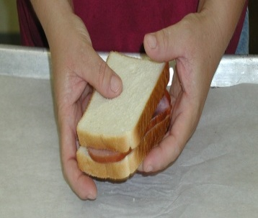
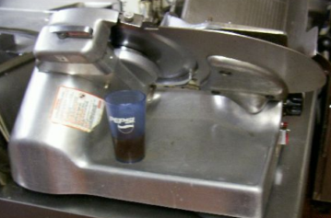
FOOD SAFETY RISK FACTORS
POOR PERSONAL HYGIENE:
Lack of appropriate hand washing
Bare hand contact with ready-to-eat foods
Ill food workers
Employees eating, drinking or using tobacco in food areas
Inadequate hand sink
Lack of soap or paper towels
Booklet Page 4

Slide 51
PRACTICE GOOD HYGIENE
Sick employees can spread illness
Enforce sick leave policy or reassign duties
Dry hands with paper towels
Don’t eat, drink, chew gum, or use any form of tobacco in food areas
Wash hands only in the hand sink
Don’t use dishwashing, food preparation or mop sinks for handwashing
Designate non-work areas for breaks
Don’t use common cloth towels, wiping cloths, or aprons for hand wiping
Does Mr. Yucky work in your kitchen?
Booklet Page 10

Slide 52
PRACTICE GOOD HYGIENE
Wear nails short, clean and unpolished
Restrict rings to plain bands
No bare hand contact with ready-to-eat food!
Cover open cuts and burns with bandages and finger cots or single-use gloves
Does Mr. Yucky work in your kitchen?
Booklet Page 10

Slide 53
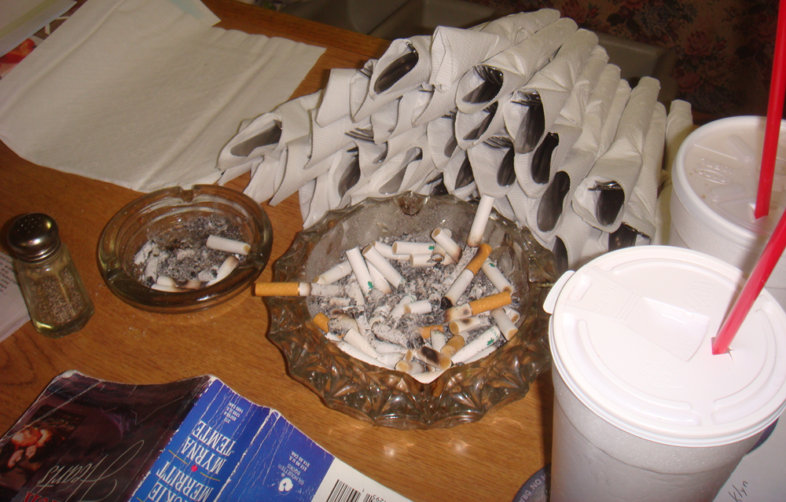
PRACTICE GOOD HYGIENE

Slide 54
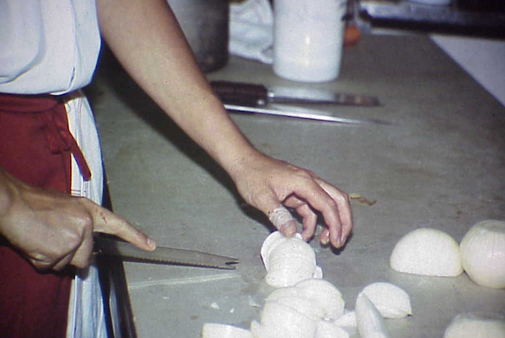
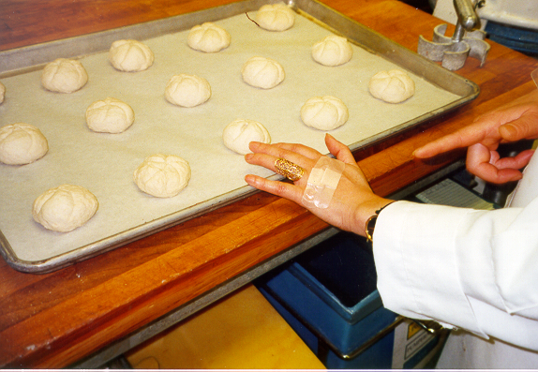
PRACTICE GOOD HYGIENE
Notes:
Need to cover bandages

Slide 55
FOOD SAFETY IS IN YOUR HANDS
Wash your Hands After:
Going to the Restroom
Handling money
Handling raw food
Using a tissue
Eating or Smoking
Touching hair, face, other body parts
Handling dirty dishes
Handling trash
Booklet Page 11

Slide 56
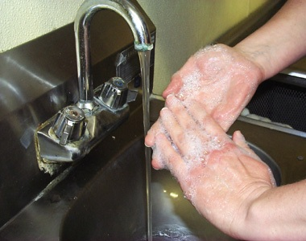
HANDWASH PROCEDURE
Wet under warm water
Apply Soap
Scrub for 10-15 seconds
Rinse with warm water
Use paper towel to dry, turn off water, open door
Booklet Page 11

Slide 57
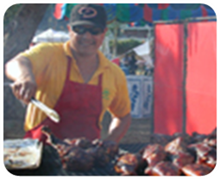
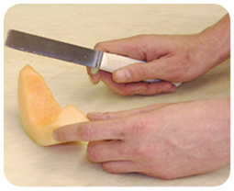
NO BARE HAND CONTACT
Must not touch Ready-to-Eat food with bare hands (RTE)
Use
Deli Tissue
Spatulas
Tongs
Forks
Dispensing Equipment
Single-Use Gloves
Booklet Page 12

Slide 58
GLOVE USE
Wash hands before putting on gloves
Put gloves on only when you are ready to handle ready-to-eat food
Use gloves for only one task, such as ready-to-eat foods, then discard
If an interruption occurs during food preparation, remove gloves’
Use clean gloves when you resume food preparation
Glove usage does not replace the need for good hand washing practices
Booklet Page 12

Slide 59
GLOVE USE
Avoid single-use gloves made of natural rubber latex
Fabric or re-usable gloves may not be used with RTE food
Gloves are susceptible to contamination, so discard when soiled or damaged
Single-use gloves should not be used around heat or hot fats
Dispose of gloves immediately upon removal
Booklet Page 12

Slide 60
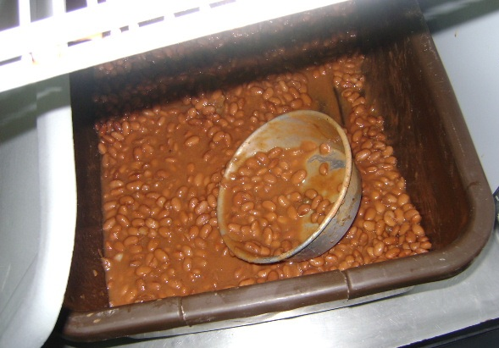
IS THIS OK?
Notes:
No handle, hands can contaminate the food

Slide 61
FOOD SAFETY RISK FACTORS
INADEQUATE COOKING:
Improper cooking temperatures
Improper reheating temperatures
Booklet Page 4

Slide 62
CRITICAL TEMPERATURES
165°F - Poultry, stuffed meats and pasta, reheating
155°F - Ground beef or pork (tenderized or injected meats)
145°F - Whole muscle meat (beef, pork) or fish
135°F - MINIMUM HOT HOLDING
130°F - Rare roast beef
DANGER ZONE!
41°F - MAXIMUM COLD HOLDING
32°F - Freezing
0°F - Frozen Food Storage
Booklet Page 15
Notes:
What’s a degree among friends? (+/- 2 degrees accuracy)

Slide 63

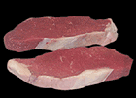

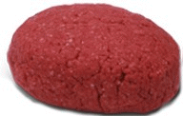
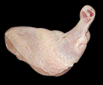
Safe Cooking Temperatures
145°F - Intact Fish, Beef, Pork and Eggs
155°F - Non-intact Fish, Beef, Pork, Pooled Eggs
165°F - Raw Poultry
Notes:
To Summarize, people can die when food is not properly cooked. The only way to know is to check with an accurate thermometer.

Slide 64
IS IT DONE?
Eyeball test
Picture courtesy of the Kansas State University Meat Science Program.

Slide 65
Notes:
55°C = 131°F

Slide 66
IS IT DONE?
NO!
Eyeball test
  Ground beef may turn brown below 155°F
Picture courtesy of the Kansas State University Meat Science Program.

Slide 67

IS IT DONE?
NO!
Poke test

Slide 68

THE ONLY WAY
Thin-tip probe for thin patties or small pieces
Notes:
Small holes, minimal juice loss. Check multiple areas.

Slide 69
CONSUMER ADVISORY
You must advise consumers of the risks of eating raw or undercooked:
Hamburgers
Fish
Pork
Eggs
Lamb
Poultry
Shellfish
Booklet Page 16
Notes:
Egg nog, homemade ice cream, Caesar salad, Hollandaise sauce, etc.

Slide 70
CONSUMER ADVISORY
Disclosure
Reminder
Consumer Advisory
Booklet Page 16

Slide 71
CONSUMER ADVISORY
Disclosure
A description of the animal-derived FOODS
“oysters on the half shell (raw oysters),”
“raw-EGG Caesar salad,” and
“hamburgers (can be cooked to order);” OR
Identification of the animal-derived FOODS by asterisking them to a footnote that states the items are served raw or undercooked, or contain (or may contain) raw or undercooked ingredients.
Booklet Page 16
Notes:
Either option satisfies the disclosure requirement.

Slide 72
CONSUMER ADVISORY
Regarding the safety of these items, written information is available upon request;
Consuming raw or undercooked MEATS, POULTRY, seafood, shellfish, or EGGS may increase your RISK of foodborne illness; or
Consuming raw or undercooked MEATS, POULTRY, seafood, shellfish, or EGGS may increase your RISK of foodborne illness, especially if you have certain medical conditions.
Reminder
Asterisk to a footnote
Booklet Page 16

Slide 73
CONSUMER ADVISORY
Menu
Table Tent
agriculture.ks.gov
Brochures
Sign
Deli Case
Booklet Page 17
Notes:
Templates available at agriculture.ks.gov

Slide 74
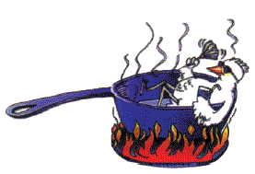
REHEATING
Reheat previously cooled foods to an internal temperature of 165°F or above
41°F to 165°F in less than 2 hours
Stir frequently to distribute the heat
Measure the internal temperature with a thermometer
After reaching 165°F, hold at 135°F or above
Booklet Page 23

Slide 75
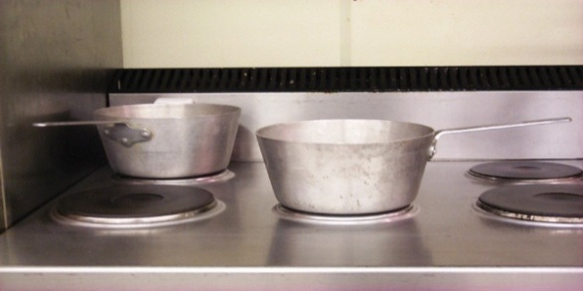
REHEATING
Direct heat (stove top) is best
Steam cookers
Ovens
Microwaves
Reheating in steam tables and crock pots is unsafe
Booklet Page 23

Slide 76
FOOD SAFETY RISK FACTORS
IMPROPER HOLDING:
Improper cold/hot holding temperatures
Lack of date marking
Booklet Page 4

Slide 77
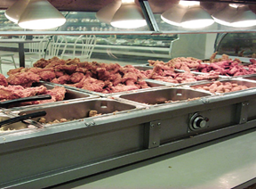
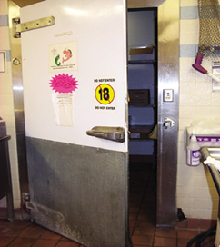
HOT & COLD HOLDING
Hold cold food at 41°F or below
Hold hot foot at 135°F or above
Use proper equipment
Stir frequently to distribute the temperature
Covered foods maintain temperature longer
Booklet Page 20

Slide 78
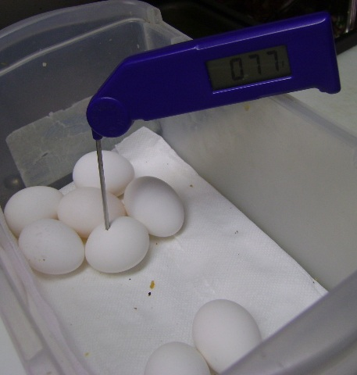
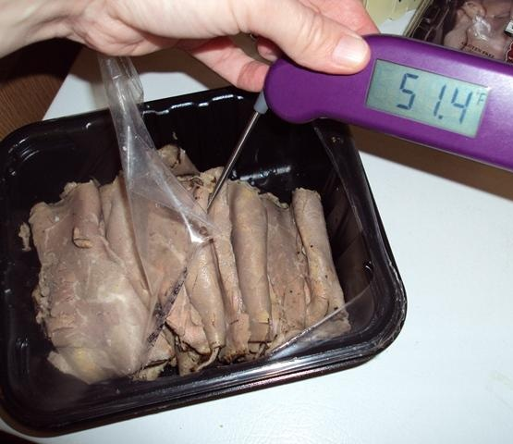
TOO WARM

Slide 79
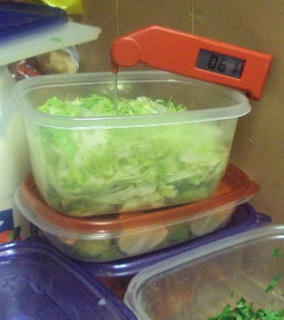
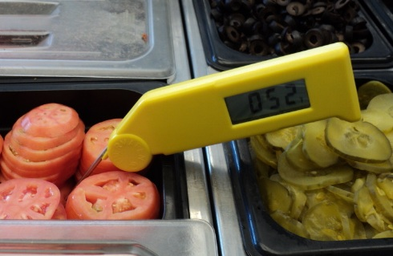
TOO WARM

Slide 80
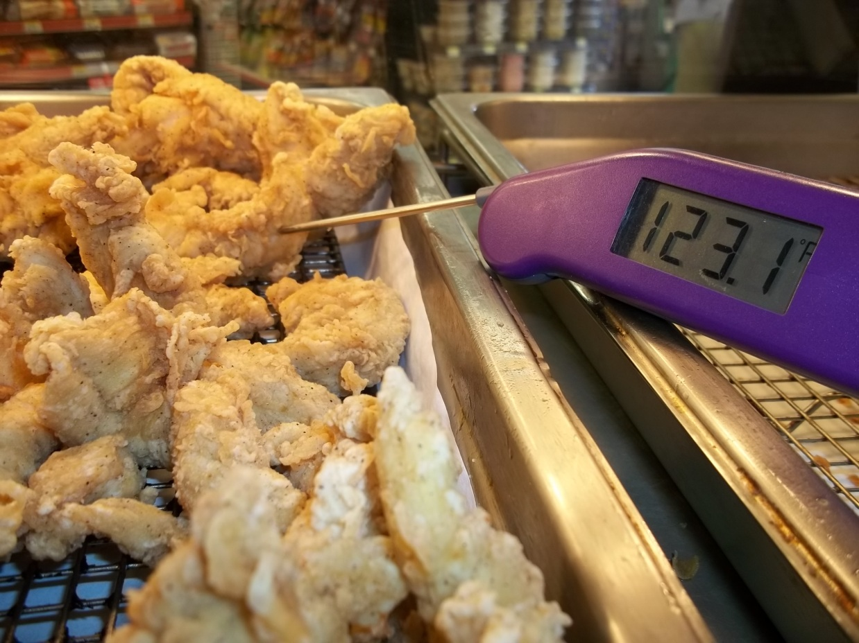
TOO COOL
Notes:
Mention Time as Public Health Control as possible option

Slide 81
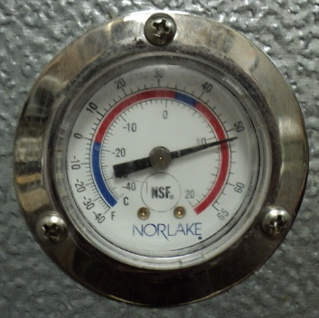
OK?
Notes:
Possible defrost cycle-need to monitor temps closely.

Slide 82
SAFE BUFFETS
Take food temperatures every 2-3 hours. If food is in the Temperature Danger Zone, take corrective actions (REHEAT, QUICK CHILL or DISCARD)
Determine why the food was in TDZ
Stir foods frequently to distribute temperature. Do not add fresh food to old. “First In, First Out”
Booklet Page 19

Slide 83
SAFE BUFFETS
Trained food employees must monitor self-service food bars
Require customers to use clean plates and bowls for return trips to the food bar
Post signs
Protect food from contamination
Proper serving utensils
Sneeze guards
Label foods
Booklet Page 19

Slide 84
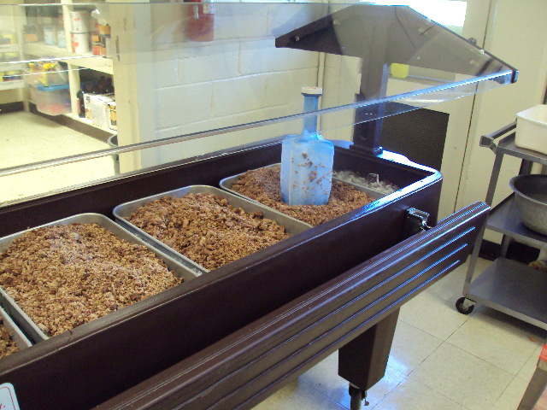
COOLING OR HOLDING?

Slide 85
THAWING
In a refrigerator
Running
During cooking
Continuous process
Microwave
Submerged
First step in a continuous process
Less than 2 hours
The best way
Cold Water (<70°F)
Booklet Page 18

Slide 86
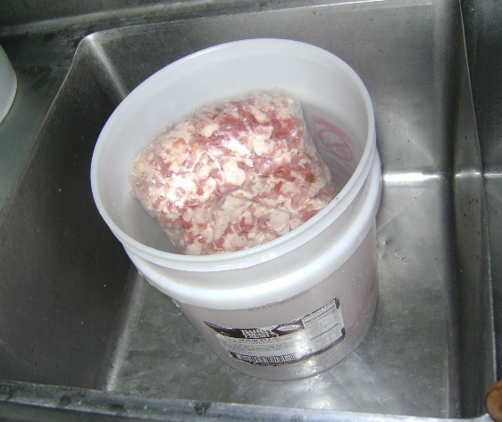
WHAT’S WRONG?
Notes:
Need to use running, cold water. Drain may also be blocked. Must be an indirect drain connection.

Slide 87
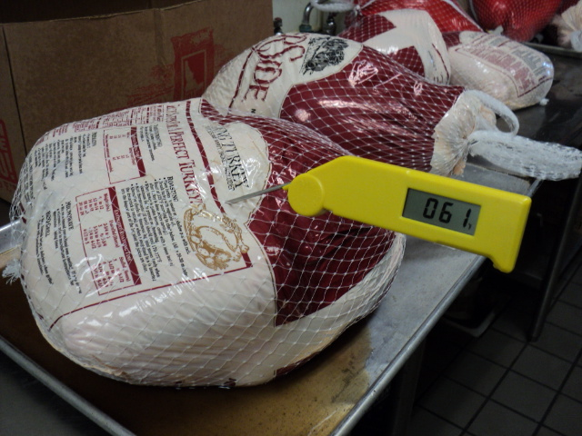
WHY IS THIS WRONG?
Notes:
Thawing on the counters.

Slide 88
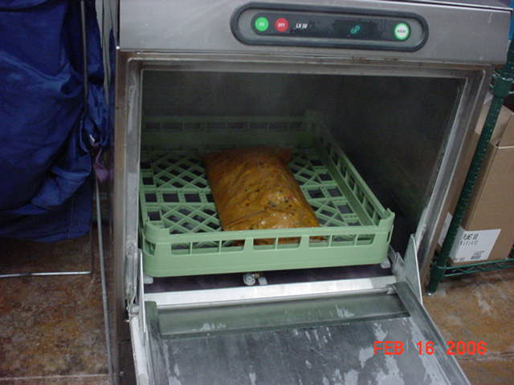
WHY IS THIS WRONG?
Notes:
Thawing in dishwasher

Slide 89
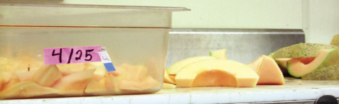
DATE MARKING
Prepared on-site and refrigerated, or commercially processed after the original container is opened
Held for more than 24 hours
Hold up to 7 days at 41°F or less
Mark With the Date To Be Consumed By or Discarded
Day 1 is prep or open date (add 6 to the date)
What foods?
Potentially hazardous, Ready-to-eat
How long?
Booklet Page 21

Slide 90
DATE MARKING
When removed from the freezer
Mark to consume within 24 hours
Mark with remaining days-subtract days held in cooler before freezing
Booklet Page 21

Slide 91
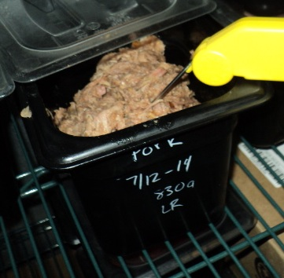
OK?
Notes:
Yes, make sure the writing is completely removed during warewashing. Be clear in writing. 14 is OK, 19 would be too long.

Slide 92
COOLING
From 135°F to 41° in less than 6 hours
From 135°F to 70° in the first 2 hours
Room temperature ingredients to 41°F in less than 4 hours
Booklet Page 22

Slide 93
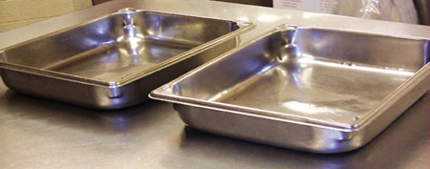
COOLING
Shallow metal pans - 2” - 4” deep
Leave pan partially uncovered
Refrigerate immediately
DO NOT stack hot pans - allow for air flow
Booklet Page 22

Slide 94
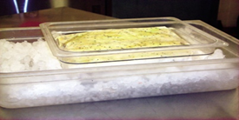
COOLING
Ice Bath
Fill a clean sink or large pan with ice and fill spaces with cold water
Divide product into 1 gallon containers
Immerse product pan to depth of product in sink or larger pan until it is level with the ice
Agitate/stir every 10 minutes using an ice paddle or other equipment
Drain water and replenish ice as it melts
Use a clean thermometer to monitor the temperature of the food
Refrigerate immediately after the food has cooled to 41°F
Booklet Page 22
Notes:
Plastic pans shown for clarity-use metal in real life for better heat transfer

Slide 95
COOLING
Small Portions - reduce the mass/volume
Divide food into smaller pans
Separate food into smaller or thinner portions (2” depth for thick foods/ 4” for thick liquids)
Cut or slice portions of meat no larger than 4 inches or 4 pounds
Booklet Page 22

Slide 96
COOLING
Hints
Add ice directly to the product as an ingredient
Use rapid chill refrigeration equipment that encourages quick cooling
Never try to cool foods in plastic containers
Never allow foods to cool at room temperature
Booklet Page 22

Slide 97
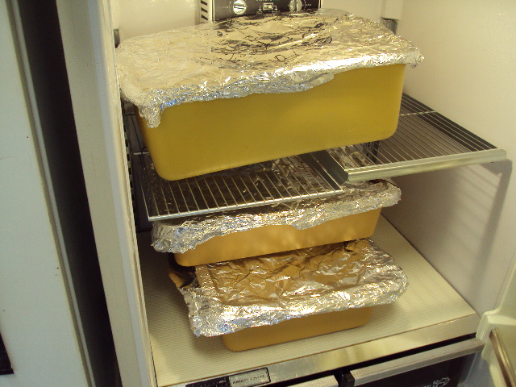
WILL IT COOL IN TIME?
Notes:
Large mass, completely covered, old refrigerator.

Slide 98
FOOD SAFETY RISK FACTORS
CONTAMINATION:
Raw animal products not separated from ready-to-eat foods
Species not separated
Equipment not properly cleaned and sanitized
Booklet Page 4

Slide 99



AVOID CROSS CONTAMINATION
Incorrect
Correct
Use Separate Cutting Boards for Raw Meats & Cooked or Ready-to-Eat Foods
Booklet Page 13

Slide 100
AVOID CROSS CONTAMINATION
Store food properly to prevent cross contamination that can lead to Foodborne Illness.
Booklet Page 14

Slide 101


WHAT’S WRONG?
Notes:
Raw sausage over RTE meats
Raw ground beef touching RTE tortillas and over cooked meats

Slide 102
AVOID CROSS CONTAMINATION
Clean and sanitize all utensils and surfaces that touch food:
  after each use
  when changing product
  between raw animal types (beef, pork, fish, etc.)
  frequently when preparing large amounts
  between raw meats and cooked or ready-to-eat foods
Booklet Page 13

Slide 103
CLEAN & SANITIZE
Items must be clean to the sight and touch
Items must be sanitized after cleaning
Booklet Page 24

Slide 104


IS IT CLEAN?
Notes:
French Fry cutter, cappuccino machine

Slide 105


IS IT CLEAN?
Notes:
Meat slicer (Listeria biofilms), can opener blade

Slide 106


MOLDY SODA NOZZLE

Slide 107

MOLDY ICE BIN

Slide 108

3-COMPARTMENT SINK
Scrap
Wash
Rinse
Sanitize
Air Dry
Booklet Page 24

Slide 109

3-COMPARTMENT SINK
Scrap
  Remove scraps so cleaning is more effective
Booklet Page 24

Slide 110
3-COMPARTMENT SINK
Wash
  Clean and sanitize sinks and drain boards
  Pre-soak/pre-rinse all eating utensils and equipment
  Use 110°F water and detergent
Booklet Page 24
Notes:
Remove all soils and grease so sanitizing is effective

Slide 111
3-COMPARTMENT SINK
Rinse
  Use clean, 110°F water
Booklet Page 24

Slide 112
3-COMPARTMENT SINK
Sanitize
  50-200 parts per million (ppm) chlorine
  200 ppm quaternary ammonia (mix with 75°F water)
  25 ppm iodine
  Use correct immersion time
  Air dry utensils and equipment
  Use appropriate test strips to check concentration
Booklet Page 24
Notes:
10 seconds for chlorine
30 seconds for quat or iodine
Follow sanitizer manufacturer’s directions-Read the Label

Slide 113


CHECK THE CONCENTRATION
Notes:
Chemical Supplier will have test strips for your sanitizer

Slide 114
3-COMPARTMENT SINK
Making a 100 ppm Chlorine Solution is as Easy as 1-2-3
  1 ounce of plain bleach to 3 gallons water
  Read the label to confirm!
Booklet Page 24
Notes:
10 seconds for chlorine
30 seconds for quat or iodine
Follow sanitizer manufacturer’s directions-Read the Label

Slide 115
3-COMPARTMENT SINK
Air Dry
  Allows sanitizer to continue working
  Prevents cross contamination
  Use clean, self-draining location.
Booklet Page 24

Slide 116
DISHMACHINE
High Temperature
  Wash Temperature:
    Single tank, stationary rack, dual temperature machine is 150°F
    Single tank, conveyor machine is 160°F
  Hot Water Sanitization:
    180°F at manifold
    160°F at plate level
Booklet Page 24

Slide 117
DISHMACHINE
Low Temperature
  Chemical Sanitization Required
  Water Temperatures According to Manufacturer
  Chemicals Must Be Auto-dispensed into Final Rinse Water
    Check Daily
  Must Have a Visual or Audible Low Sanitizer Indicator
Booklet Page 24

Slide 118
DISHMACHINE
Air Dry
  Allows sanitizer to continue working
  Prevents cross contamination
  Use clean, self-draining location.
Booklet Page 24

Slide 119

IS THIS OK?
Notes:
Washing potatoes in a dishwasher

Slide 120


POOR CONDITION

Slide 121


PROPER STORAGE?

Slide 122

WHAT’S WRONG?
Notes:
Compartments too small, clutter, chemical

Slide 123
FOOD SAFETY RISK FACTORS
ENVIRONMENTAL CONTAMINATION:
Improper storage, labeling, or usage of chemicals
Presence of insects or rodents
Lack of potable water
Improper sewage disposal
Booklet Page 4

Slide 124



PEST CONTROL
Insects and rodents carry diseases and can contaminate food and food-contact surfaces. Utilize measures to minimize their presence
Protect outer openings
  outer doors closed, repair screens, maintain tight fitting doors & openings, use air curtains
Eliminate harborage conditions
Use Integrated Pest Management practices
Booklet Page 25

Slide 125



WHAT’S WRONG?
Notes:
Pet, harborage

Slide 126


CHEMICALS
These Items Can Be Poisonous Or Toxic If Ingested
  Detergents
  Sanitizers
  Polishes & Cleaners
  Insecticides
  Rodenticides
  First Aid Supplies & Personal Medication
Booklet Page 25

Slide 127
CHEMICALS
Storage, Labeling & Use
  Store separately from foods & food-contact surfaces
  Never store above foods or food surfaces
  Label all toxins
  Use only approved chemical in food areas
Booklet Page 25

Slide 128


OK?
Notes:
Unapproved pesticide stored with food, chemical on food prep table.

Slide 129


WHAT’S WRONG?
Notes:
Rodent bait not in tamper resistant covered bait station

Slide 130
LABEL THE BOTTLE
“This material mistaken for flour contains 92.6% sodium fluoride. It was responsible for the death of one person and the illness of approximately thirty others.” 1944
Notes:
1944 at a Topeka hotel.

Slide 131


LABEL THE BOTTLE
Notes:
Unlabeled working container on left.
Blue sno cone story

Slide 132

HARBORAGE

Slide 133

WHAT’S WRONG?
Notes:
Chemical storage, rags

Slide 134

WATER SOURCE
Water from a Public Water Supply
Water from a Private Water Supply
  Appropriate well construction
  Water tested for:
    total coliforms (0 CFU)
    fecal coliforms (0 CFU)
    nitrates (<20 PPM)

Slide 135
PLUMBING
Backflow prevention
Protect water supply
Proper installation
Air gap or Backflow preventer
Protect equipment
Indirect drain connection
Notes:
Soda machine carbonator with dual check valve and intermediate vent

Slide 136

PROPER PLUMBING?

Slide 137


PROPER PLUMBING?
Notes:
Left-Backflow device (Atmospheric Vacuum Breaker) with shut off valves downstream, improper installation
Right-No backflow prevention. Also mold from overspray

Slide 138
CORRECTIVE ACTIONS
Risk Factor: Approved Source/Sound Condition | Corrective Action
Food from unapproved/unlicensed source or in unsound condition | Discard Reject Return
Booklet Page 26

Slide 139
CORRECTIVE ACTIONS
Risk Factor: Handwashing | Corrective Action
Food worker failed to wash hands as needed | Instruct worker about handwashing Discard any contaminated food
Booklet Page 26

Slide 140
CORRECTIVE ACTIONS
Risk Factor: Cold Holding | Corrective Action
TCS Food above 41°F for MORE than 4 hours | Discard
TCS Food above 41°F for LESS than 4 hours | Use immediately Cool below 41°F before total time reaches 4 hours
Booklet Page 26

Slide 141
CORRECTIVE ACTIONS
Risk Factor: Cooking | Corrective Action
Raw Animal Food is undercooked | Continue Cooking process until minimum temperature is reached See page 15 for Temperatures
Booklet Page 26

Slide 142
CORRECTIVE ACTIONS
Risk Factor: Hot Holding | Corrective Action
TCS Food below 135°F for MORE than 4 hours | Discard
TCS Food below 135°F for LESS than 4 hours | Use immediately Reheat to 165°F before total time reaches 4 hours
Booklet Page 26

Slide 143
CORRECTIVE ACTIONS
Risk Factor: Cooling | Corrective Action
TCS Food cooled from 135°F to 70°F in MORE than 2 hours | Discard
TCS Food cooled from 135°F to 41°F in MORE than 6 hours | Discard
Room temperature TCS Food ingredients cooled to 41°F in MORE than 4 hours | Discard
Booklet Page 26
Notes:
Monitor the process so there is time to make corrections. This also helps you establish when a process is not working.

Slide 144
CORRECTIVE ACTIONS
Risk Factor: Reheating | Corrective Action
TCS Food heated from 41°F to 165°F in MORE than 2 hours | Discard
Booklet Page 26
Notes:
Same as cooling, Monitor the process so there is time to make corrections. This also helps you establish when a process is not working.

Slide 145
CONTACT KDA
Prior to opening food operations
For plan review prior to construction or remodeling
For licensing or inspection inquiry
To Report
Change of ownership or location
Natural disasters involving food
Power outages of 2 hours or more
Transportation accident involving food
Food establishment complaint
Foodborne illness outbreak
To request an educational seminar
Reportable employee illness
Booklet Page 27

Slide 146
CONTACT KDA
KANSAS DEPARTMENT OF AGRICULTURE
FOOD SAFETY AND LODGING
1320 Research Park Drive
Manhattan, KS 66502
Telephone: (785) 564-6767
Fax: (785) 564-6779
agriculture.ks.gov
Booklet Page 27

Slide 147

UNSANITARY
Notes:
Generally insanitary, not food grade containers

Slide 148

ICE PRESERVATION
Notes:
Ice preservation

Slide 149

NECESSARY CONDIMENTS

Slide 150

POTATO CHIP PRINTER
Notes:
Potato chip printer, ashtray

Slide 151

QUESTIONS?

Slide 152
CONTACT KDA
KANSAS DEPARTMENT OF AGRICULTURE
FOOD SAFETY AND LODGING
1320 Research Park Drive
agriculture.ks.gov
Manhattan, KS 66502
Telephone: (785) 564-6767
Fax: (785) 564-6779
Booklet Page 27

